Slide 1

Approach to a remote sensing based forest inventory (RS-Inventory) on all forest of Ukraine
Vitaliy Storozhuk, SFI Project Coordinator
Viktor Myroniuk, SFI Project Expert
Viktor Melnychenko, General Director of SE «Ukrderzhlisproject»
Andriy Shamrai, Head of Center of National Forest Inventory of SE «Ukrderzhlisproject»
Experiences in implementing National Forest Inventories, considering war impacts
31.10.2023, Kyiv-Berlin-Tbilisi

Slide 2
Regulatory and legal support of the NFI
LAW OF UKRAINE "On Amendments to the Forest Code of Ukraine on Conducting a National Forest Inventory" of 02.06.2020 No. 643-IX
RESOLUTION of the Cabinet of Ministers of Ukraine "On Approval of the Procedure for Conducting a National Forest Inventory and Amendments to the Annex to the Regulation on Data Sets to be Disclosed in the Form of Open Data" of 21 April 2021 No. 392
RESOLUTION of the Cabinet of Ministers of Ukraine "On Amendments to the Procedure for the Use of Funds Provided in the State Budget for Financing Measures for Forestry and Hunting, Protection and Conservation of Forests in the Forest Fund, Creation of Protective Forest Plantations and Shelterbelts" of 9 June 2021 No. 602
RESOLUTION of the Cabinet of Ministers of Ukraine "Some issues of conducting a national forest inventory during martial law" of 25 April 2023, No. 388

Slide 3
Developmental stages of NFI
Stage 1: Regional inventories (2007-2015): Conducting regional inventory work in two regions of Ukraine covering an area of about 1 million hectares.
Stage 2: Formation of national legislation (2020-2021)
Stage 3: Present-day period (from 2021):
Standardised forest inventory system is being implemented in Ukraine. Centralised database is created and unified methods of data collection and analysis are developed.
NFI web-site: https://nfi.org.ua/en/

Slide 4
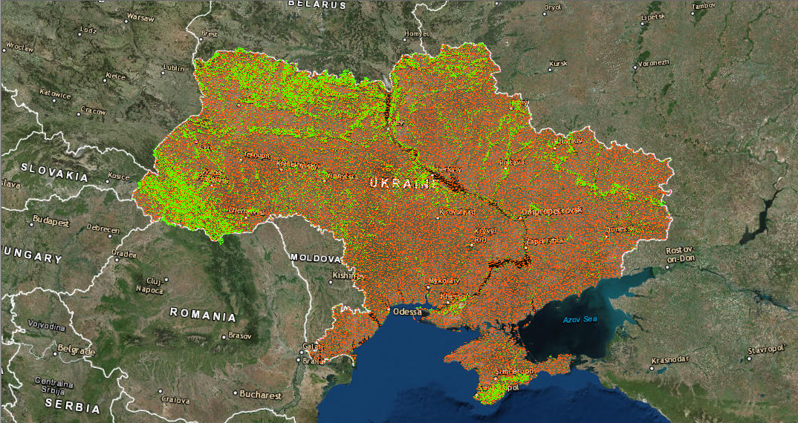
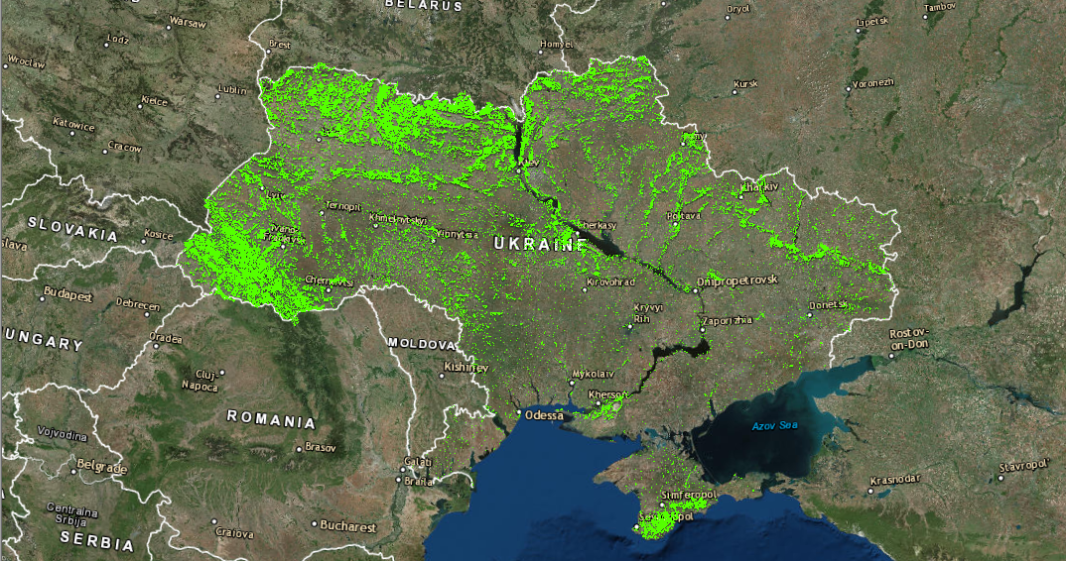
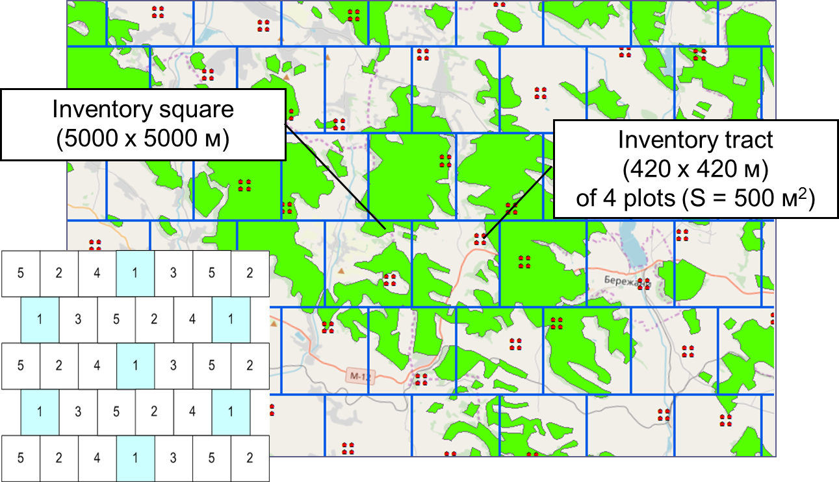
NFI grid: Scale 1:10000000
Total number of inventory plots - 96,6 thousand.

Slide 5
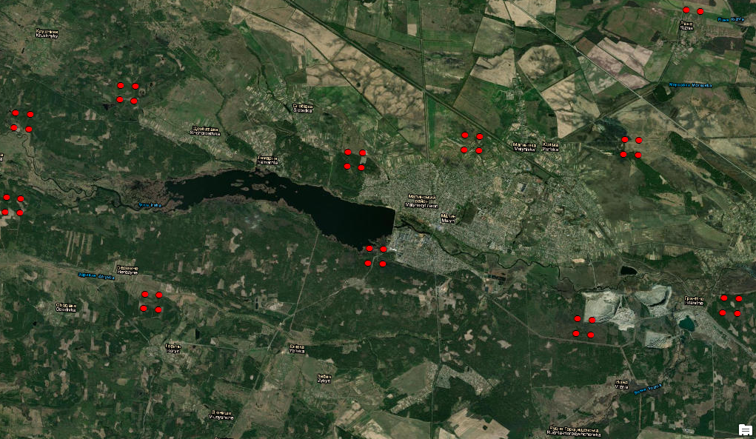
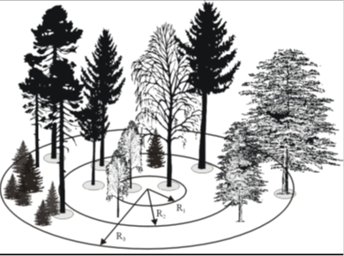
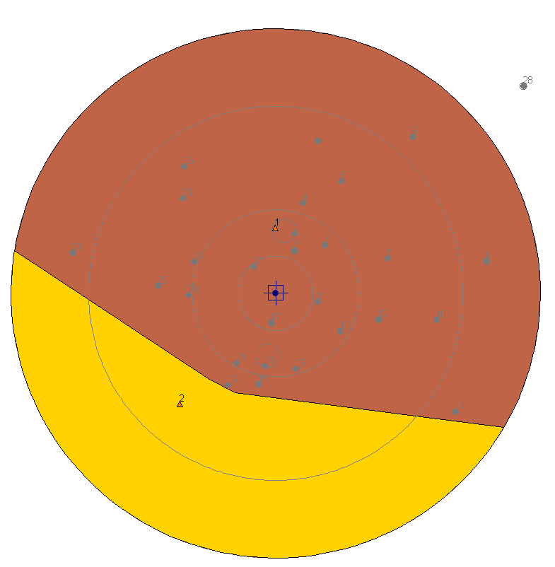
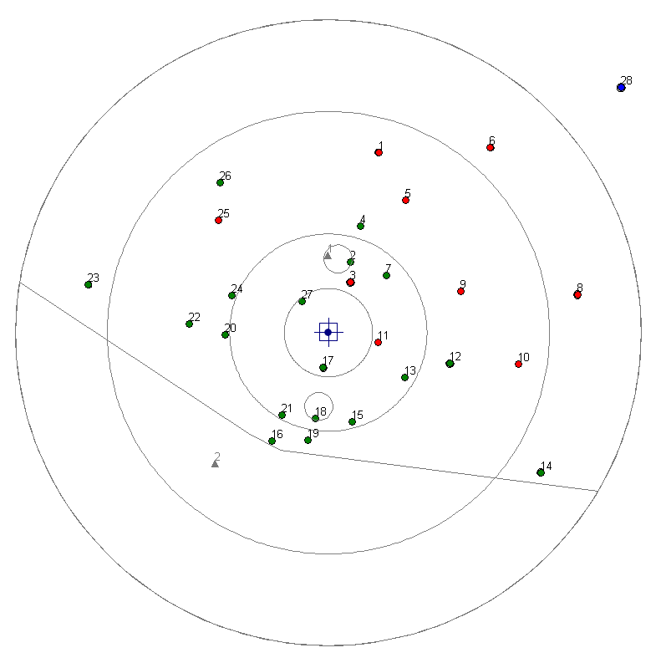
NFI grid: Scale 1:100000
About 20 thousand forest inventory plots

Slide 6
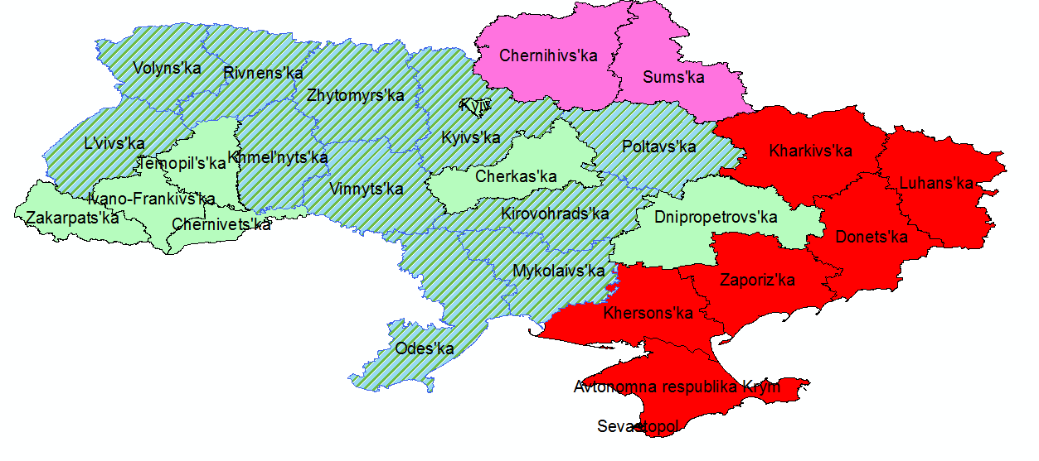
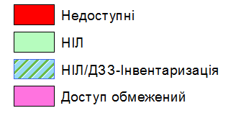
NFI conducting in 2023
Not available
NFI
NFI/ RS-Inventory
Restricted access
NFI: ≈ 2300 forest inventory plots
+ ≈ 660 data collection plots: RS-Inventory

Slide 7
Current framework and challenges
It is impossible to complete the first cycle of the National Forest Inventory in the coming years:
  Reduced state funding for NFI
  Limited access to forests for field data collection
How to achieve forest inventory results
  for the whole Ukraine
    in a shorter timeframe?

Slide 8
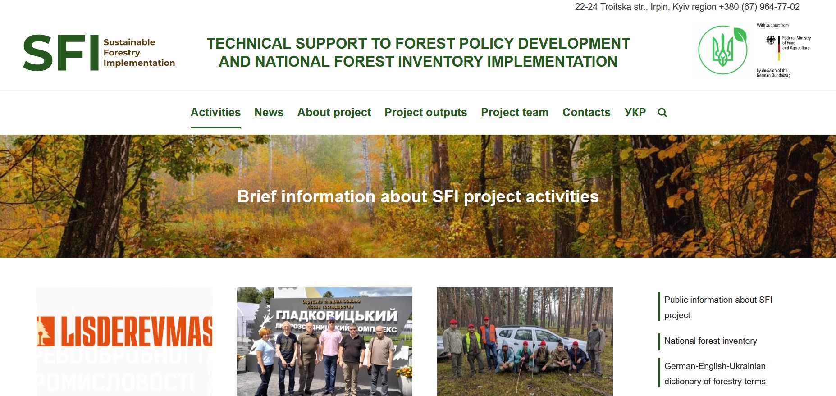
German-Ukrainian SFI project
German-Ukrainian project "Technical support to forest policy development and national forest inventory implementation"(2021-2024)
  Project "Special support to the national forest inventory“ (2022-2023)
    Conducting forest inventory using remote sensing
    (RS-Іnventory)
(https://www.sfi-ukraine.org.ua/)

Slide 9
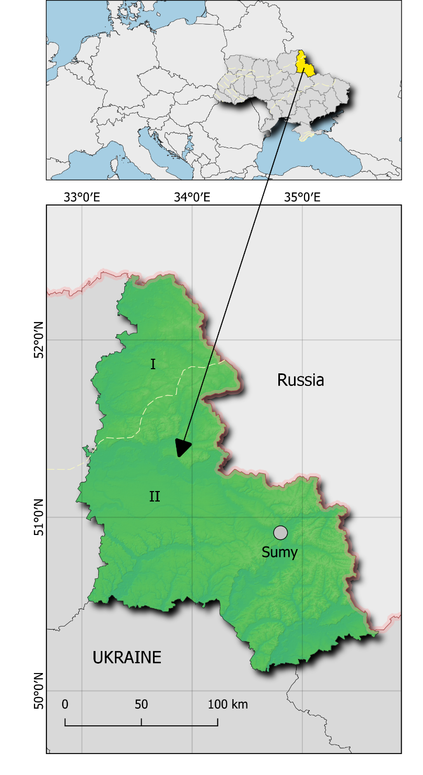
RS-Inventory approach:
on case study of Sumy region
Strategy for combined use of multi-source input data in RS-Inventory (i.e., NFI plots, forest management data, visual interpretation) developed
Selection of remote sensing data and formation of satellite time series (data source, spatial resolution, other technical issues) were performed
A technological process of data processing for forest cover mapping was developed
Methods for mapping species distribution and forecasting taxation indicators of forest plantations (stand growing volume, diameter, height, etc.) are determined

Slide 10
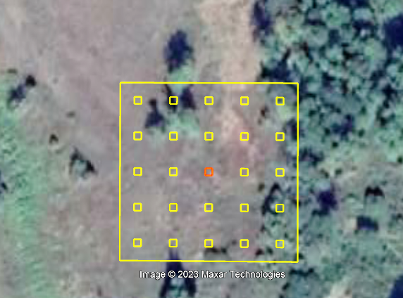
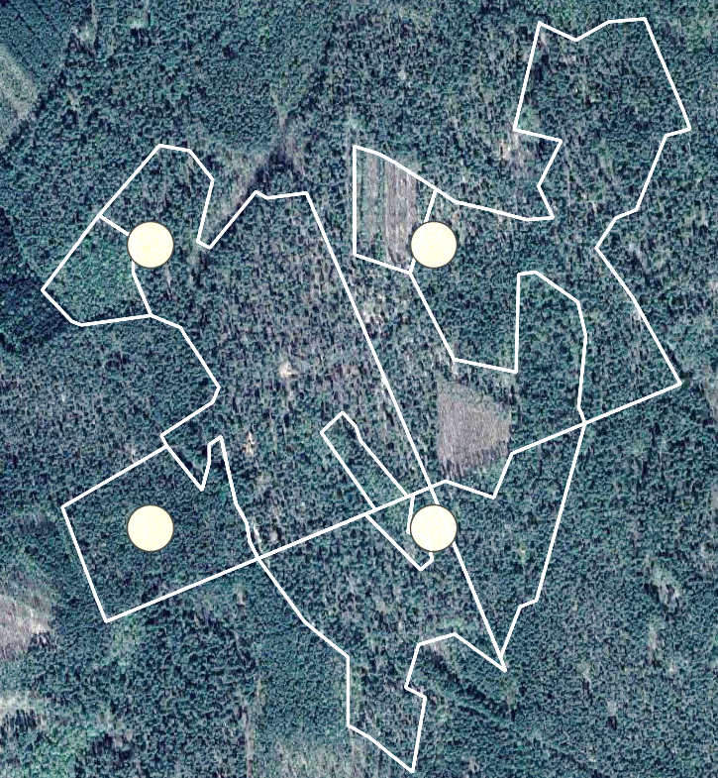
Reference data types
NFI Data plots (mapping of taxation indicators)
Attributes of NFI plots obtained in 2021-2023
Visually interpreted high spatial resolution imagery (forest mask creation)
Classification of forest cover based on the location of NFI plots
Forest management planning data (supplement to NFI data)
FMP polygons that cross NFI plots
Forest stand indicators updated during baseline FMP

Slide 11
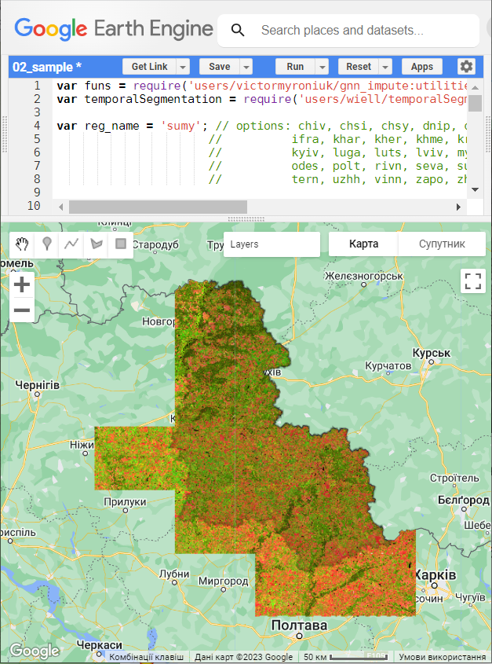
Satellite data time series
Data sources
Sentinel time series (March 2017 – October 2023)
Raster geodata sets (climate, topography) - Abatzoglou et al. (2018)
Spatial resolution (pixel size)
Sentinel data with a spatial resolution of 20 m
Image processing platform
Google Earth Engine cloud processing platform

Slide 12
Data processing
Image mosaicking
CCDC temporal segmentation algorithm that incorporates seasonal variations in spectral data to extract stable time series (Zhu&Woodcock, 2014)
FNF mapping
Random Forest machine learning algorithm (Breiman, 2001)
Forest attributes mapping
Gradient Nearest Neighbor (GNN) predicting technique (Ohmann&Gregory, 2002)
Accuracy assessment
Leave-one-out cross validation for mapping forest cover
Three first independent neighbors for GNN imputation model

Slide 13
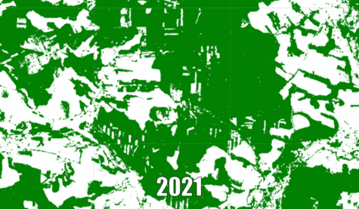
Forest cover time-series
Spatially explicit characterization of forest cover change
Wall-to-wall forest maps at fine spatial scale
Estimates of forested area for small areas (i.e., administrative districts)
Consistent in time estimates of forested area
Support to NFI field data collection
Information on forest cover change within unavailable for field data collection areas

Slide 14
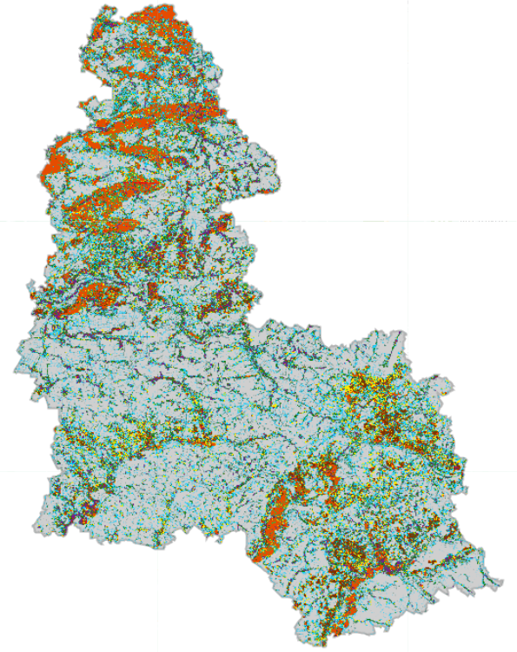
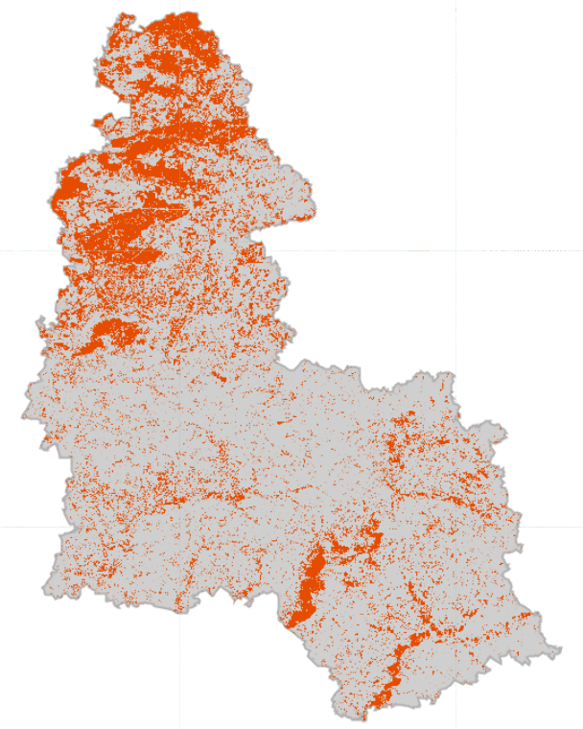
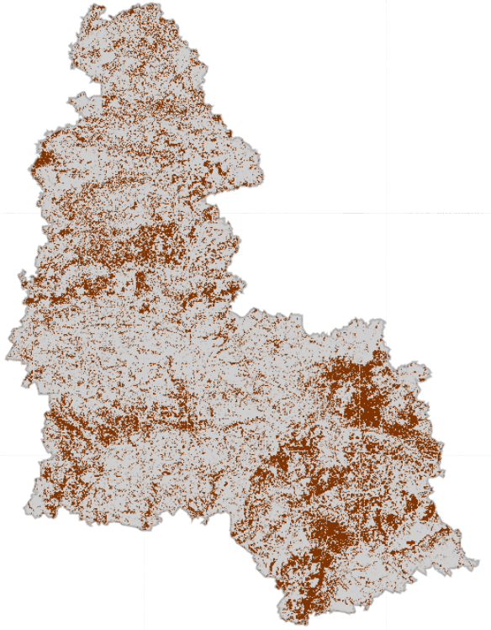
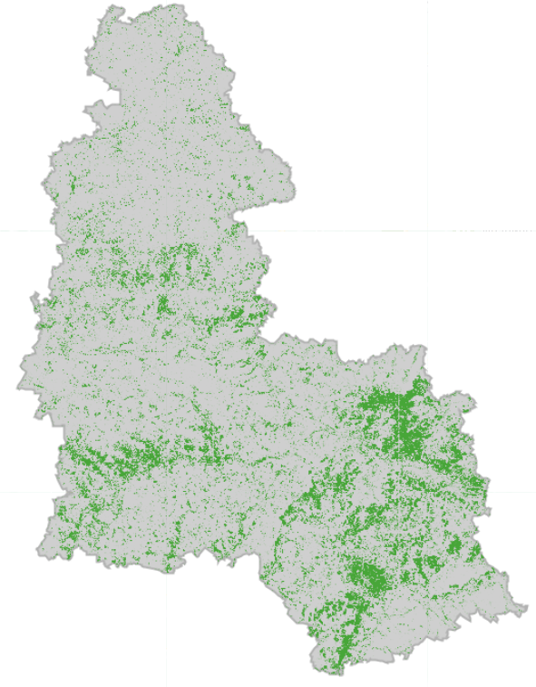
Tree species distribution
Species presence/absence maps
Species distribution mapping based on their abundance (basal area threshold)
Dominant species map (right panel)
 | Oak
 | Pine
 | Maple
 | Linden
 | Birch
 | Ash
 | Poplar
 | Alder
 | Willow
 | Others
Pine
Oak
Ash

Slide 15
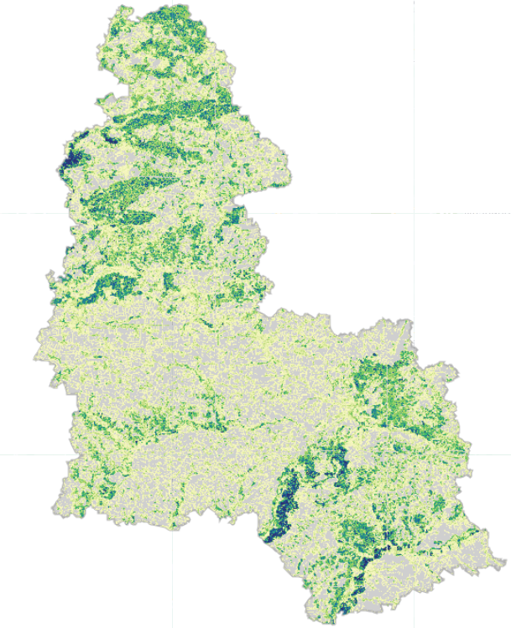
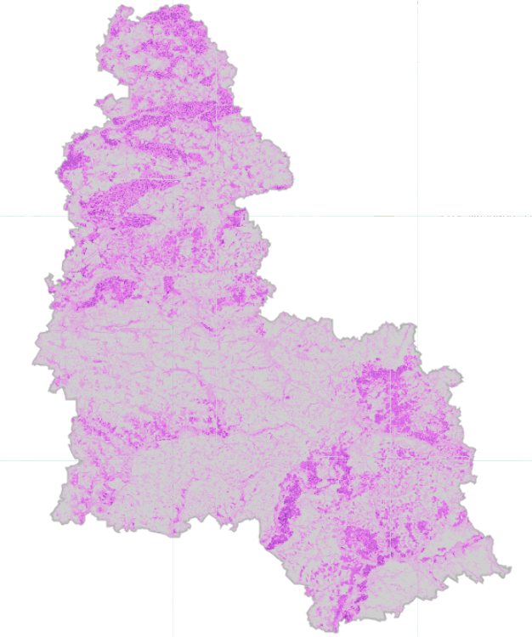
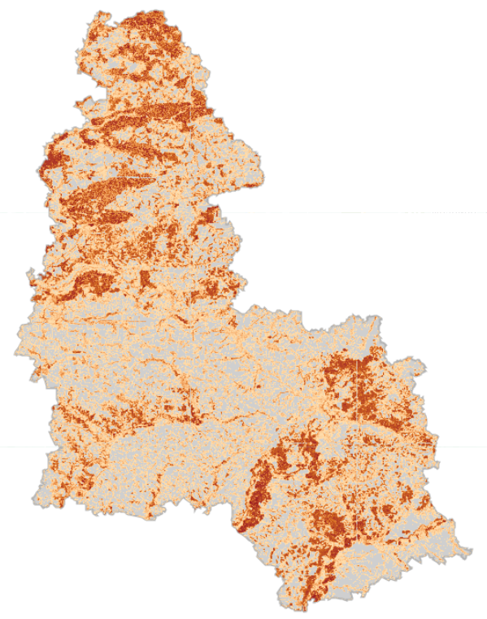
RS-Inventory:
Forest attribute mapping
Growing stock volume
(cub. m per ha)
Mean stand height
(m)
Mean stand diameter
(cm)
600
30
60
0
0
0

Slide 16
Inventory results in 2023
NFI
(administrative regions)
RS-Іnventory
(Ukraine, administrative regions/districts)
Reporting tables for plantations and trees
Maps
  Forest cover map (forest mask) and tree species distribution maps
  Maps and tables of key indicators distribution
About 2200 forest inventory plots
Additional 660 data collection plots

Slide 17
Planned activities of the SFI project in 2024
  Elaboration of the Concept for further development of the methodology and organisation of NFI using remote sensing approaches
  Development of the Concept for analysing potential timber supply scenarios in Ukraine

