Slide 1
Ireland’s National Forest Inventory
John Redmond
29th November 2023

Slide 2
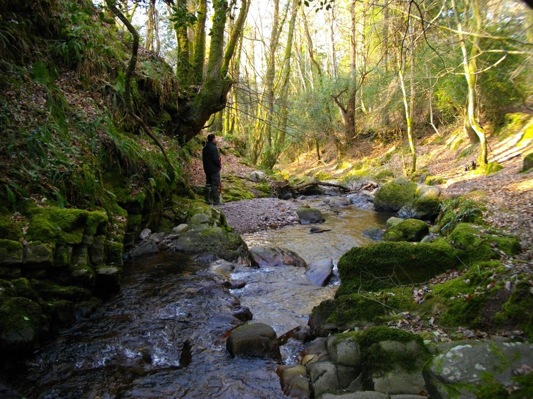

Presentation Overview
Forestry in Ireland
NFI Design
Software & Hardware
Field Data Collection
Data Analysis
Results
Summary
An Roinn Talmhaíochta, Bia agus Mara │ Department of Agriculture, Food and the Marine

Slide 3
Brief overview of Forestry in Ireland
An Roinn Talmhaíochta, Bia agus Mara │ Department of Agriculture, Food and the Marine

Slide 4
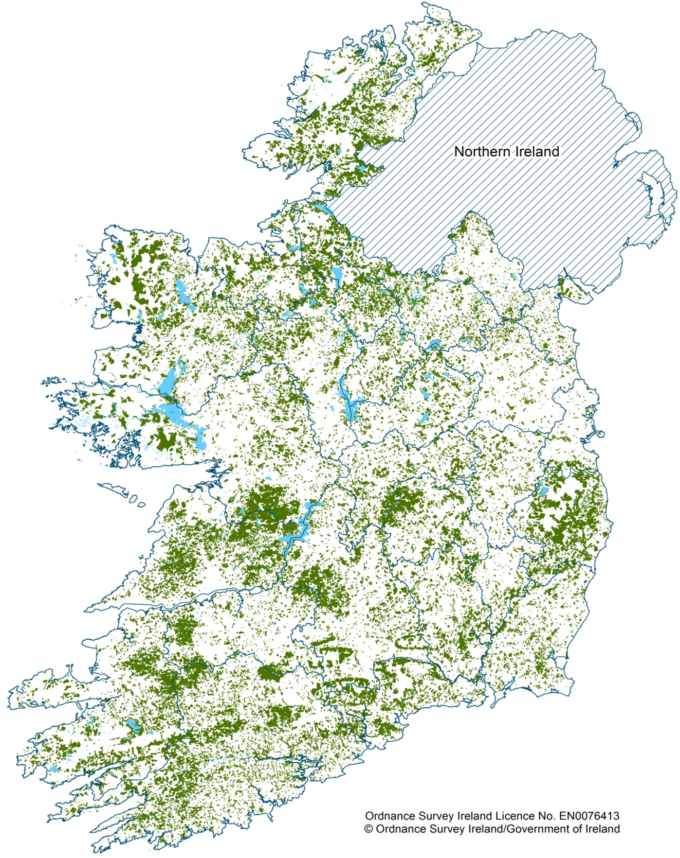
Forestry In Ireland
11.6 % forest cover (808,848 ha)
51% Private & 49% Public
Nearly 24,000 owners (85% farmers)
9,400 jobs (mainly rural)
Forestry sector worth over €2 billion
An Roinn Talmhaíochta, Bia agus Mara │ Department of Agriculture, Food and the Marine

Slide 5
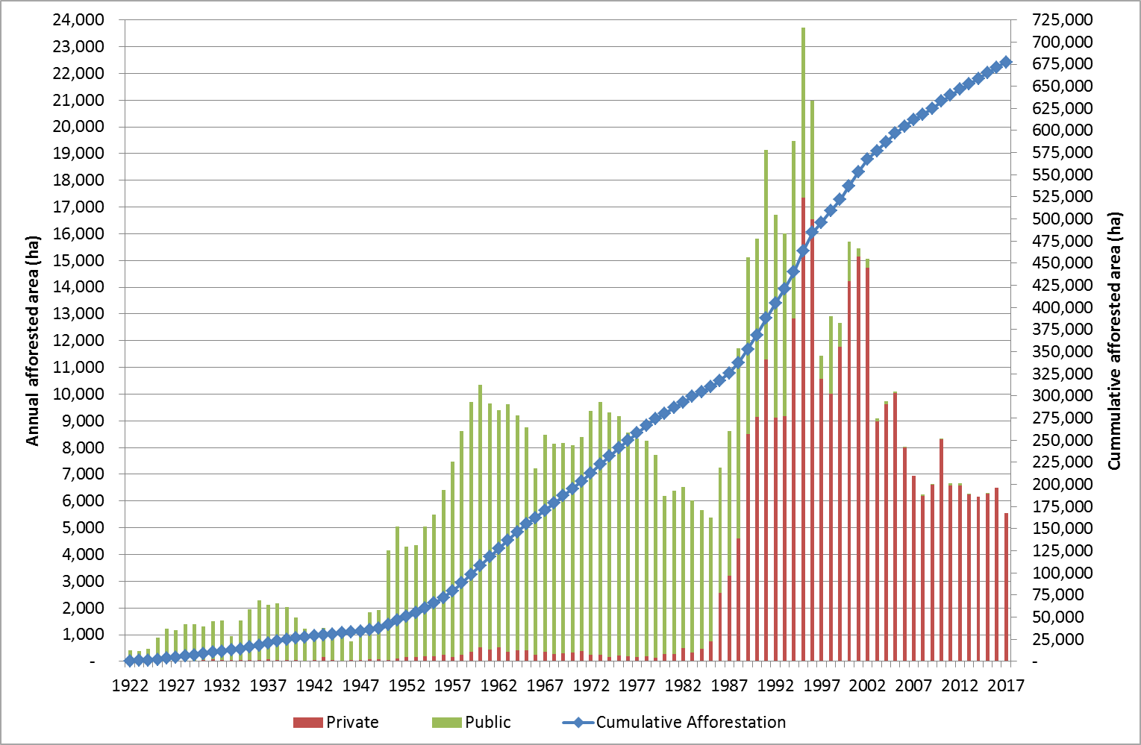
Development of Forest Cover
An Roinn Talmhaíochta, Bia agus Mara │ Department of Agriculture, Food and the Marine

Slide 6
Ireland’s NFI Design
An Roinn Talmhaíochta, Bia agus Mara │ Department of Agriculture, Food and the Marine

Slide 7
What is the NFI?
The NFI is a survey to monitor all forests within a state.
Objective: To assess the current extent, state, composition of the forests in a timely, accurate & reproducible manner over time.
Information Collected: The NFI provides a wide range of information describing the national forest estate, specifically in relation to:
- Forest area - Tree species - Timber Volume - Harvesting - Increment - Carbon stocks - Forest biodiversity - Forest health
What is the information used for: National & international reporting processes. Inform the development of forest policy.
An Roinn Talmhaíochta, Bia agus Mara │ Department of Agriculture, Food and the Marine

Slide 8
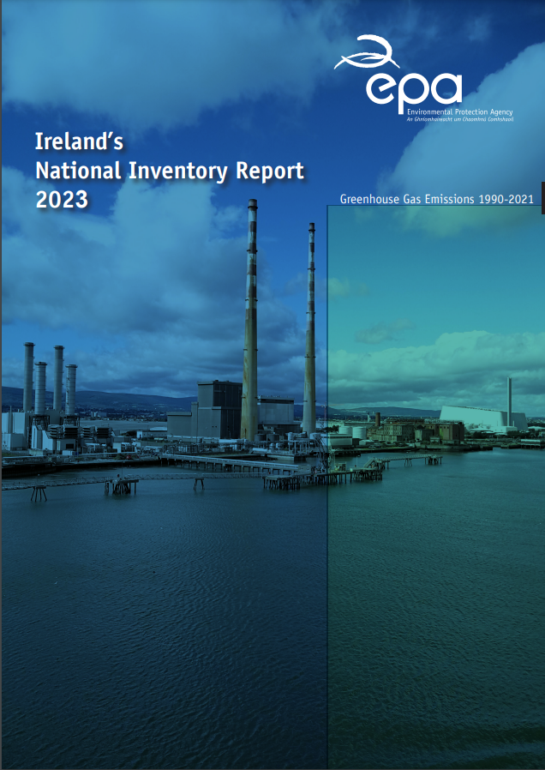
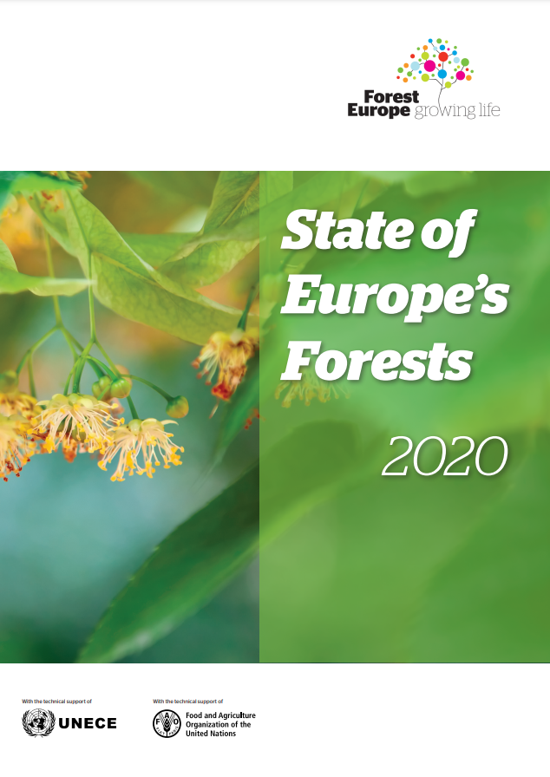

International Reporting Obligations

Slide 9
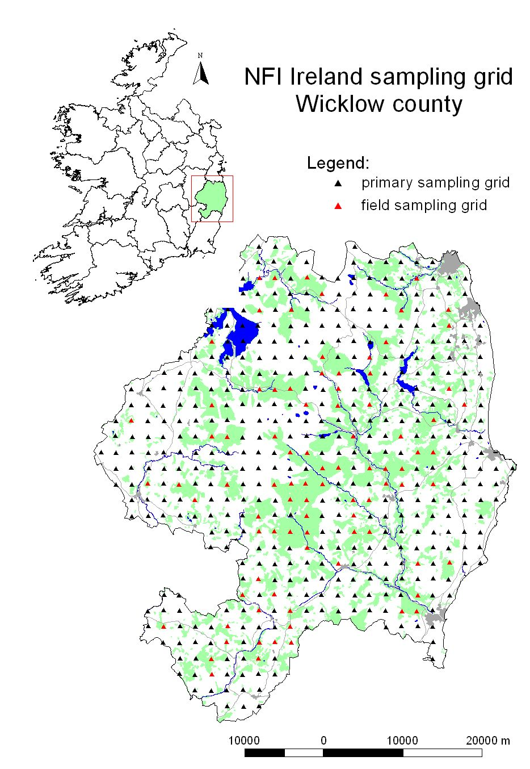
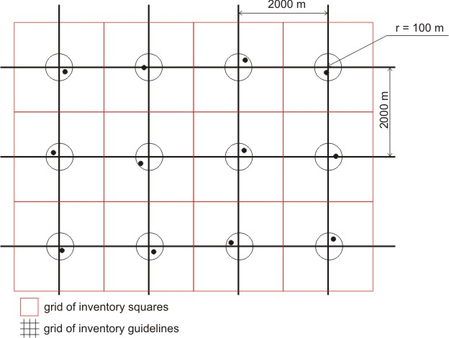
NFI Sampling Frame
statistical sample survey, 2 km grid
17,423 points, each representing 400 ha.
Randomised displacement
An Roinn Talmhaíochta, Bia agus Mara │ Department of Agriculture, Food and the Marine

Slide 10
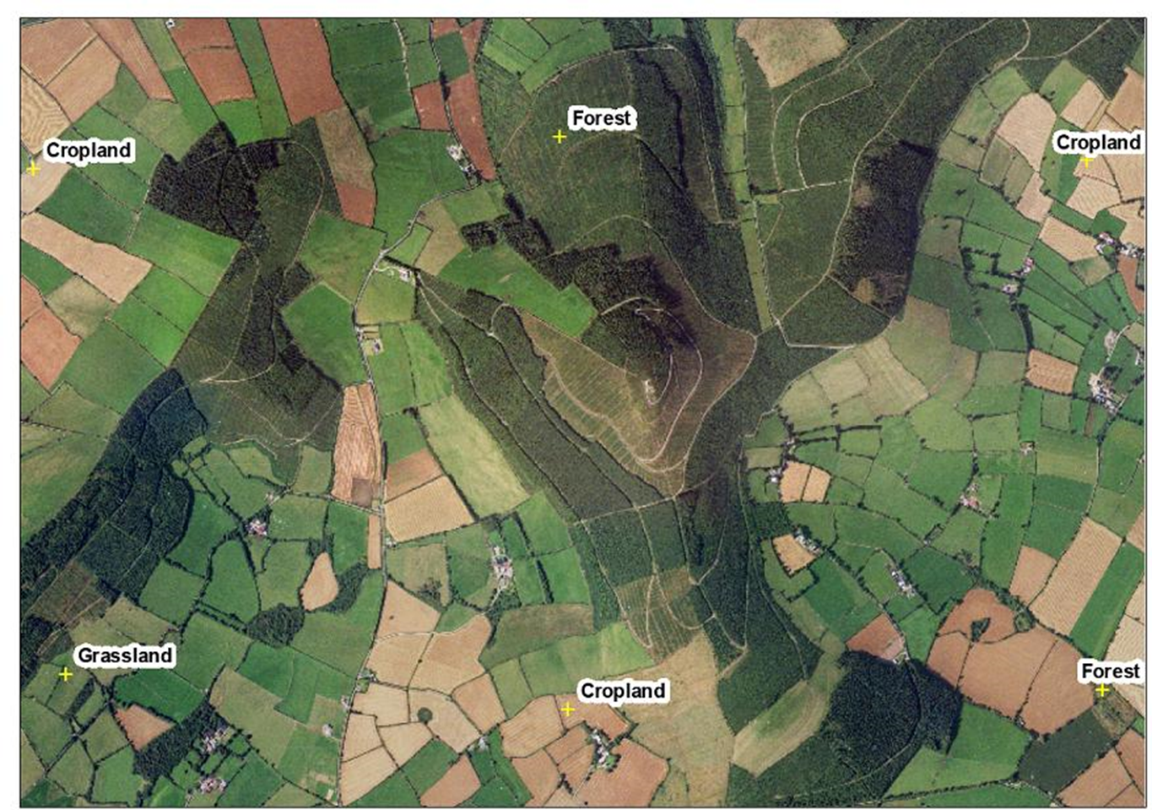
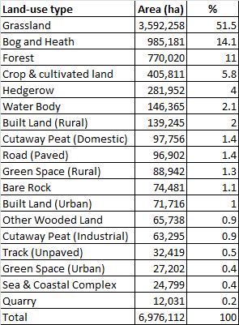
Land-use type assessment
An Roinn Talmhaíochta, Bia agus Mara │ Department of Agriculture, Food and the Marine

Slide 11




International Co-operation
The European National Forest Inventory Network (ENFIN) serves as a European network to promote NFIs, harmonise forest information and support decision makers in a broad range of forest related policies. The ENFIN group was established in 2003 with a core group of 17 members.
An Roinn Talmhaíochta, Bia agus Mara │ Department of Agriculture, Food and the Marine

Slide 12
Software & Hardware
An Roinn Talmhaíochta, Bia agus Mara │ Department of Agriculture, Food and the Marine

Slide 13
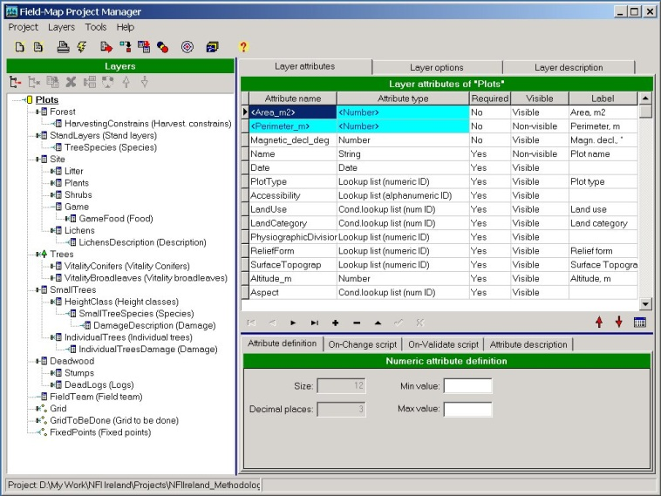
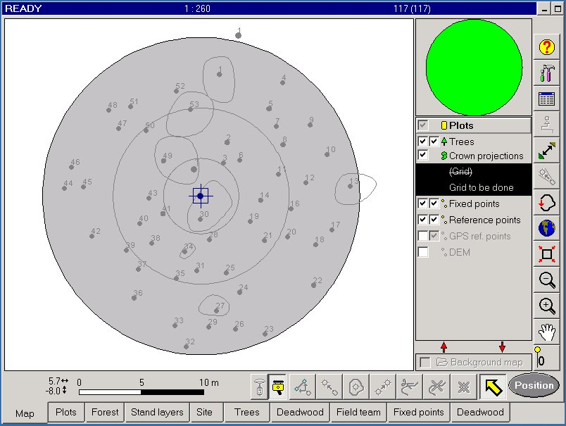
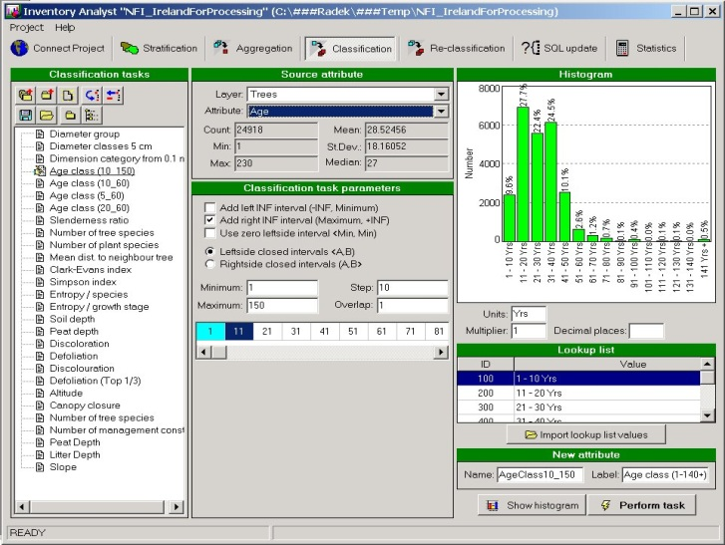
NFI Software: Field-Map
An Roinn Talmhaíochta, Bia agus Mara │ Department of Agriculture, Food and the Marine

Slide 14
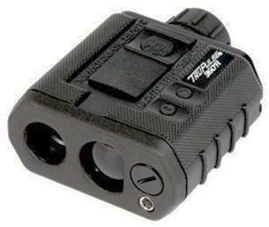

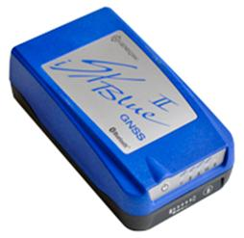
NFI Hardware
Laser Tech TruPulse 360R
Getac UX10 Rugged Tablet
iSXBlue II GNSS
An Roinn Talmhaíochta, Bia agus Mara │ Department of Agriculture, Food and the Marine

Slide 15
Role of Ifer in Ireland’s Forest Inventory
Development of NFI design and methodology
Provision of hardware and software
Data verification scripts for use in field data checking
Training and validation
Data Analysis and Modelling
An Roinn Talmhaíochta, Bia agus Mara │ Department of Agriculture, Food and the Marine

Slide 16
NFI Field Data Collection
An Roinn Talmhaíochta, Bia agus Mara │ Department of Agriculture, Food and the Marine

Slide 17
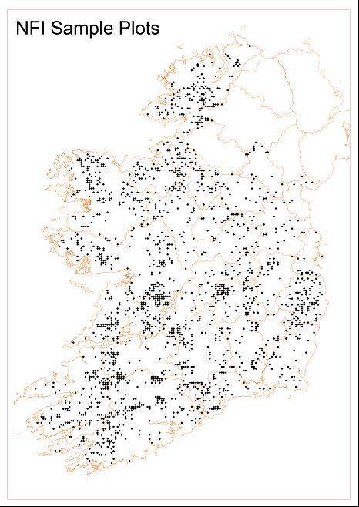
Field Data Collection Process
Operates on 5 year cycle.
Six field staff are recruited for field-work, who work in two person teams.
Permanent sample plots
  NFI 1 (2004 – 2006) - 1,742 forest plots
  NFI 2 (2009 – 2012) - 1,827 forest plots
  NFI 3 (2015 – 2017) – 1,923 forest plots
  NFI 4 (2020 – 2022) – 2,020 forest plots
An Roinn Talmhaíochta, Bia agus Mara │ Department of Agriculture, Food and the Marine

Slide 18
Training Staff for Field Data Collection
Four weeks of intensive training.
Two weeks of training with the software and hardware (Ifer)
Followed by specialist modules on aspects such as soil, vegetation identification and forest health.
Close supervision to support staff in the early days of actual plot measurement.
An Roinn Talmhaíochta, Bia agus Mara │ Department of Agriculture, Food and the Marine

Slide 19
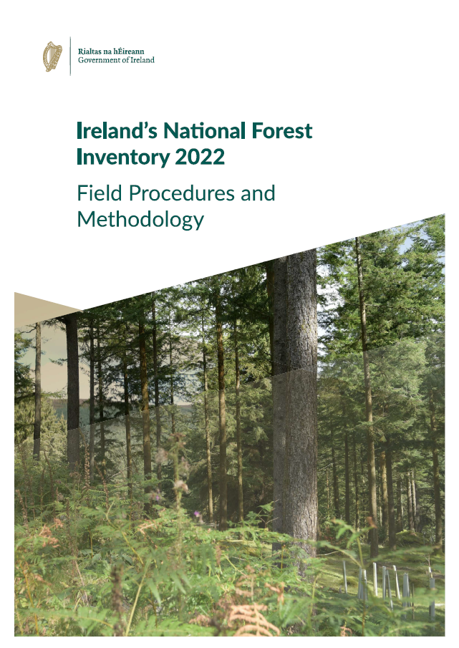
Information Collected
Tree level – Diameter, height, damage, defoliation ...
Site – Soil, elevation, cultivation ...
Deadwood – stumps, logs & standing trees .….
Vegetation – Plant coverage, species …
Forest Health – Abiotic and biotic damage …
An Roinn Talmhaíochta, Bia agus Mara │ Department of Agriculture, Food and the Marine
Notes:
Over 50k trees assessed. Diameter was recorded on 43k trees. Height was measured on 20k trees

Slide 20
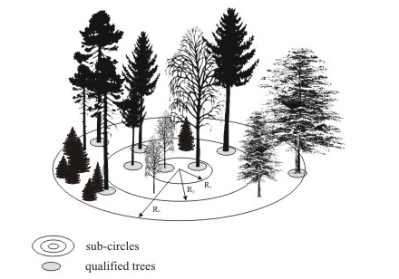
NFI Plot Design
Concentric circles
No plot segmentation
Permanent plots
High precision to monitor change
An Roinn Talmhaíochta, Bia agus Mara │ Department of Agriculture, Food and the Marine

Slide 21
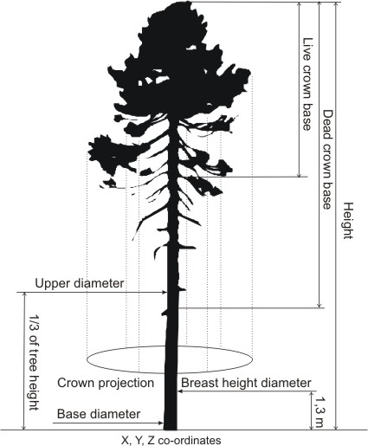
Tree measurement
Tree measurement:
qualified tree … all trees which fulfil DBH threshold of particular sub-circle to which tree belongs
crown sample tree … total height, crown base & dead crown base (excluded are dead, broken or forked trees) is measured for 7 trees per species distributed across DBH range.
stem sample tree … upper diameter and base diameter are measured for 5 height sample trees of each species
vitality sample tree … vitality is measured for all Crown sample tree, which belongs to selected species (spruce, pine, beech and oak).
An Roinn Talmhaíochta, Bia agus Mara │ Department of Agriculture, Food and the Marine

Slide 22
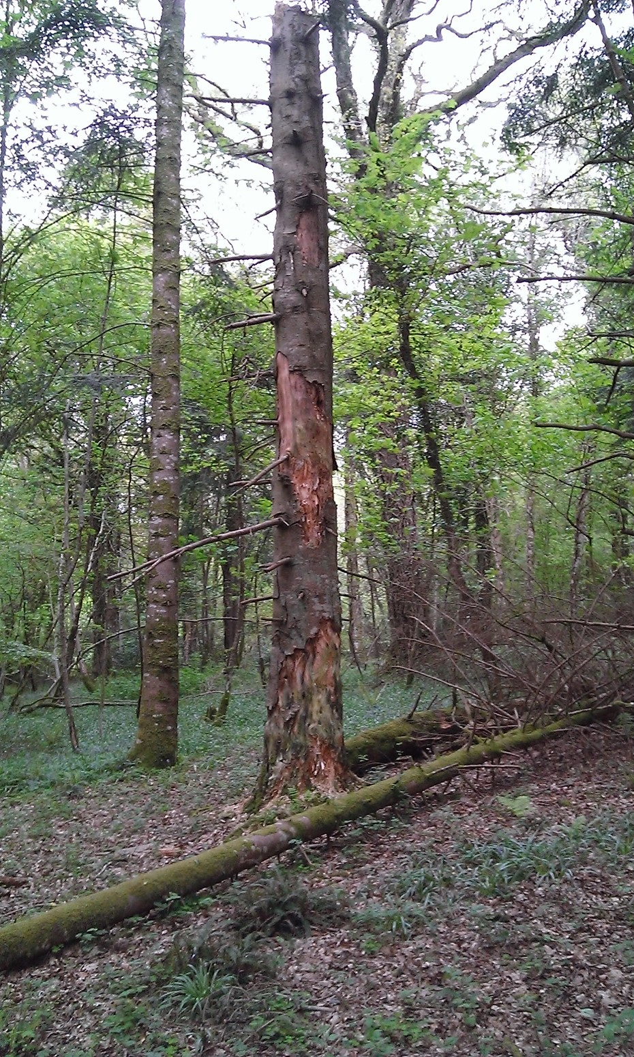
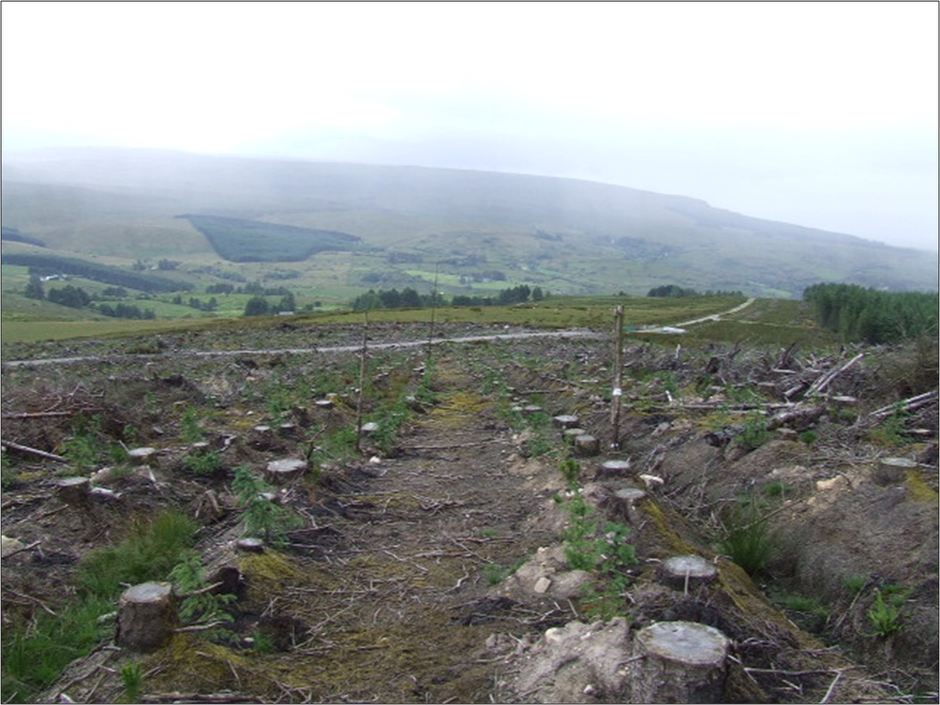
Deadwood measurement
Deadwood components:
standing dead trees … measured and described if qualified for position, DBH, species, stand layer, age, stem rot, fork and other damage
lying dead logs … all dead lying timber to the top of 7 cm measured for length and mid diameter plus description of decay stage
stumps … all stumps with top
diameter bigger than 20 cm and
height less than 130 cm are
measured for top diameter and
height plus description of decay
stage

Slide 23
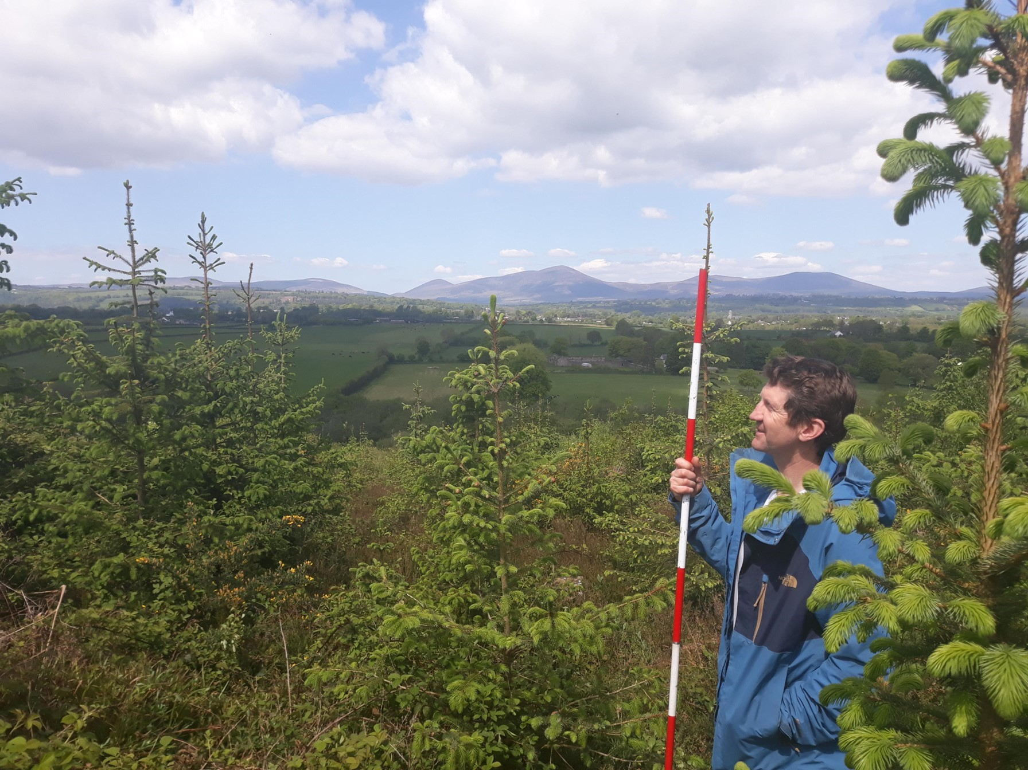
Small tree measurement
planted trees and natural regeneration is assessed on 4 m sub-circle starting from 20 cm of height up to 7 cm of DBH
Details Recorded:
        origin
        species,
        height,
        diameter,
        age,
        damage type and
        age of damage
An Roinn Talmhaíochta, Bia agus Mara │ Department of Agriculture, Food and the Marine

Slide 24
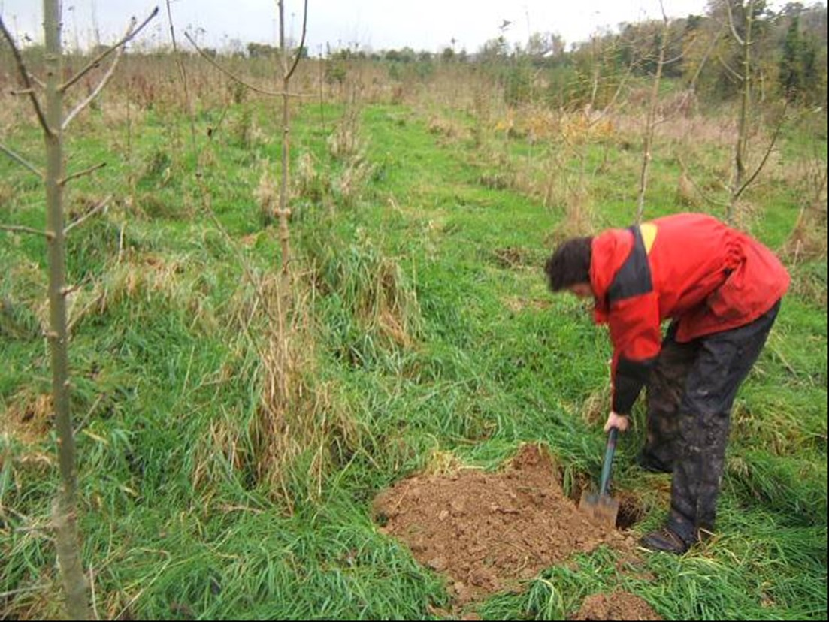
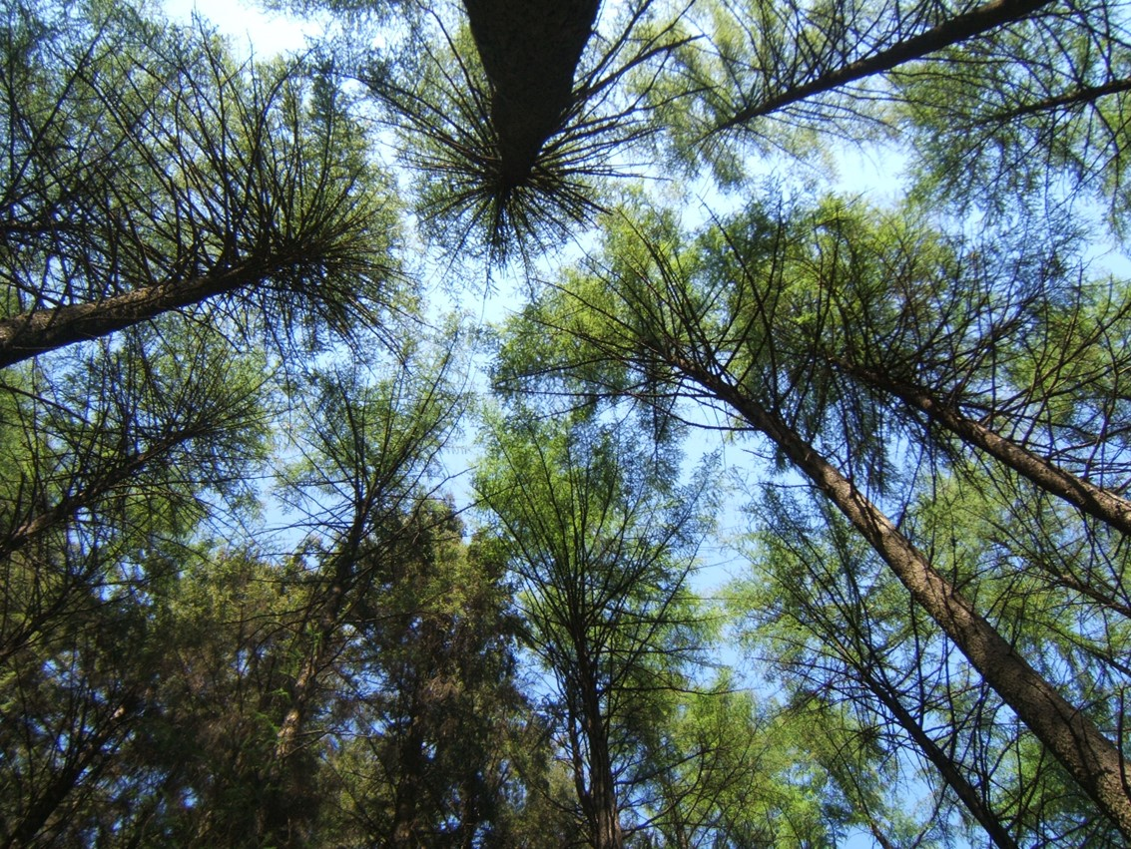
Site & Forest measurement
Forest type
Management intervention
Group Soil Classification (Depth, texture, ..)
Litter layer (Depth, Composition, …)
Vegetation (Type, coverage, …)
Ground Conditions (Drainage, slope, …)
Availability for wood supply
An Roinn Talmhaíochta, Bia agus Mara │ Department of Agriculture, Food and the Marine

Slide 25
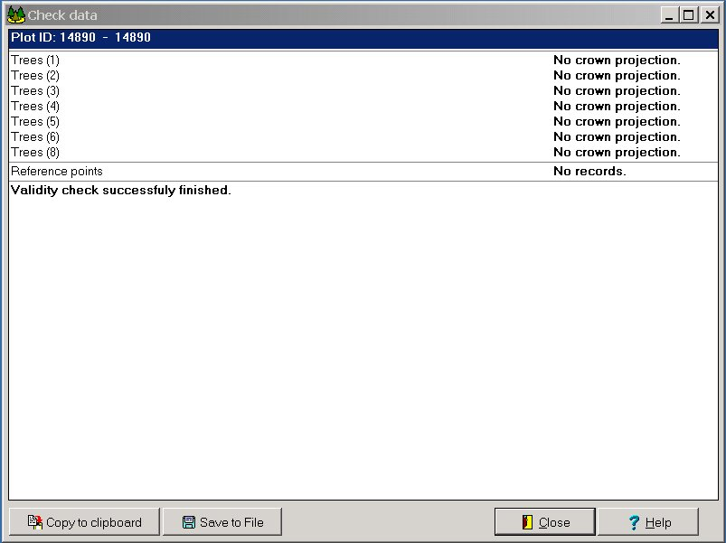
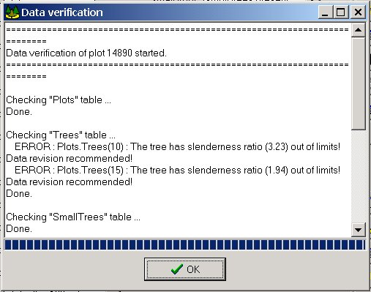
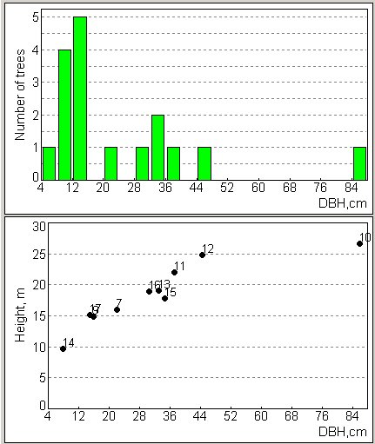
Data checking in the field
Data check:
Prior leaving the inventory plot, the operator performs a comprehensive data checks, including:
missing data check … Field-Map searches for all missing information which are required and list missing items in “Check data” output file
data verification script … Field-Map checks defined logical relations and list errors or “possible errors” in “Data verification” output file
visual check … visual check of DBH distribution and Height x DBH graphs
Operator inputs missing or corrects wrong information identified during data check procedure
An Roinn Talmhaíochta, Bia agus Mara │ Department of Agriculture, Food and the Marine

Slide 26
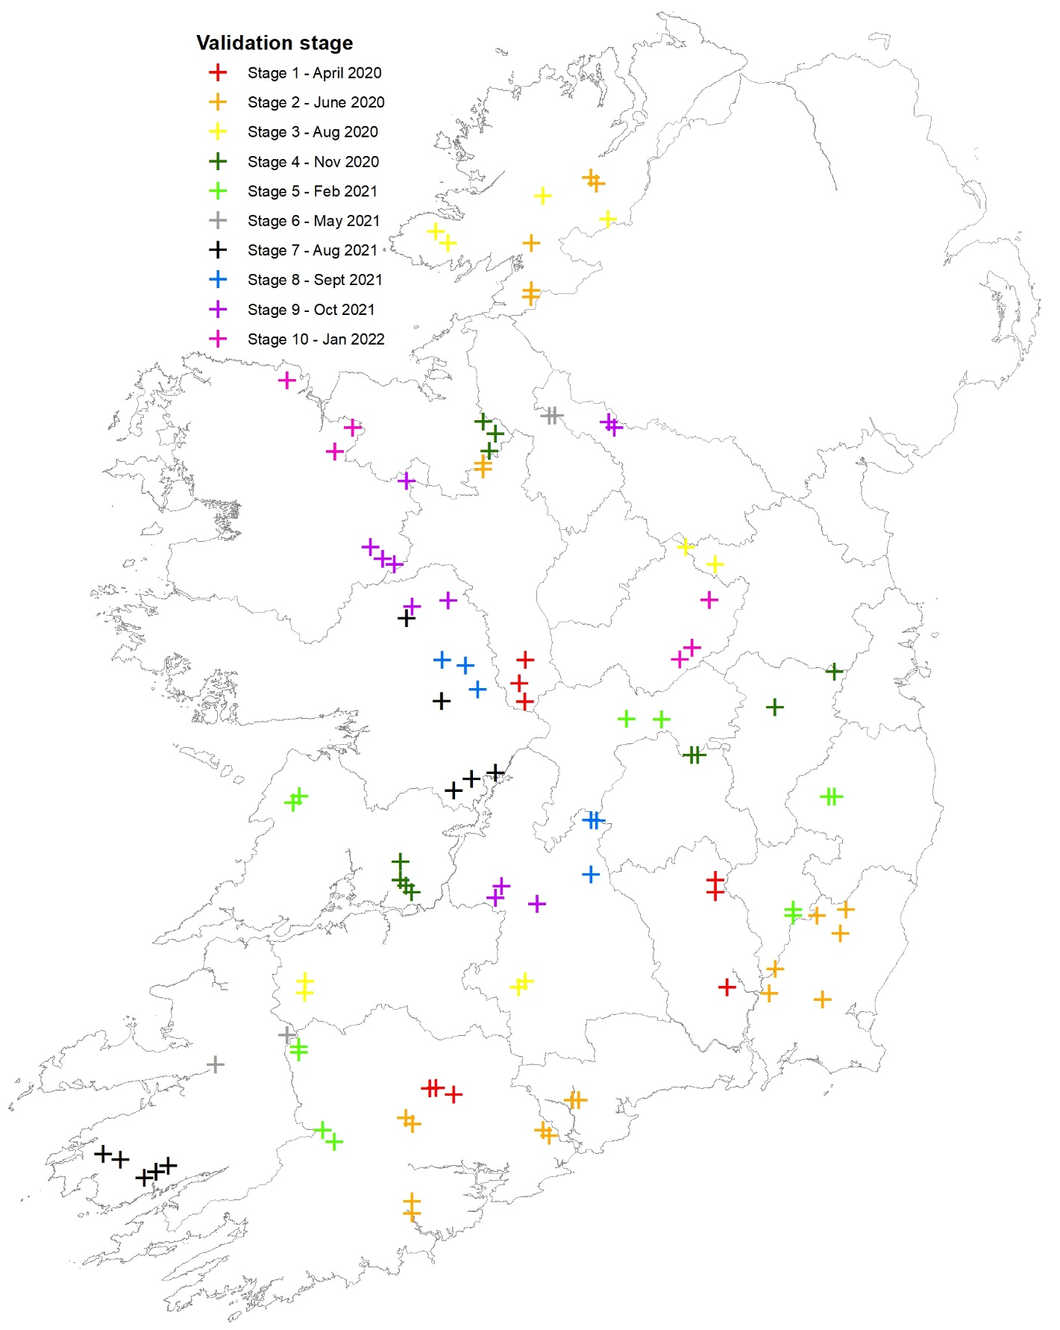
Data validation
5% of plots randomly selected and completely remeasured
Results are published
Field team update
Project management changes
An Roinn Talmhaíochta, Bia agus Mara │ Department of Agriculture, Food and the Marine

Slide 27
NFI Data Processing
An Roinn Talmhaíochta, Bia agus Mara │ Department of Agriculture, Food and the Marine

Slide 28
Data Pre-processing Methods
Data cleaning
Modelling (e.g. tree volume)
Classification (e.g. diameter classes)
Aggregation (e.g. number of species per plot)
Re-classification (e.g. species groups)
Post-stratification (e.g. by counties)
An Roinn Talmhaíochta, Bia agus Mara │ Department of Agriculture, Food and the Marine

Slide 29
Calculation of Secondary Variables

Slide 30
Modelling Increment
Missing information:
        Previous cycle Dbh & Ht unknown e.g. ingrowth trees.
        Current cycle Dbh & Ht unknown e.g. harvested trees.
        Dbh data is present for both cycles
Field-map module allows K nearest neighbour (kNN) non-parametric modelling to estimate the missing Dbh values.
The model compares each tree which has no Dbh with all other trees that have a Dbh value, and uses predefined attribute information to find a tree that will be most similar in terms of the attribute data supplied.

Slide 31
Statistical data processing
Evaluated variable
    Totals - (total area, total volume, etc.) Mean values - (mean volume, mean height, etc.)
    Confidence interval (α=0.05)
Stratifier (post-stratification decreasing variance)
Classifier (species, diameter classes, soil groups, etc.)
An Roinn Talmhaíochta, Bia agus Mara │ Department of Agriculture, Food and the Marine

Slide 32
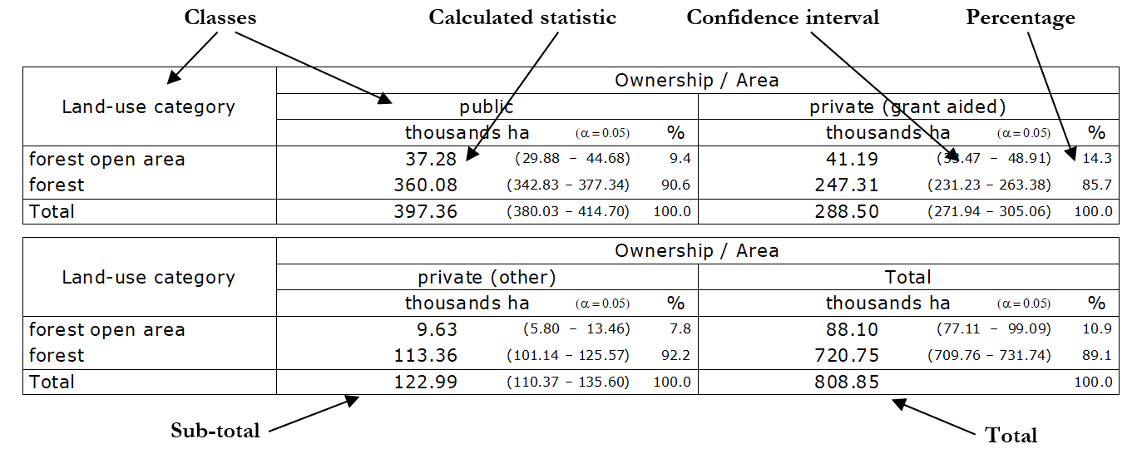
Standardised Outputs

Slide 33
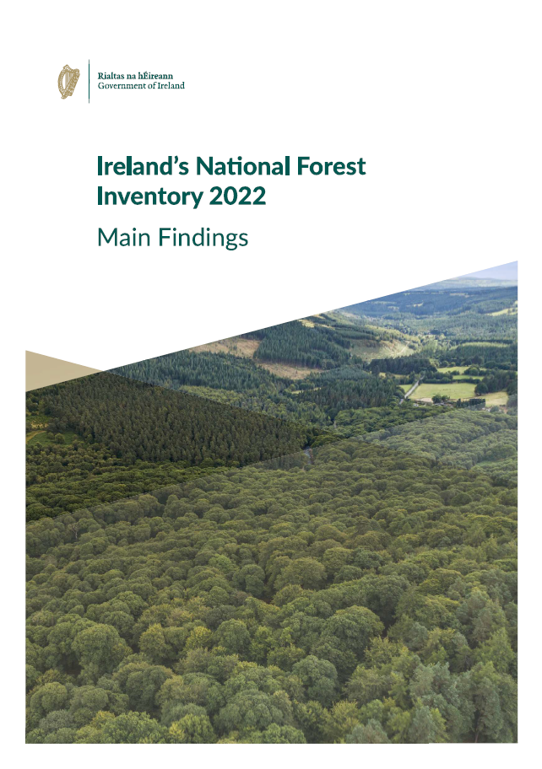
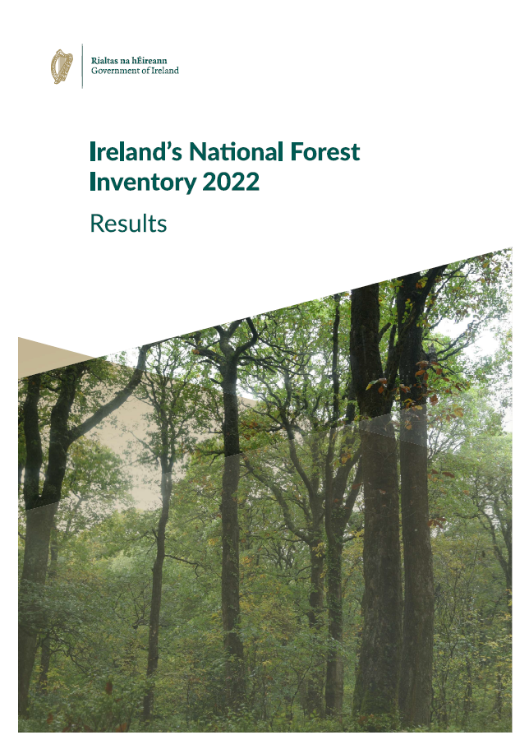
Results from Ireland’s NFI
An Roinn Talmhaíochta, Bia agus Mara │ Department of Agriculture, Food and the Marine

Slide 34
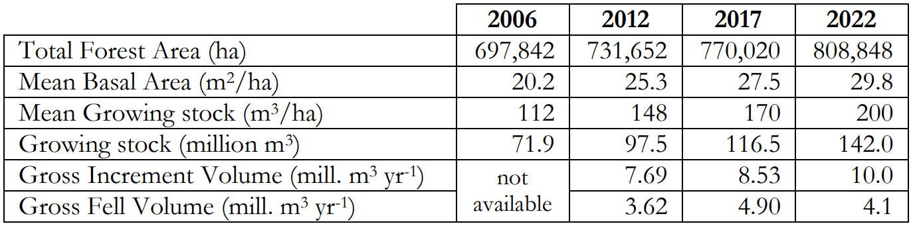
Overview of NFI Results 2006-2022
An Roinn Talmhaíochta, Bia agus Mara │ Department of Agriculture, Food and the Marine

Slide 35
Key Findings of Ireland’s NFI 2022
The national forest estate is still expanding and has now reached 11.6% of the total land area, The total forest area has increased from 697,842 hectares (ha) in 2006 to 808,848 ha in 2022.
For the first time over half (411,484 ha or 50.9%) of forests are in private ownership and 397,364 ha (49.1%) in public ownership. The share of private forests has increased by over 7.9% since 2006.
Leitrim is the county with the highest percentage of forest cover (20.1%), while Cork has the largest forest area (92,471 ha).
Conifer species are the dominant species present, representing 69.4% of the stocked forest area while broadleaved species accounted for 30.6% of the area. The share of broadleaf species in the national forest estate has increased by 5.9% between 2006 and 2022.
The age-profile of the forest estate is increasing with 39.6% of the stocked forest estate being less than 20 years of age and 30.4% between the ages of 21 and 30 years.
An Roinn Talmhaíochta, Bia agus Mara │ Department of Agriculture, Food and the Marine

Slide 36
Key Findings of Ireland’s NFI 2022 cont.
The total volume of forests is estimated to be over 142 million m³. Gross annual volume increment between 2017 and 2022 was 10 million m³ per year, while the mean annual standing volume felled within this period was 4.1 million m³ per year.
Since 2017, 39,640 ha of forests were thinned for the first time, which is a positive for wood mobilisation.
Forests play an important role in mitigating climate change by sequestering and storing atmospheric carbon dioxide. The results indicate that the national forest estate is an important sink for carbon, at 323.5 million tonnes of carbon.
Irish forests are a rich resource of biodiversity providing important and abundant habitats for many non-tree plant species and lichens frequent across the forest estate. Nearly one-third of Ireland’s forests have four or more tree species present. Also, large quantities of deadwood are present within the forest, with 10.2 million m³ of deadwood present.
Overall, the forest estate appears healthy with no or low severity of damage recorded.
An Roinn Talmhaíochta, Bia agus Mara │ Department of Agriculture, Food and the Marine

Slide 37
Summary
An Roinn Talmhaíochta, Bia agus Mara │ Department of Agriculture, Food and the Marine

Slide 38
In summary
Ireland’s NFI records a diverse range of information on Ireland’s forests to monitor changes overtime and is becoming more valuable over time as additional cycles are completed.
Results are accompanied with information on the sampling error.
The information facilitates a wide range of activities:
        National and international reporting.
        Valuable and accurate information for the forest sector.
        Inform the development of forest policy.
        Data source for forest research projects.
Field-Map software and expertise provided by Ifer has contributed significantly to the success of Ireland’s NFI.
An Roinn Talmhaíochta, Bia agus Mara │ Department of Agriculture, Food and the Marine

Slide 39
Thank you
& Any questions?
Email: johnj.redmond@agriculture.gov.ie
Website: Ireland’s National Forest Inventory

