Slide 1


Use of National Forest Inventories data to harmonise and improve the current knowledge on forest increment in Europe
Thomas Gschwantner
Department of Forest Inventory
SFI Meeting via Zoom
21 February 2024

Slide 2
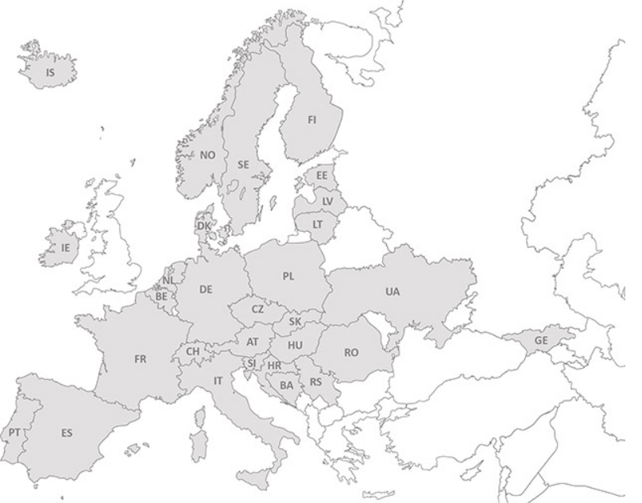

ENFIN – History and Activities
2003: ENFIN was founded with 17 members
2023: 33 different organisations from 30 countries
30 Projects
> 40 Publications
Main challenge: Harmonisation

Slide 3

ENFINs Harmonisation Work
  Forest Area with Forest Available for Wood Supply:
    SCs with JRC: https://doi.org/10.1016/j.forpol.2019.102032
  Above Ground Biomass:
    SCs with JRC: publication about mapping DOI:10.2760/311876
  Growing stock and Stem Volume:
    H2020-Diabolo: https://doi.org/10.1016/j.foreco.2021.119868
    https://doi.org/10.1007/s13595-019-0800-8
  Increment:
    SCs with JRC: …
  Sound statistical estimation at the European level

Slide 4
Objectives of ENFIN study on increment
1) Description of current definitions and methods applied by the involved NFIs for increment estimation, e.g. sampling designs, thresholds, growth components
2) Development of a harmonised definition and method for Net Annual Increment (NAI = GAI - ANL)
3) Application of the harmonised definition and method to calculate volume and AGB increments aggregated for NUTS regions, tree species, and forest types
4) Comparison of national and harmonised results and description of differences

Slide 5

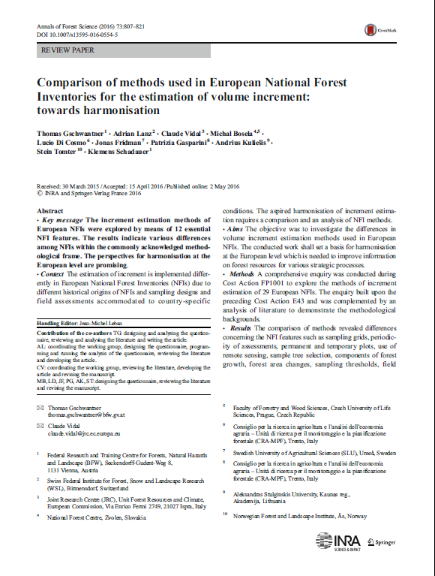
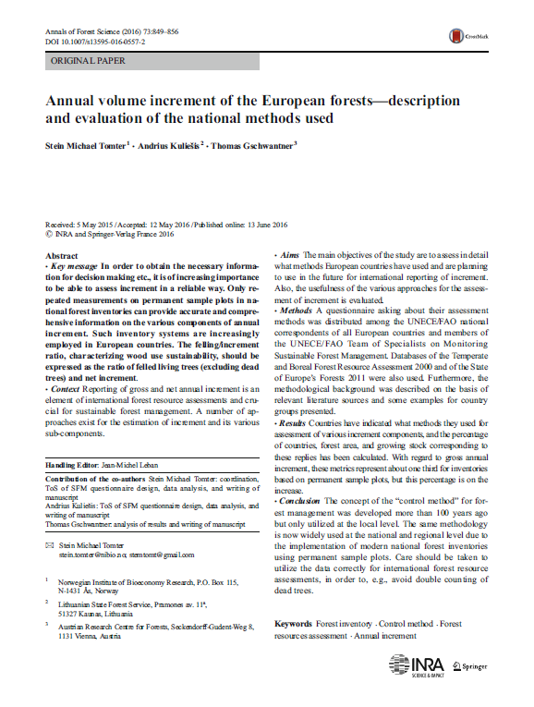
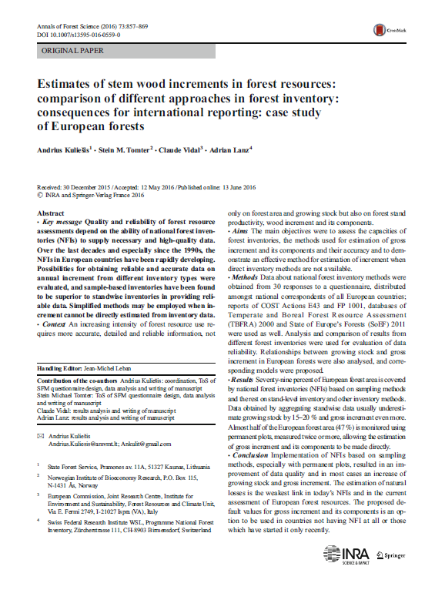
Previous works as basis
.
Stein oder Kulisies
Add pictures!

Slide 6
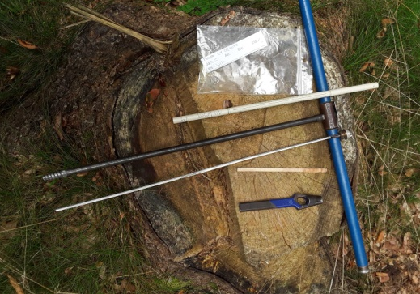
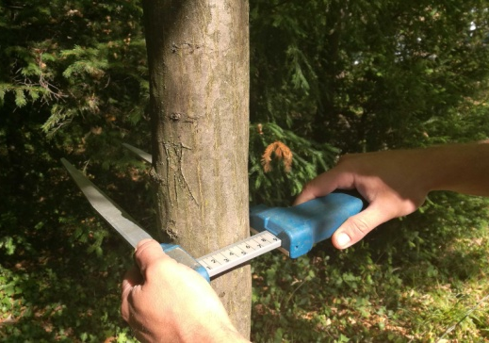
Differences between NFIs
Temporary vs. permanent plots
Increment cores vs. consecutive measurements
Growth components included
Survivor, ingrown trees, cut, mortality
Representation per ha at t1 or t2
dbh-thresholds
Sample tree selection methods
Angle Count Sampling
Concentric circular plots
Tree parts included in models
Volume: harmonisation in H2020 Diabolo
AGB: harmonisation in two SCs
Assessment of losses and mortality

Slide 7
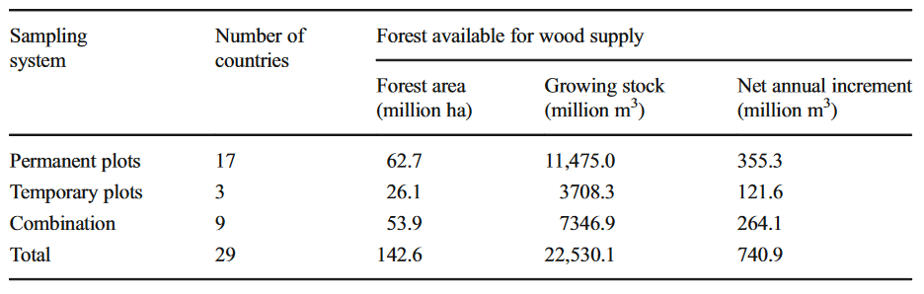
Use of permanent and temporary plots in European NFIs (2016)
https://doi.org/10.1007/s13595-016-0554-5
Further considerations about increment coring, e.g.:
sampled trees, data about cored trees, field or lab measurements, measurement position at the tree, … -> purpose

Slide 8
“Definition-based” harmonisation approach
Country-level definitions
European level Reference definition
Deviations
Country-specific bridging functions
Harmonised estimate in accordance with reference definition

Slide 9
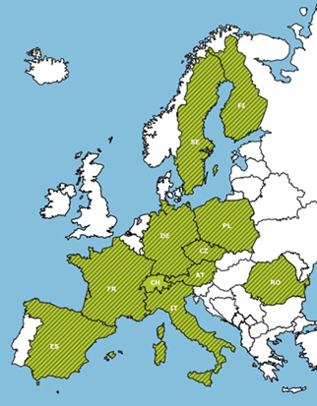
Harmonisation of increment
Gross annual increment (GAI)
Includes the increment of all growth components:
Survivor and ingrown trees: Vt2-Vt1, AGBt2-AGBt1
Cut and mortality trees: Vtc-Vt1, Vtm-Vt1, AGBtc-AGBt1, AGBtm-AGBt1
Means per year (m³/year, m³/ha/year, t/year, t/ha/year)
Annual natural losses (ANL)
Trees that die between t1 and t2 due to natural causes and remain unharvested in the forest: V, AGB
Means per year (m³/year, m³/ha/year, t/year, t/ha/year)
Net annual increment = GAI – ANL

Slide 10
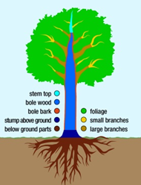
Harmonisation of increment
“final-value” method – time point t2
Forest plots at t2
per-ha sample tree representation:
t2: Survivor trees, New sample trees
t1: Cut trees, Mortality trees (last measurement as living tree)
dbh-threshold = 7.5 cm
Tree parts
Volume increment:
Conifers: Stem volume from stump height to top diameter = 7 cm.
Broadleaves: Stem volume from stump height to top diameter = 7 cm and large branches with diameter ≥ 7 cm.
AGB increment:
Conifers and Broadleaves: Stem biomass from ground to the stem tip, and large and small branches, and perennial foliage (needles).

Slide 11
Harmonisation results
Differences harmonised and national estimates
Range of ~-10% to ~+25%
Increment patterns in Europe
Highest increments in Central Europe
Lower increments towards the North, South, West and East
Range ~1-12 m³/ha/year resp. ~1-6 t/ha/year
Increment differences between forest types
Higher increments often in conifer forests
Exceptions in mixed forests
Important tree species in the study area
Conifers: Pinus and Picea ~ 55% of GAI
Broadleaves: Fagus, Quercus and Betula ~ 20% of GAI

Slide 12
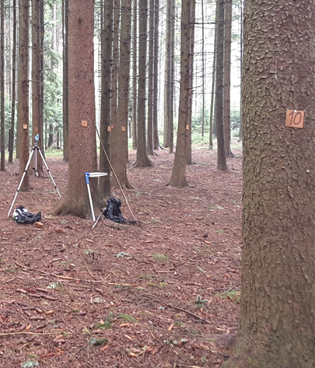
Thank you!

