Slide 1
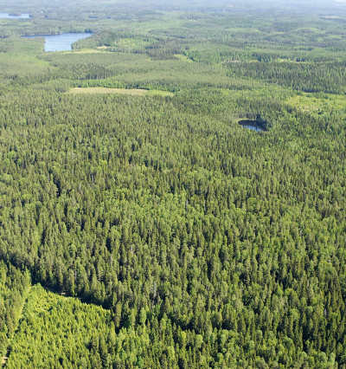
European Forestry Dynamics Model (EFDM)
Minna Räty
Natural Resources Institute Finland (Luke)
09.04.2024

Slide 2
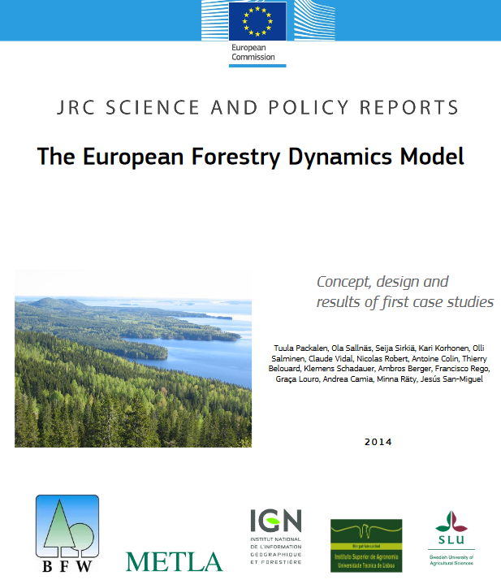
European Forestry Dynamics Model (EFDM)
Developed by Luke (Metla) and SLU for JRC year ~2012 onward
Tested in several European countries and forest management regimes
Used, for example, in DIABOLO: http://diabolo-project.eu/
Will be used in a new Horizon Europe project coordinated by Luke: MoniFun (2024–27) https://www.monifun.eu/
Packalen et al. 2014. The European Forestry Dynamics Model: Concept, Design and Results of First Case Studies; JRC Science and Policy Reports; EUR 27004;
DOI: 10.2788/153990

Slide 3
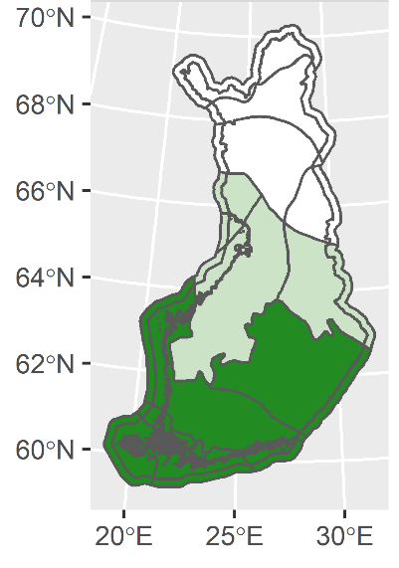
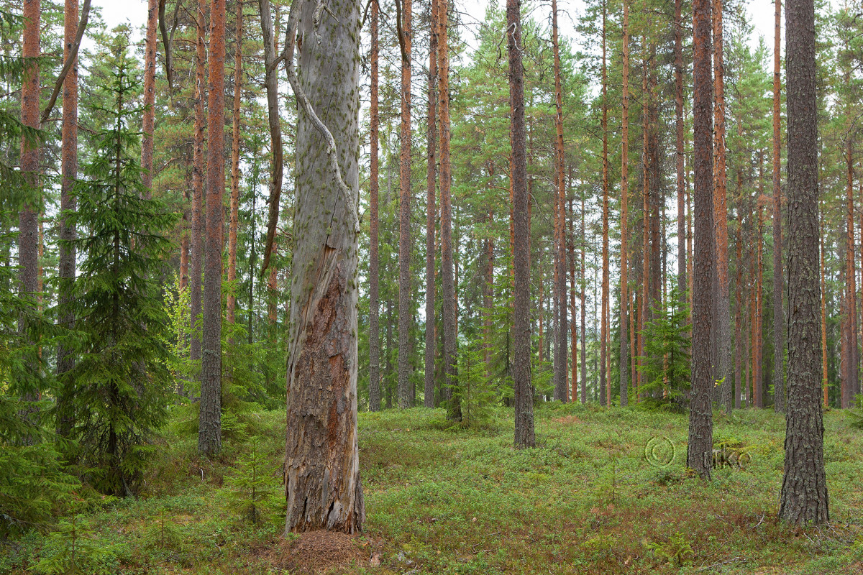
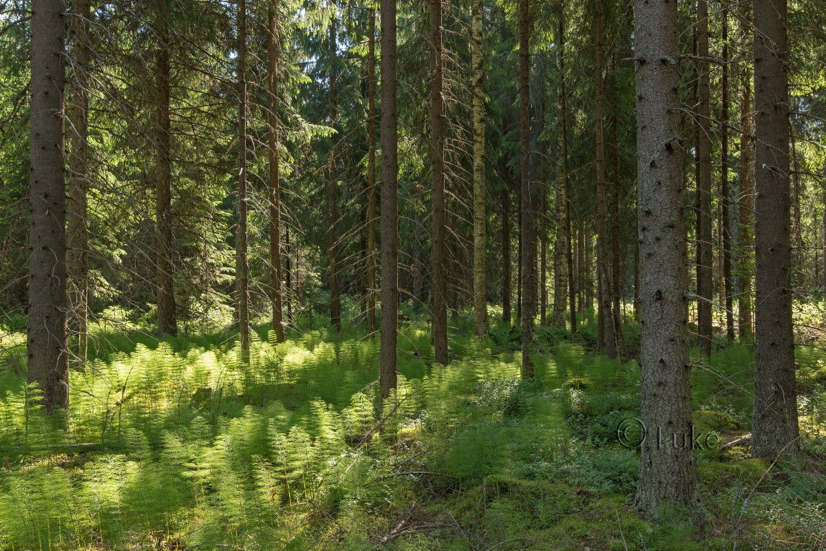
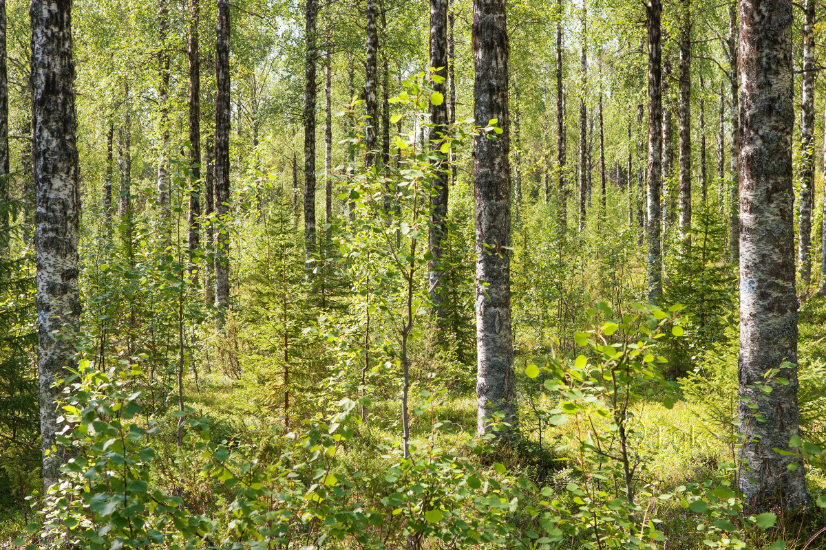
A Markov chain model; Area-based matrix model
Forest classification…
Forests are classified into ‘forest types’ by any factor affecting forest’s growth or management: region, ownership, production/protection, dominant tree species, site class,…

Slide 4
…Classification
Forest area in each ‘forest type’ is classified in respect to age and volume or age and stem number/mean diameter
INITIAL STATE/classification is ready, and similar classification should be applied to the other parts of model: management rules/activity, growth/transition, as well

Slide 5
Simulation
Areas in matrices move by simulation steps
Length of a simulation step depends on data, model and forest type, 1-20 years typical
Move is controlled by:
Activity probability: splits areas in matrix cells into different treatments, must sum up to 100%
Transition matrices: treatment specific movement of area within or between matrix/matrices

Slide 6
Example of move for 4 ha of forest in one time step

Slide 7
Results
Automatic result includes area distribution of forests in respect to:
  Classifiers of ‘forest types’
  Age – Volume classes (or other chosen classification)
  Management activity / treatment applied
  By time steps
These can be converted to any variables for which the user can give per ha value: volume, age, biomass, dead wood…

Slide 8
Matrices in EFDM, example of a set-up
1 Initial state
2 Activity probability
3 Transition matrices
4 Coefficients
Forest area in forest types divided into e.g. Age – Volume or Mean diameter – Volume classes at initial stage
Activities: Growth (=no activity), Final felling, Thinning
For all activities
E.g. mean volumes of volume classes, timber assortments, prices
For example, probability for final felling at Age classes 1-2 could equal to zero
To which Age – Volume or Mean diameter – Volume class does forest area move in one time step
Stratification into different forest types
Data sources: inventory data from one time
Data sources: management manuals, best practices, inventory data, statistics, expert knowledge
Estimated in R from a pair data with a function available in R package or estimated separately without pair data
Pair data can originate from two measurements of same (permanent) sample plots, or measured-modelled sample plot pair
Data sources: statistics, inventory data
Data sources: inventory data, growth models, yield tables, expert knowledge

Slide 9
Implementation
Implementation from a scratch takes from couple of weeks to some months 1-2 persons working on it
Advantage: once implemented fast to run
Time required for a scenario (=model) modification depends on the change
Change in output variable vs. change in forest classification
  First is not requiring much
  The latter: basically, everything needs to be redone

Slide 10
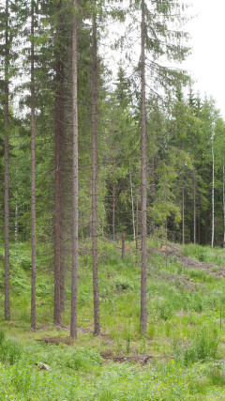
Use cases, potentials & limitations
Used as a scenario tool for policy support and decision making in large-scale:
Future forest resources, biomass and wood supply
Impacts of alternative forest treatments and protection on biodiversity, ecosystem services and wood supply
Potentials:
Simple
Fast
Does not require computer capacity
Linkages to other models possible
No licenses
Limitations:
Data driven
Coarse
Need to build the model by yourself
No optimization

Slide 11
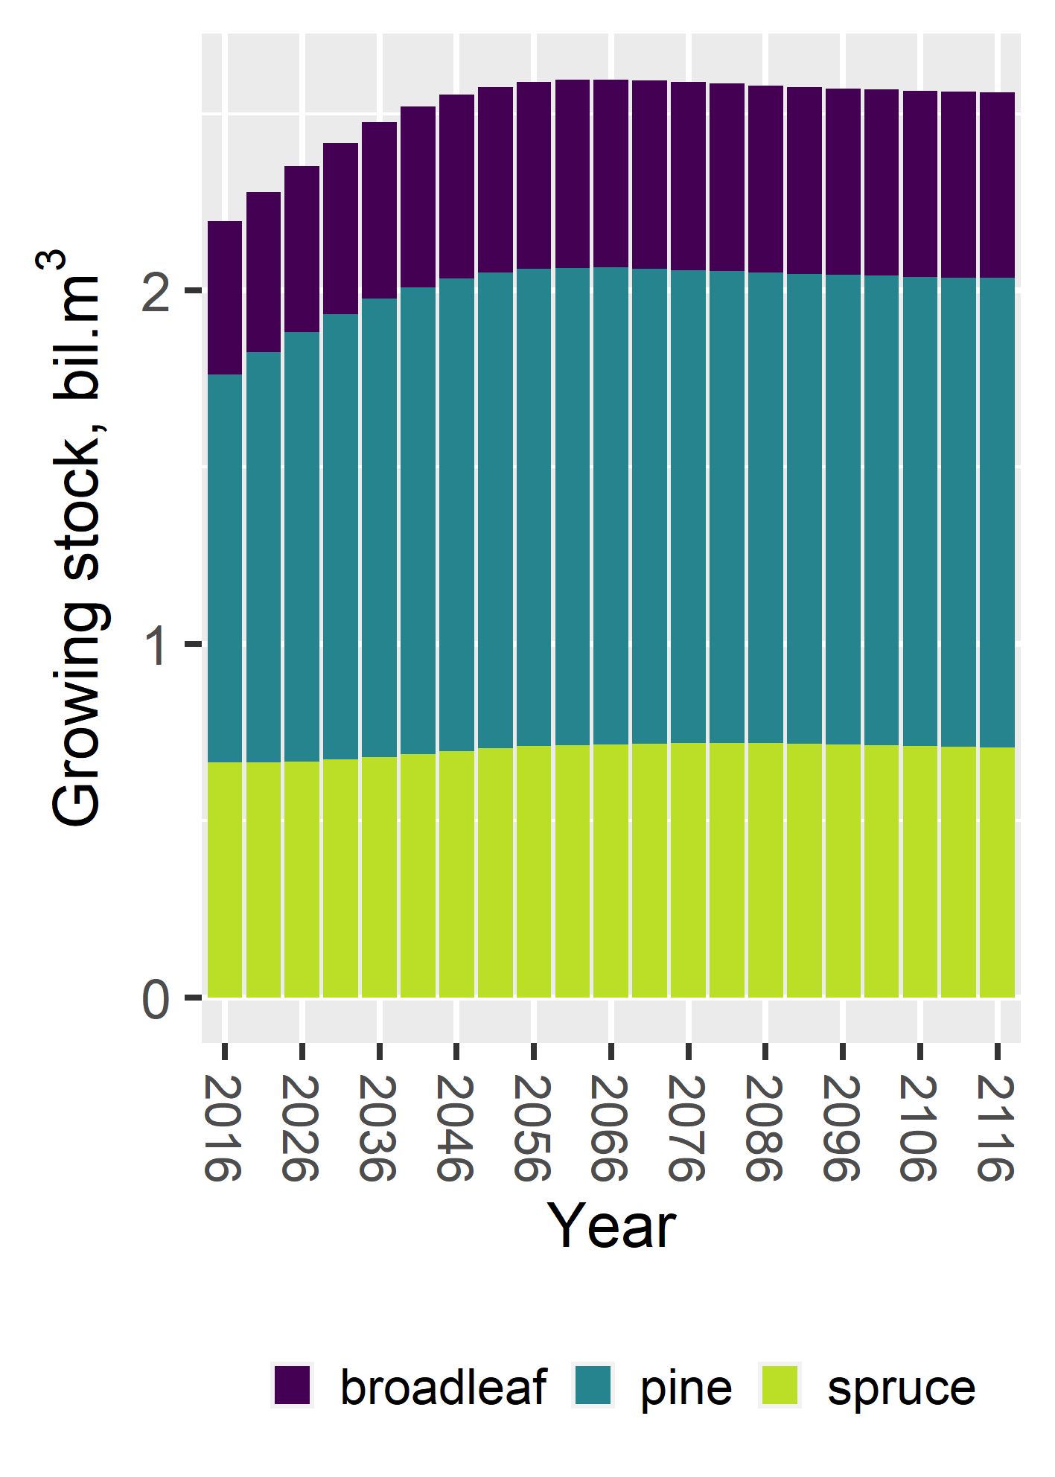
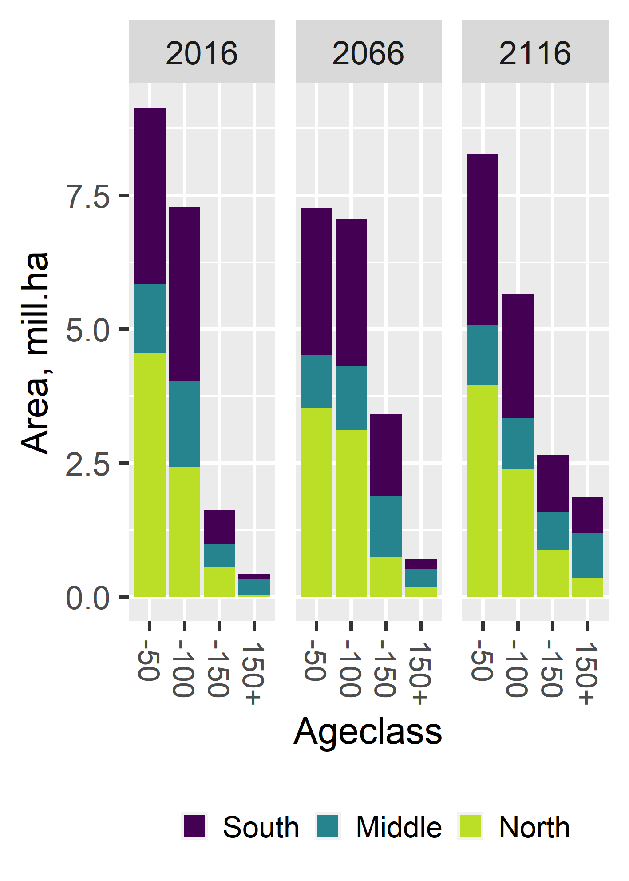
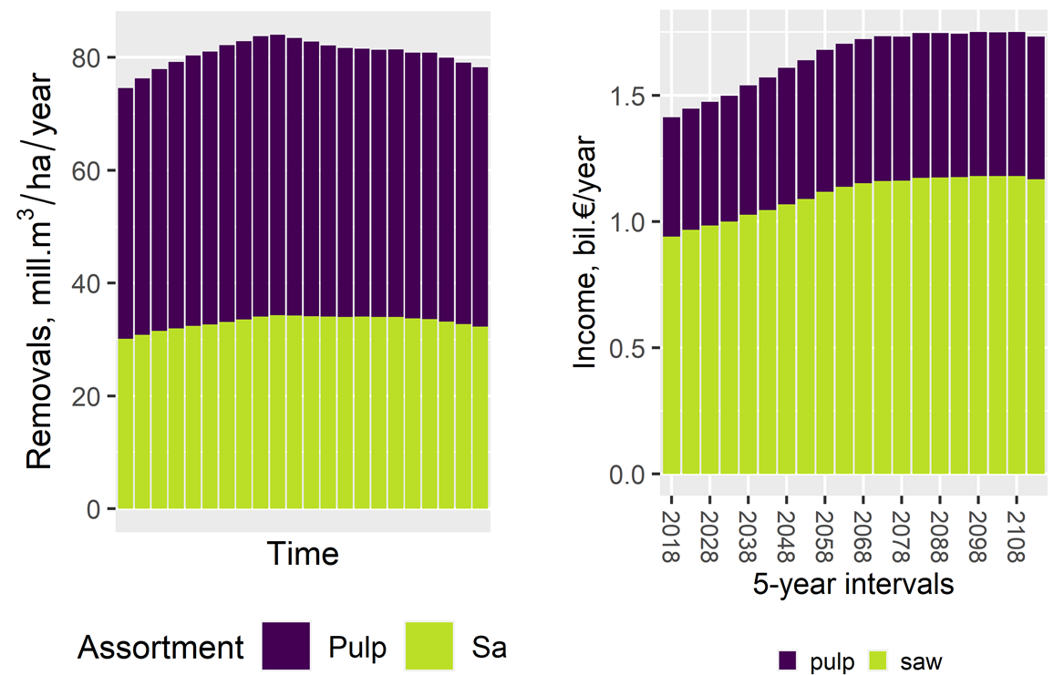
EFDM example results
Pictures from left:
Total growing stock by simulation steps divided into tree species groups
Age distribution of forests at years 2016, 2066 and 2116 by forest vegetation zones
Annual removals per time steps divided into assortments
Annual income from removals split into pulp and saw wood

Slide 12
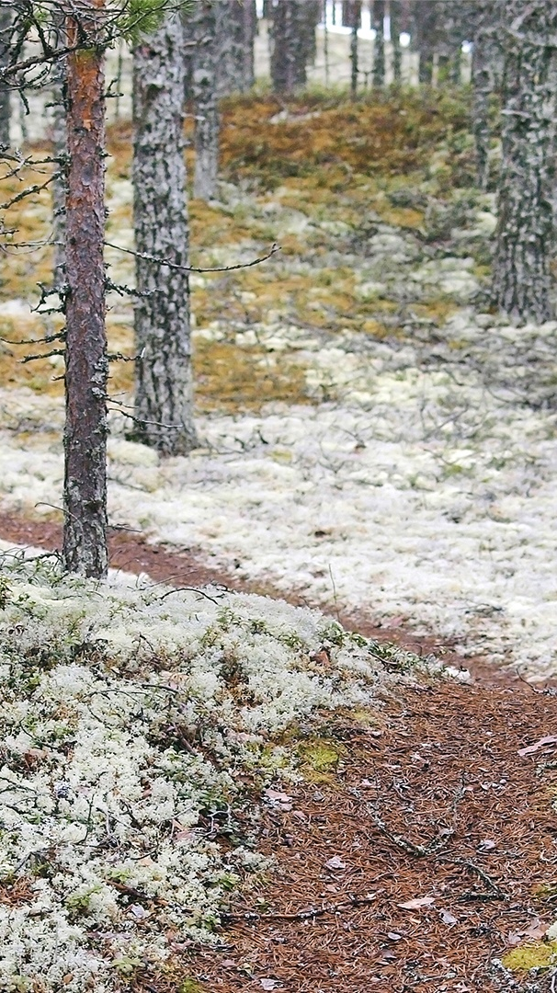
Availability, software
Desktop based, open-source R functions
New development, R package:
Räty M, Kuronen M (2022) efdm–An R package offering a scenario tool beyond forestry. PLoS ONE 17(8): e0264380. https://doi.org/10.1371/journal.pone.0264380
“efdm” R package https://CRAN.R-project.org/package=efdm
In github: https://github.com/mikkoku/efdm
Thank you!

Slide 13



luke.fi
Subscribe to our newsletter to stay informed!
luke.fi/newsletter
Natural Resources Institute Finland (Luke)
Latokartanonkaari 9, FI-00790 Helsinki

