Slide 1


Reference data, methodology and RS-Inventory results
Viktor Myroniuk¹, Axel Weinreich², Vincent von Dosky², Heino Polley³, Matthias Dees²
¹ National Short-Term Expert, NUBiP of Ukraine
² International Short-Term Experts, unique land use GmbH
³ International Short-Term Expert
Project “Technical Support to Forest Policy Development and National Forest Inventory Implementation“ (SFI)
W-UKR 21-01

Slide 2
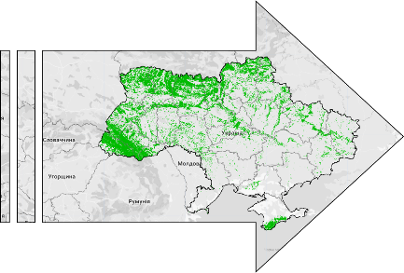
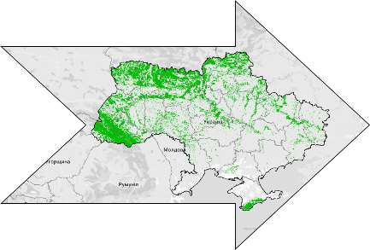
Objectives of the RS-Inventory
Harmonise forest monitoring in Ukraine with the best practices used in Europe and other developed countries
Support for the national forest inventory reporting with limited resources
First spatially explicit assessment of forest resources in Ukraine
Mapping of forests regardless of their legal status
Improved capacity for continuous forest monitoring in Ukraine and decision making
The remote sensing inventory uses a biophysical definition of forest as an area covered by woody vegetation with a canopy cover of more than 50%, observed at a pixel level of 20 × 20 m, regardless of its legal status.
2023
2024
2025

Slide 3
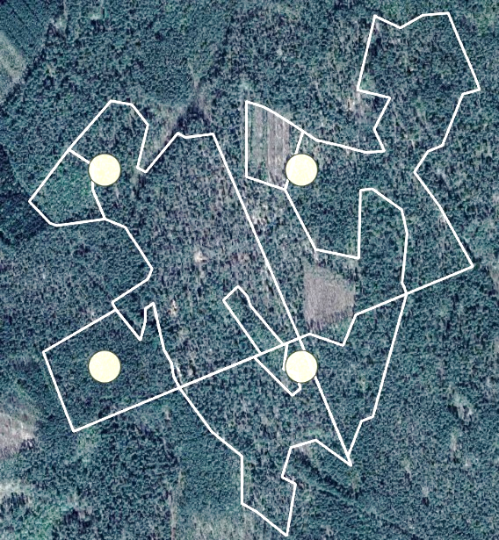
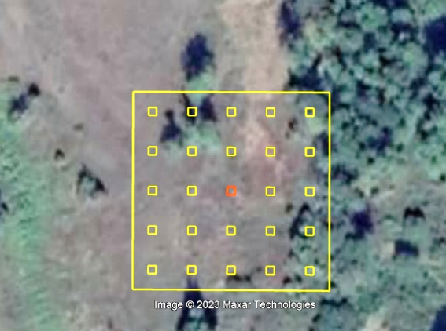
Methodology: Reference data
NFI plots data (mapping forest attributes)
NFI plots attributes obtained after inspection of ~4,100 field plots in 2021-2023
FMP data (augmenting the NFI data)
FMP forest polygons (~700) intersecting the NFI grid
Visually interpreted high-resolution images (FNF mapping)
Land cover classification using the NFI plot locations

Slide 4
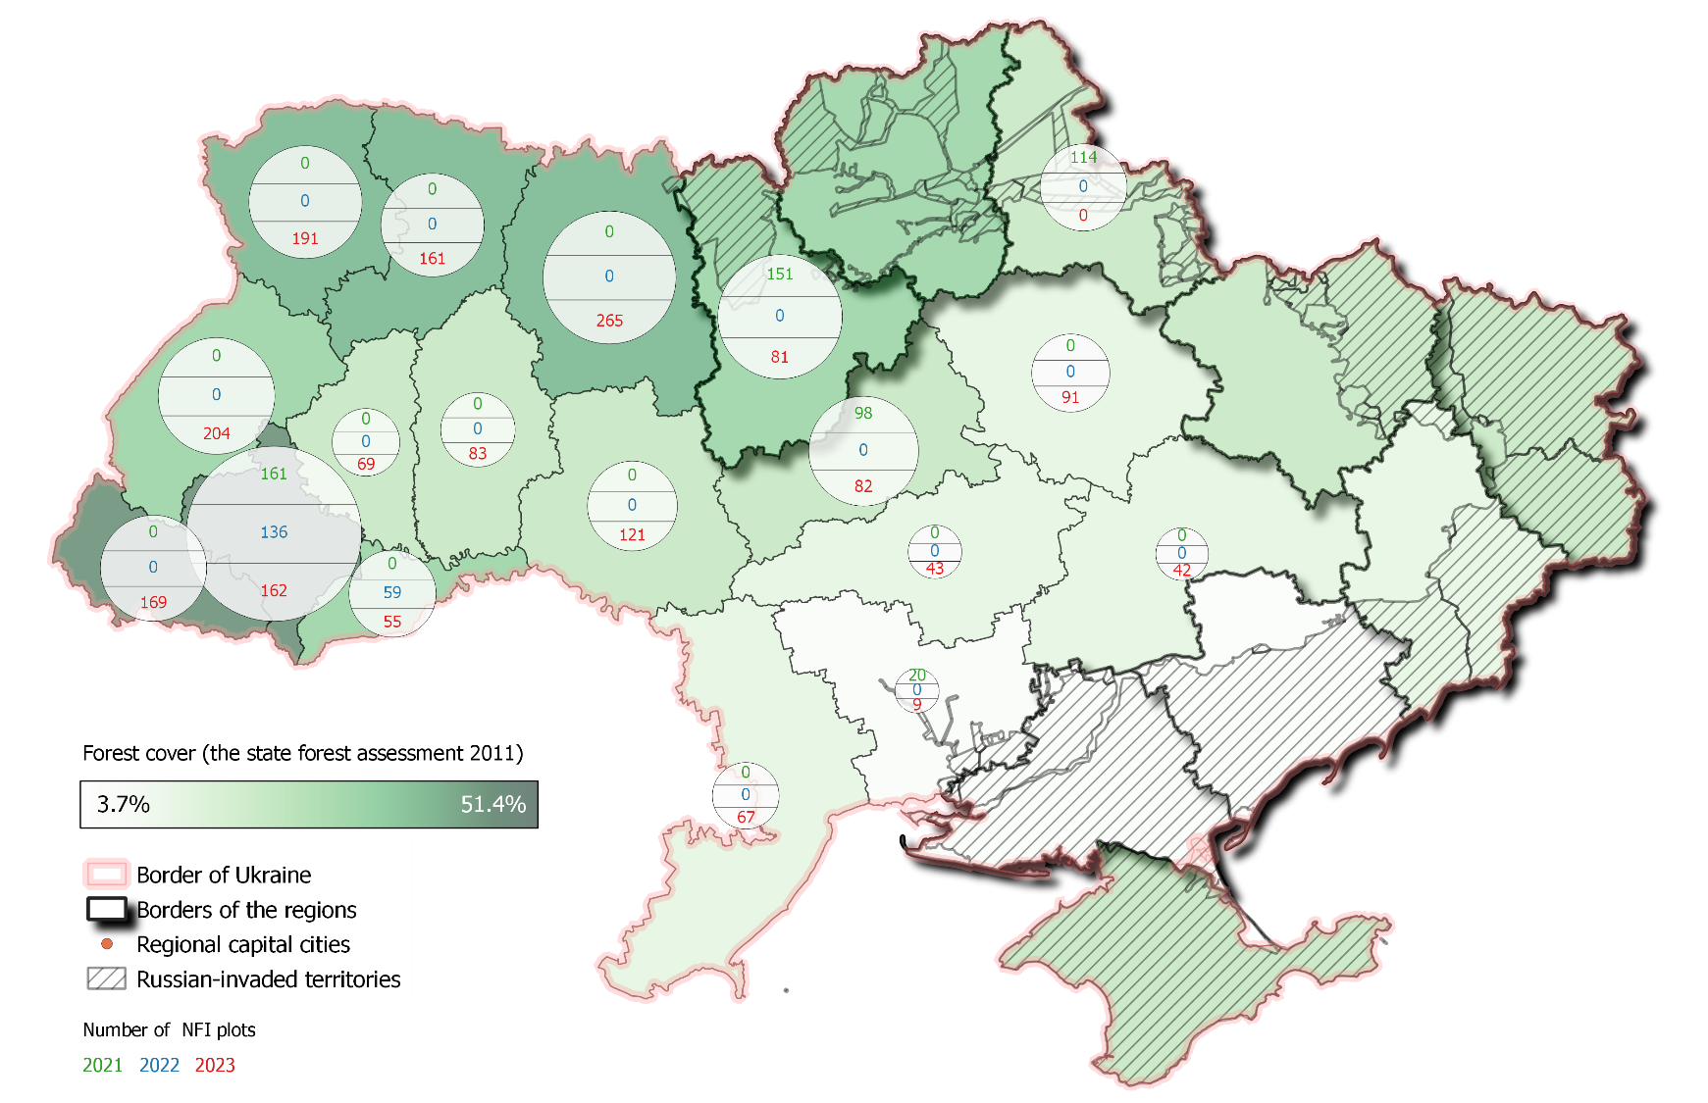
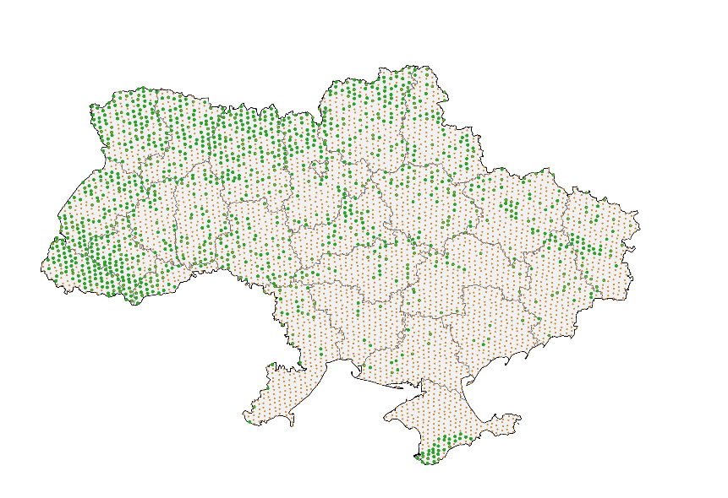
Methodology: Types of field data
NFI plots
Collected across safe areas
Represent different years of field visits
More than 75% forested
FMP plots
Occupied or unsafe territories
Expert interpretation of FMP attributes
Data collected in 2019-2021

Slide 5
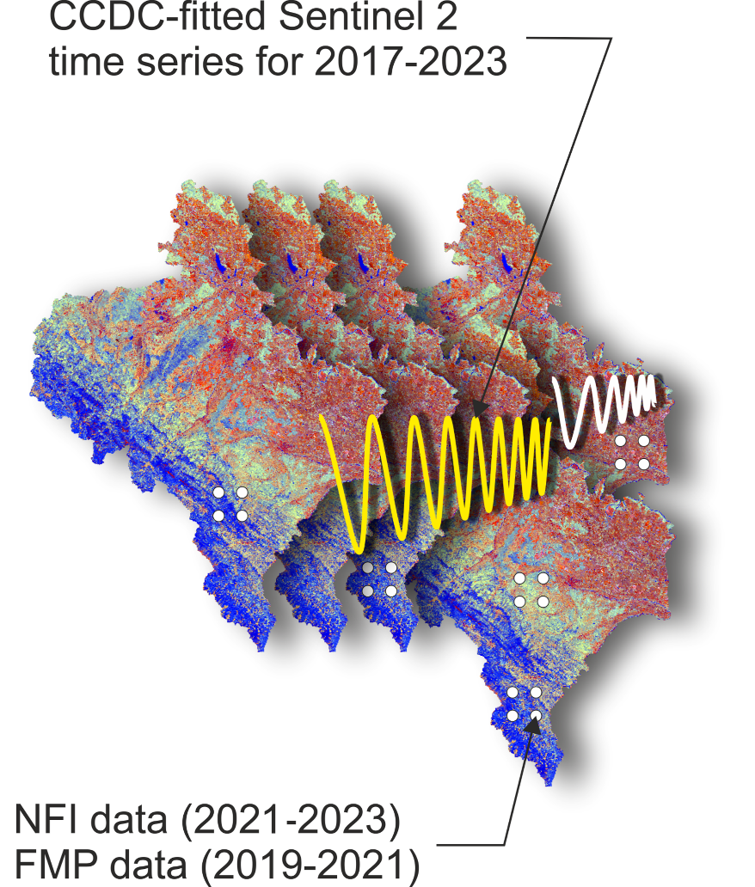
Methodology: Satellite time series
Data sources
Sentinel 2 time series for 2017–2023
Rasterized environmental data (climate, topography)
Spatial resolution (pixel size)
Sentinel 2 imagery resampled at 20-m
Temporally smoothed time series
CCDC segmentation algorithm (Zhu&Woodcock, 2014)
Image processing platform
Google Earth Engine cloud computing platform

Slide 6
Methodology: Data processing
1 | Collecting field observation data Per-hectare estimates of forest attributes for NFI sample plots and FMP data
2 | Mapping forests and dominant species Random Forest machine learning algorithm (Breiman, 2001)
3 | Mapping forest attributes Gradient Nearest Neighbor (GNN) predictive mapping technique (Ohmann & Gregory, 2002)
4 | Accuracy assessment using independent observations Leave-one-out cross validation for mapping forests and dominant species (James et al., 2013) Seven first independent neighbors for GNN imputation model (Ohmann & Gregory, 2002)
5 | Statistical estimation procedure Map-based assessment of forest area using confusion matrices (Olofsson at al., 2014). Model-assisted estimation of continuous forest characteristics (McConville et al., 2020).
1
2
3
4
5

Slide 7
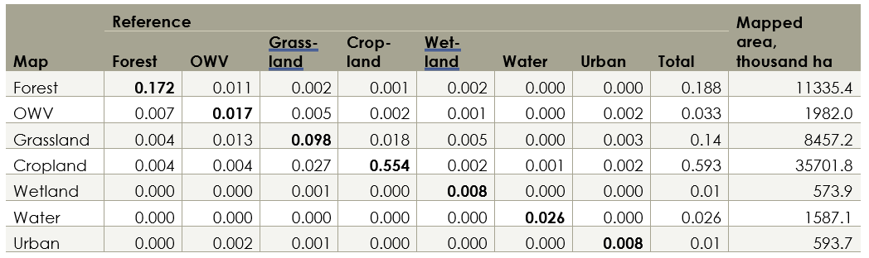
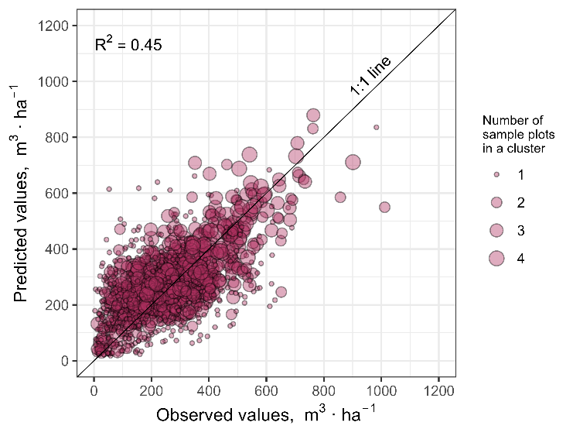
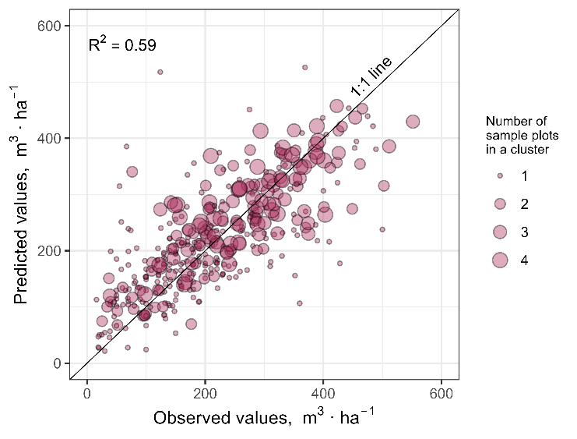
Methodology: Testing model performance
Statistical procedures
Accuracy estimates for discrete forest variables (overall, producer’s, user’s accuracies)
Model skill estimates for continuous variables (R-squared, agreement coefficients, root mean square error)
Graphical procedures
Plots of observed vs predicted values
Visual analysis
Visual inspection of forest maps

Slide 8

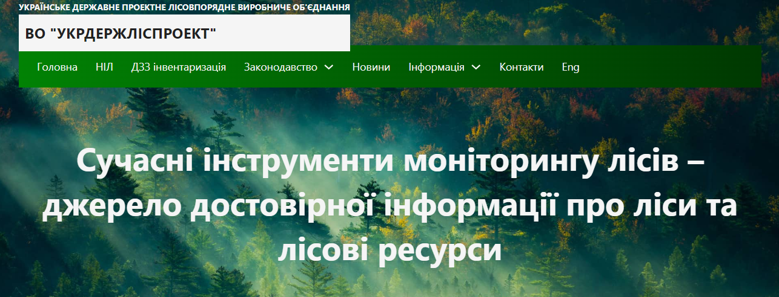
RS-Inventory website
The website of the RS-Inventory can be viewed at the following link nfi.lisproekt.gov.ua/

Slide 9
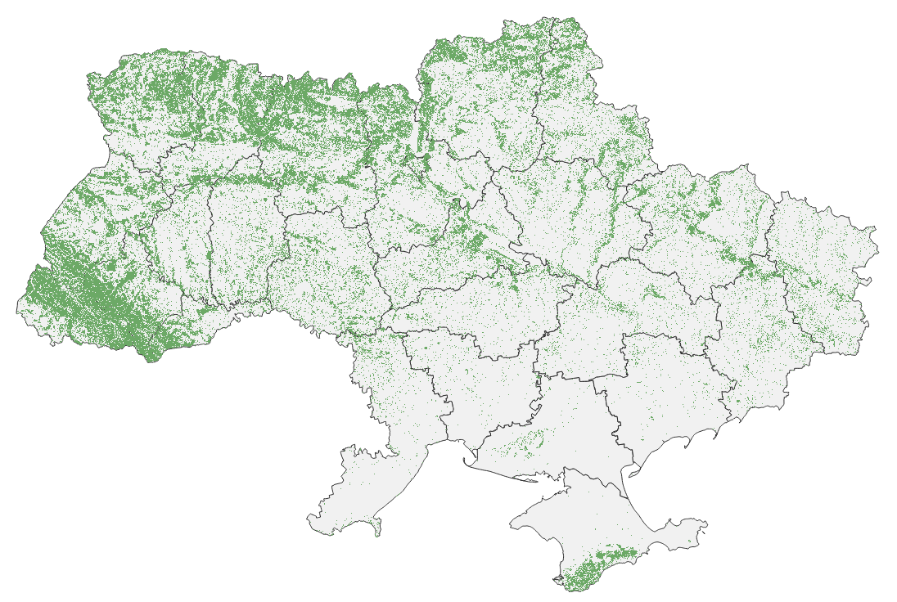
Output 1: Forest area
Tables
Regional-scale estimates of forest area and forest cover with 95% confidence intervals
Total forest area in 2023:
11,209 ± 166 thousand ha
Forest cover in 2023:
18.8 ± 0.3%
This study used the biophysical definition of forest as an area covered by woody vegetation with a predefined minimum canopy cover (>50%) observed at 20×20 m pixel level regardless of its legal status

Slide 10
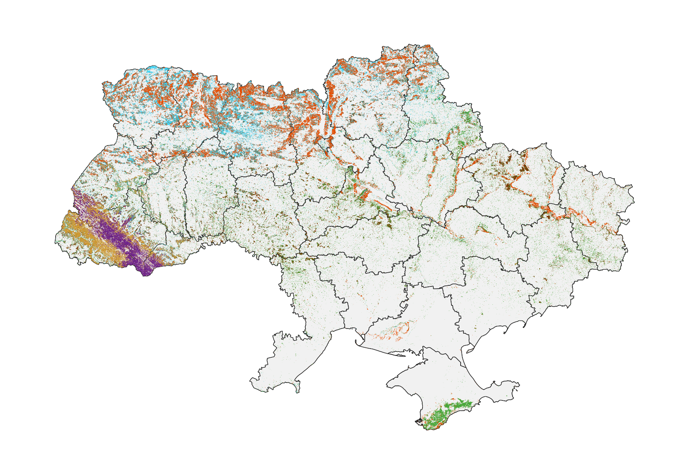
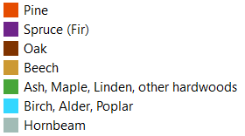
Output 2: Dominant species
Tables
Estimates with 95% confidence intervals of forest area by dominant species at ecoregion and whole-Ukraine level
Seven groups of dominant species established according to their ecological niches

Slide 11
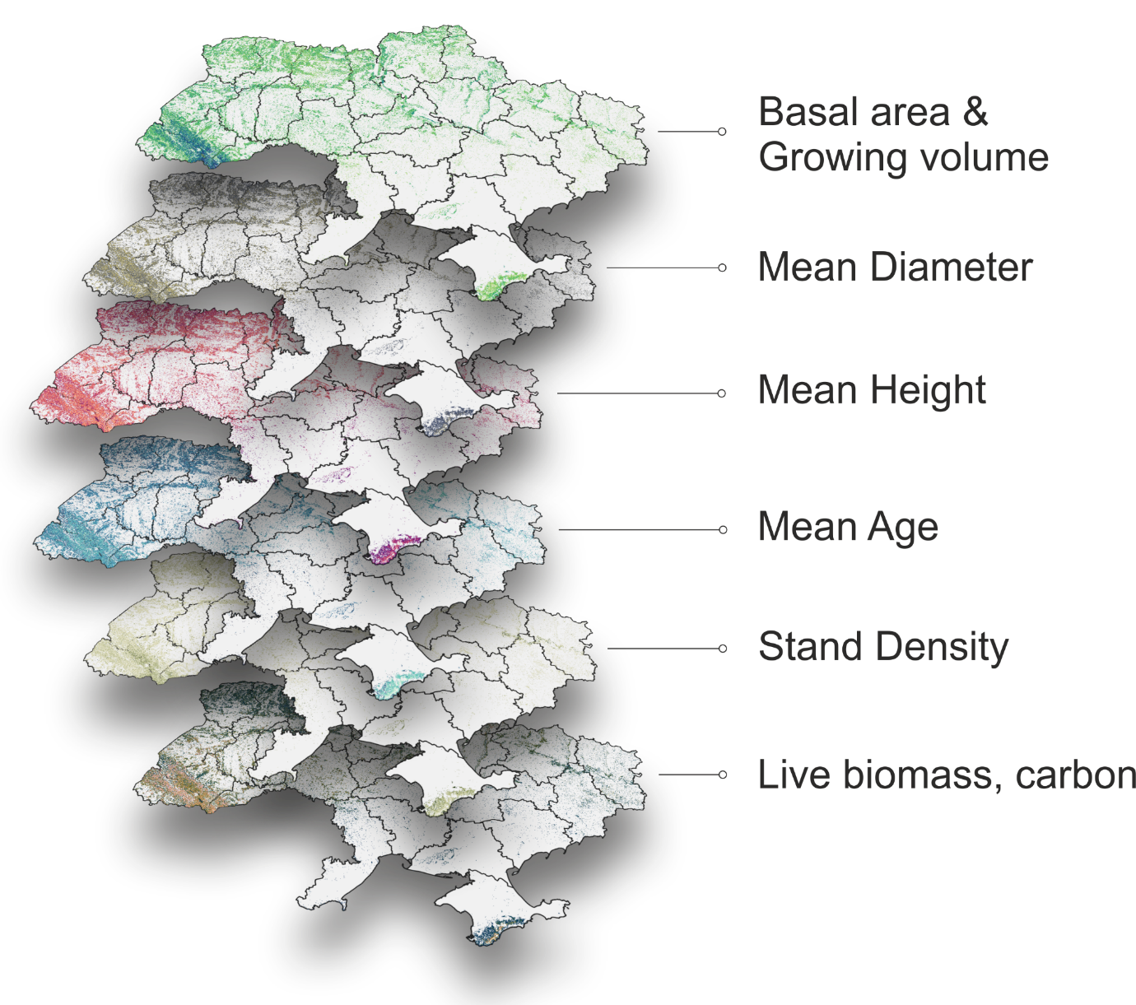
Output 3: Forest attributes
Tables
Estimates with 95% confidence intervals of mean and total values of forest attributes at ecoregion and whole-Ukraine levels
Mean growing volume
251 ± 5 m³
Total growing volume
2,813 ± 55 M m³
Mean age
57 ± 1 years
Total accumulated carbon
944 ± 20 M t

Slide 12
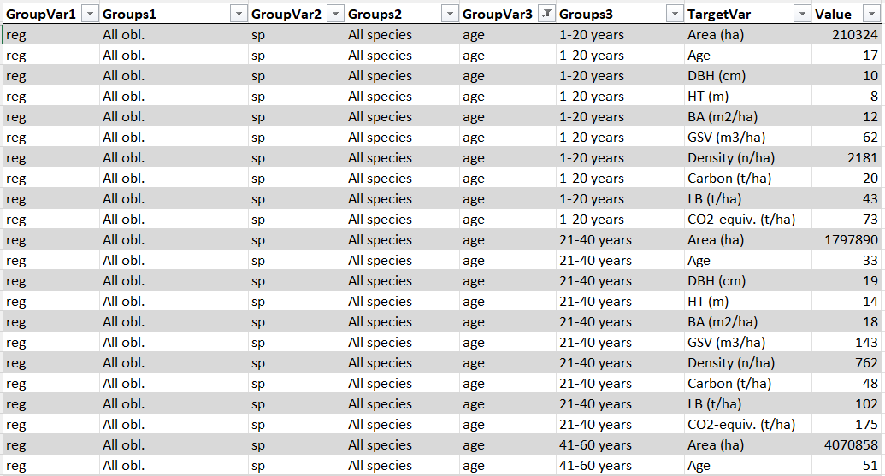
Output 4: Three-way tables
Pixel-based estimates of forest attributes at region and ecozone levels grouped by dominant tree species
Estimates fully compatible with 20-m resolution maps

Slide 13
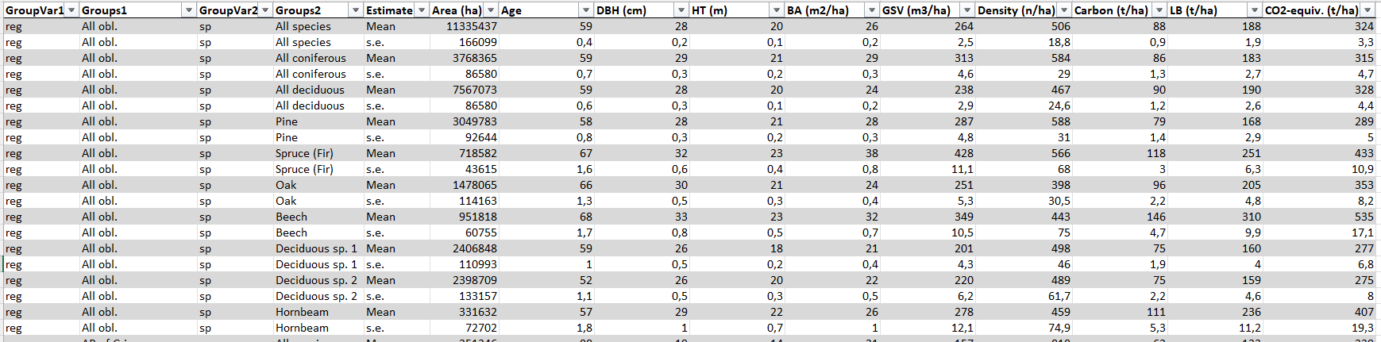
Output 5: Two-way tables
Tabular estimates with 95% confidence intervals (mean and total) at national and ecozone levels, as well as for war-affected territories:
Total forest area
Forest area by dominant species
Forest attributes (growing volume, age, diameter, height, density, live biomass, carbon)

Slide 14
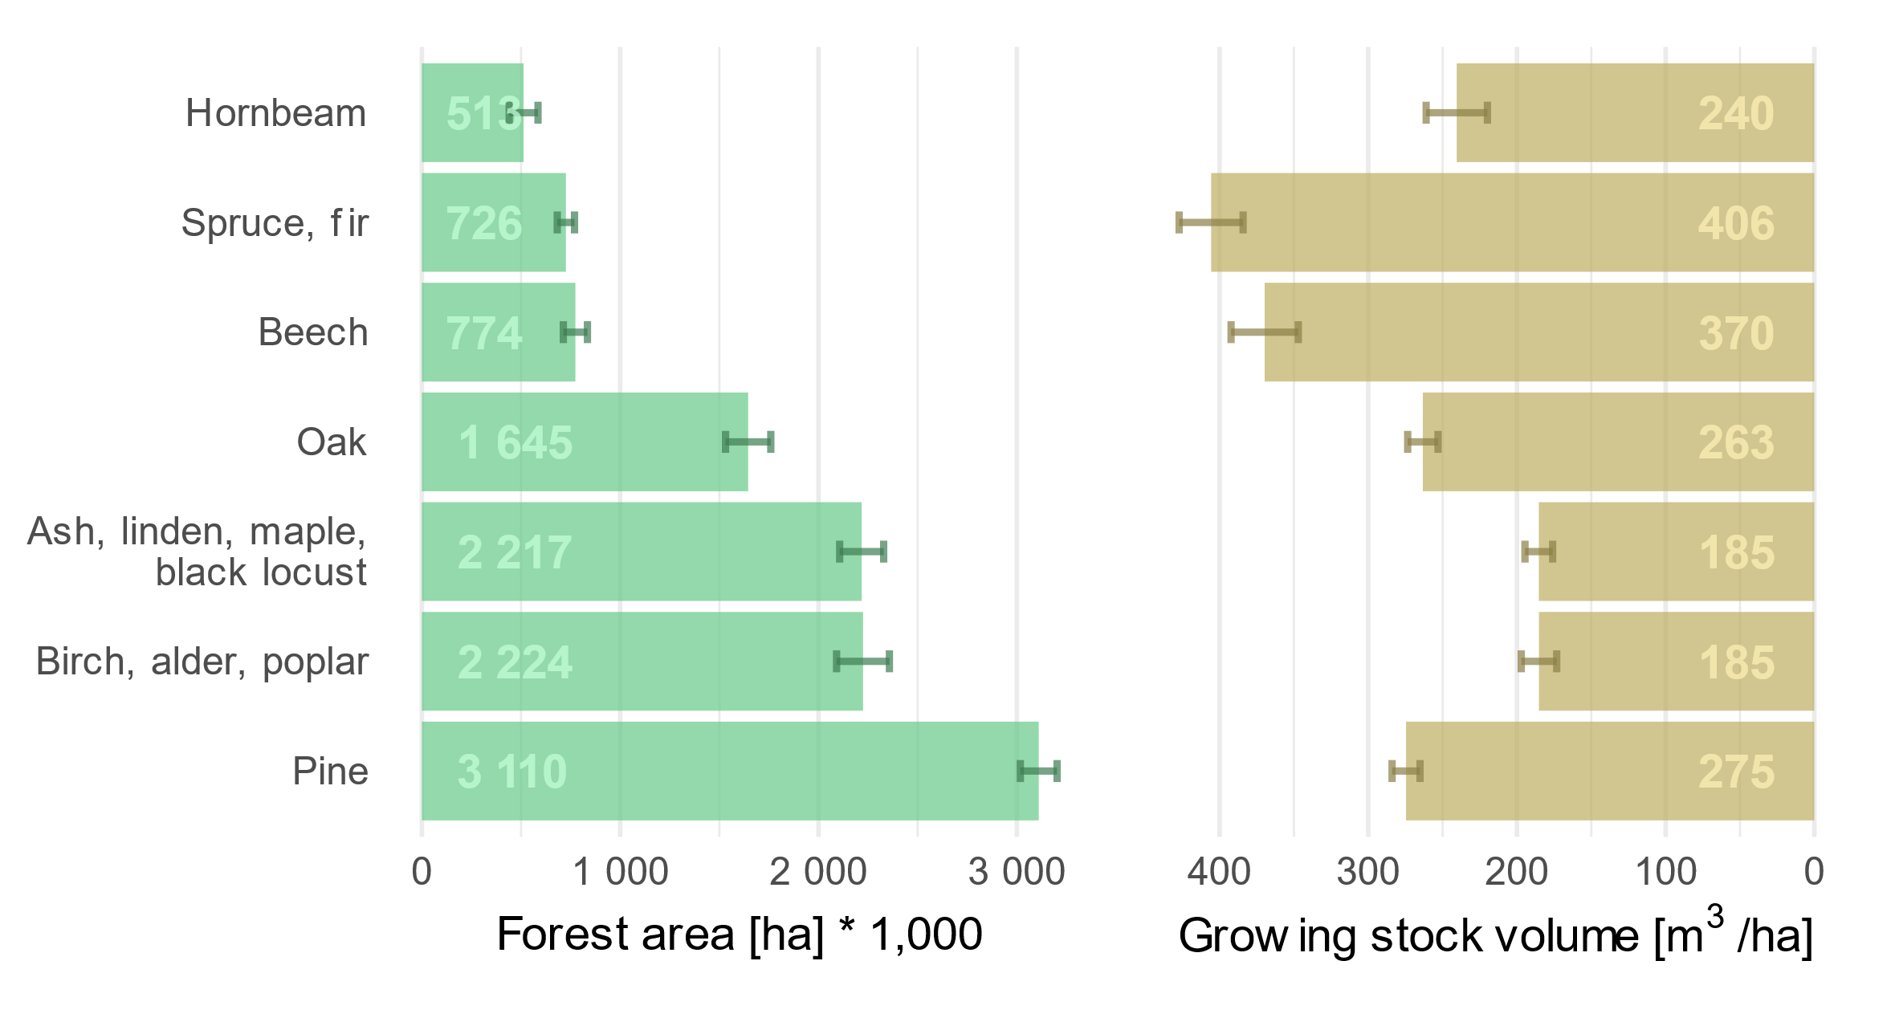
Results: Area and GSV for dominant species
Two thirds of the forest area is dominated by deciduous tree species. Pine forests occupy about 28%.
Growing stock is the highest in spruce and fir forests, followed by beech,
pine, and oak. Obtained mean values of GSV are within confidence intervals of 3-7%.

Slide 15
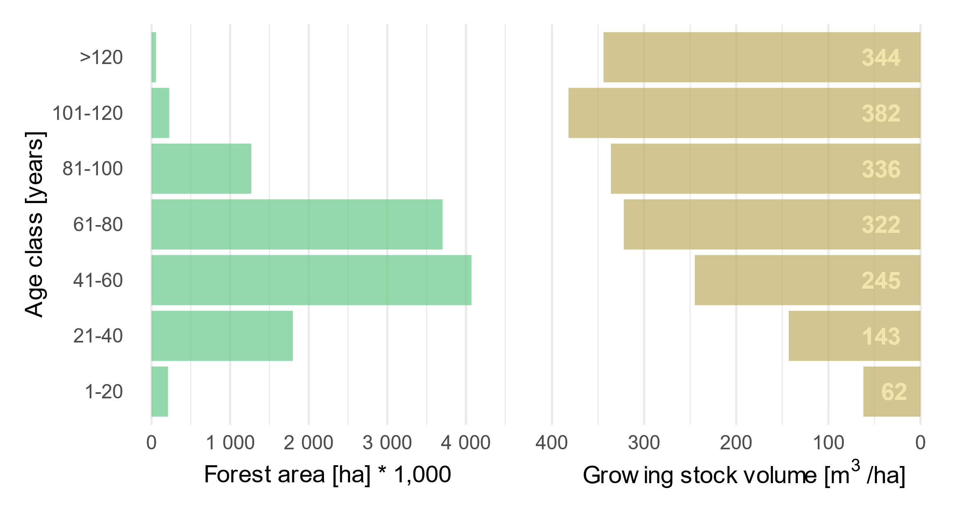
Results: Forest age structure
Forests of 41-80 years dominate in Ukraine
Forests older than 100 years cover 2.5%, while the forest stands younger that 20 years contribute only 1.9% of the forested areas
The highest GSV are observed in the age of
101-120 years, then it decreases

Slide 16
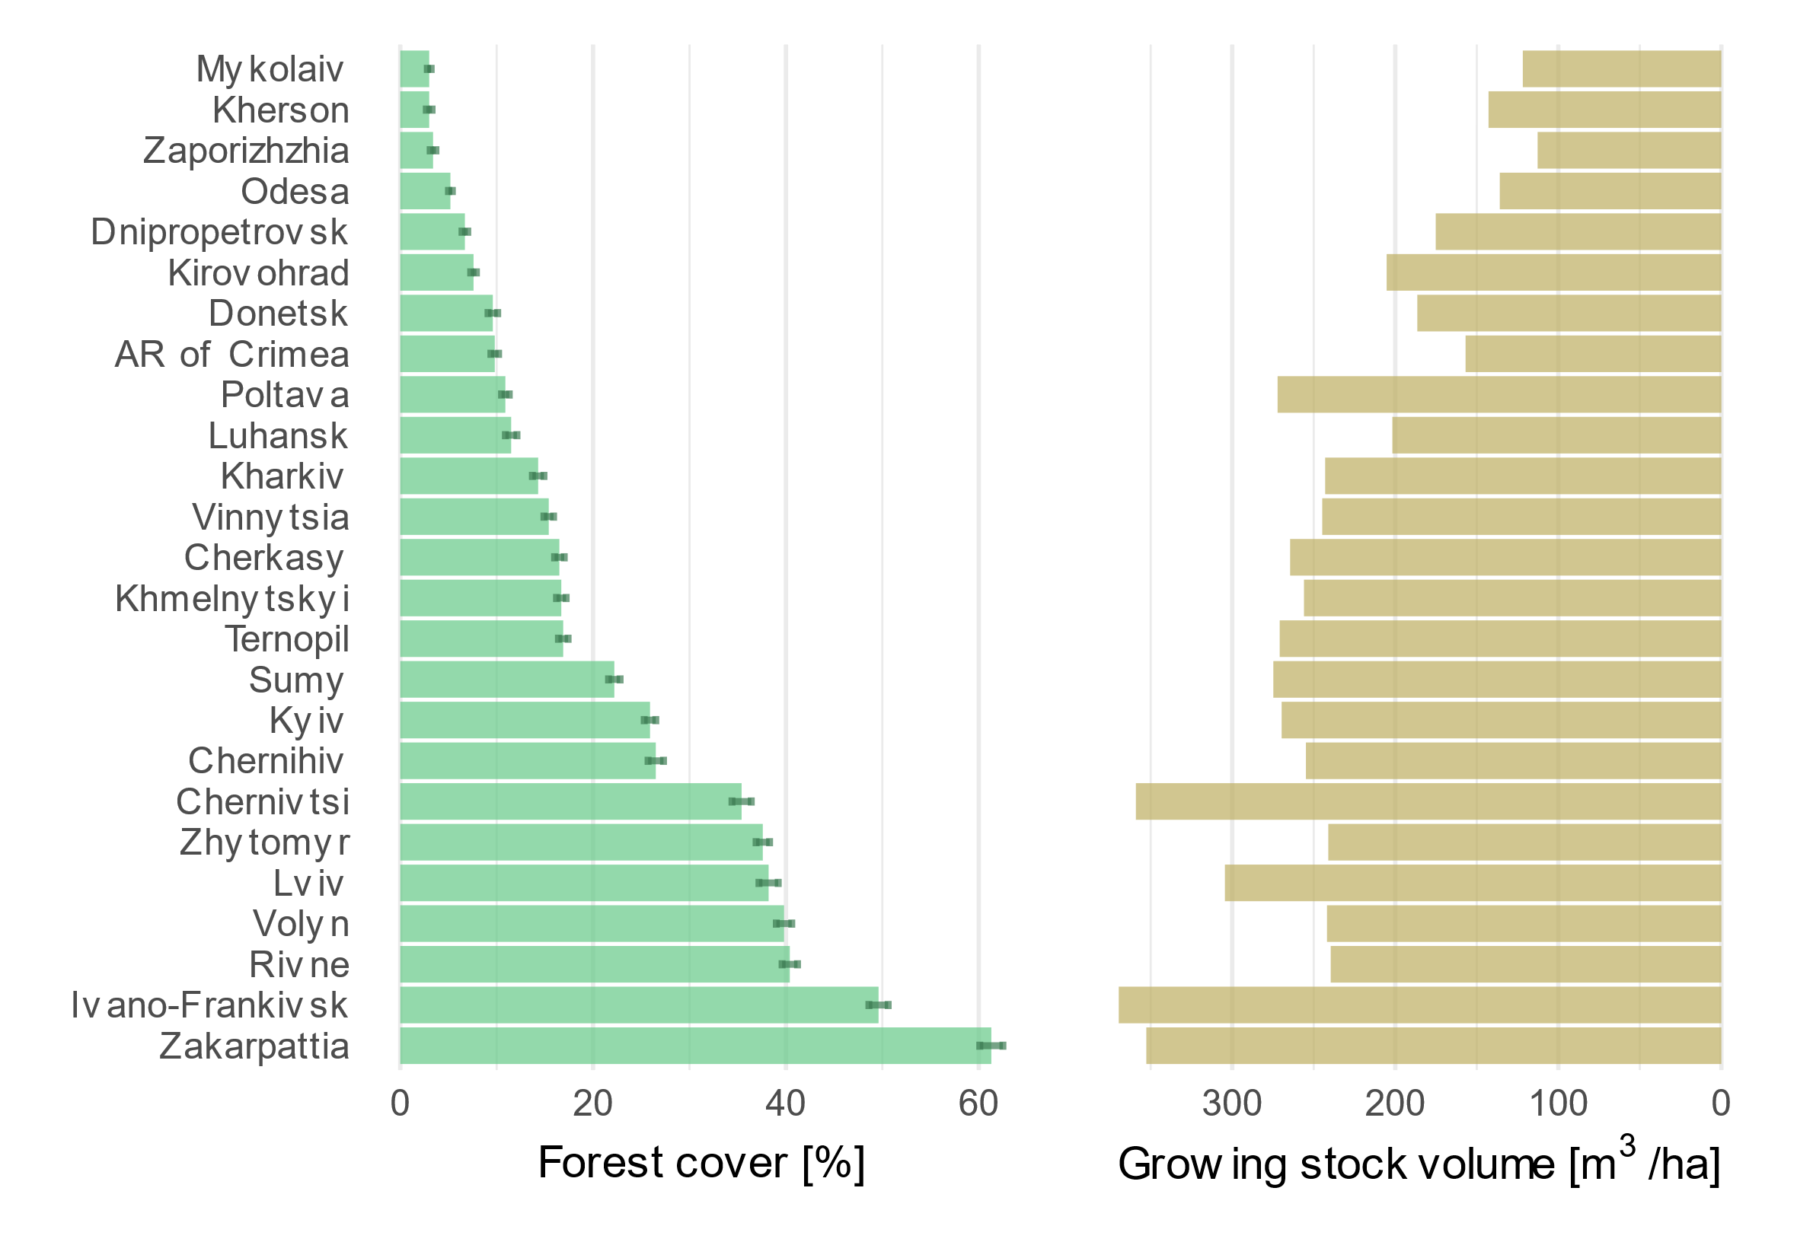
Results: Forests at regional level
The highest forest cover is in Ivano-Frankivsk and Zakarpattia oblasts (50-60%), while in step regions, such as in Mykolaiv, Kherson, and Zaporizhzhia oblasts, it is only 3%
Forests in Carpathian Oblasts accumulate more than
350 m³/ha. In contrast, in the steppe oblasts the growing stock volume is less than
150 m³/ha

Slide 17
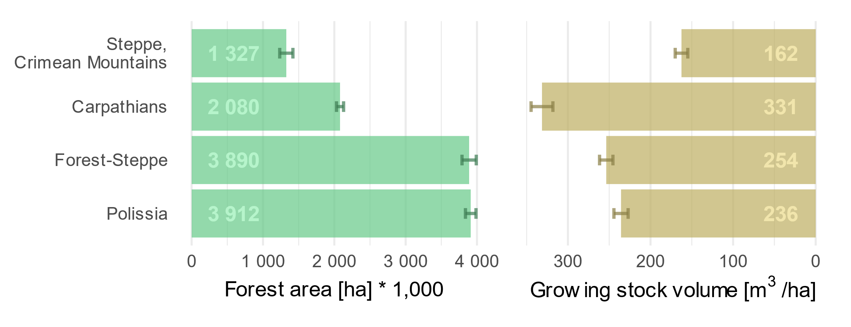
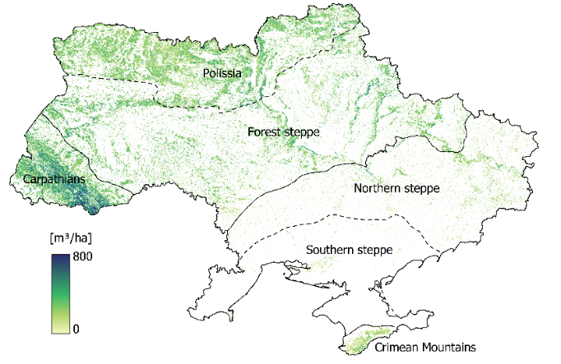
Results: Forest resources by ecozones
Carpathians have the highest percentage of forest cover (> 50%), followed by Polissia (about 40%)
About 92% of the total GSV are accumulated in the forests of Polissia, Forest steppe, and Carpathians

Slide 18
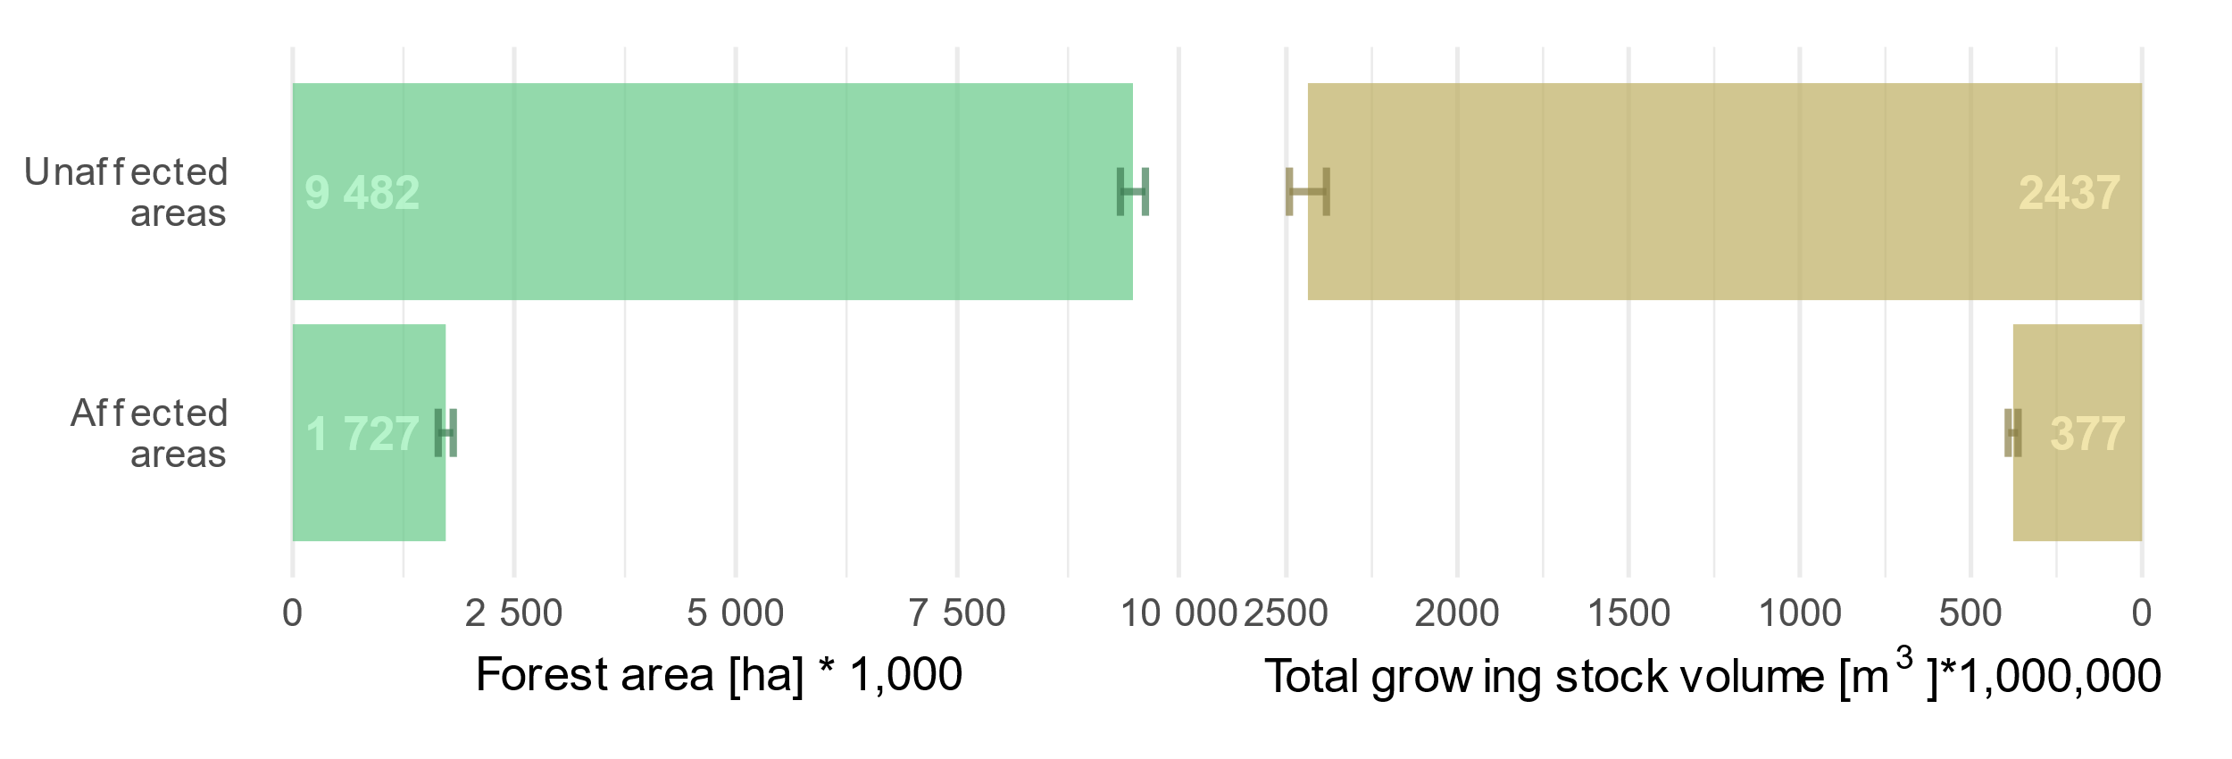
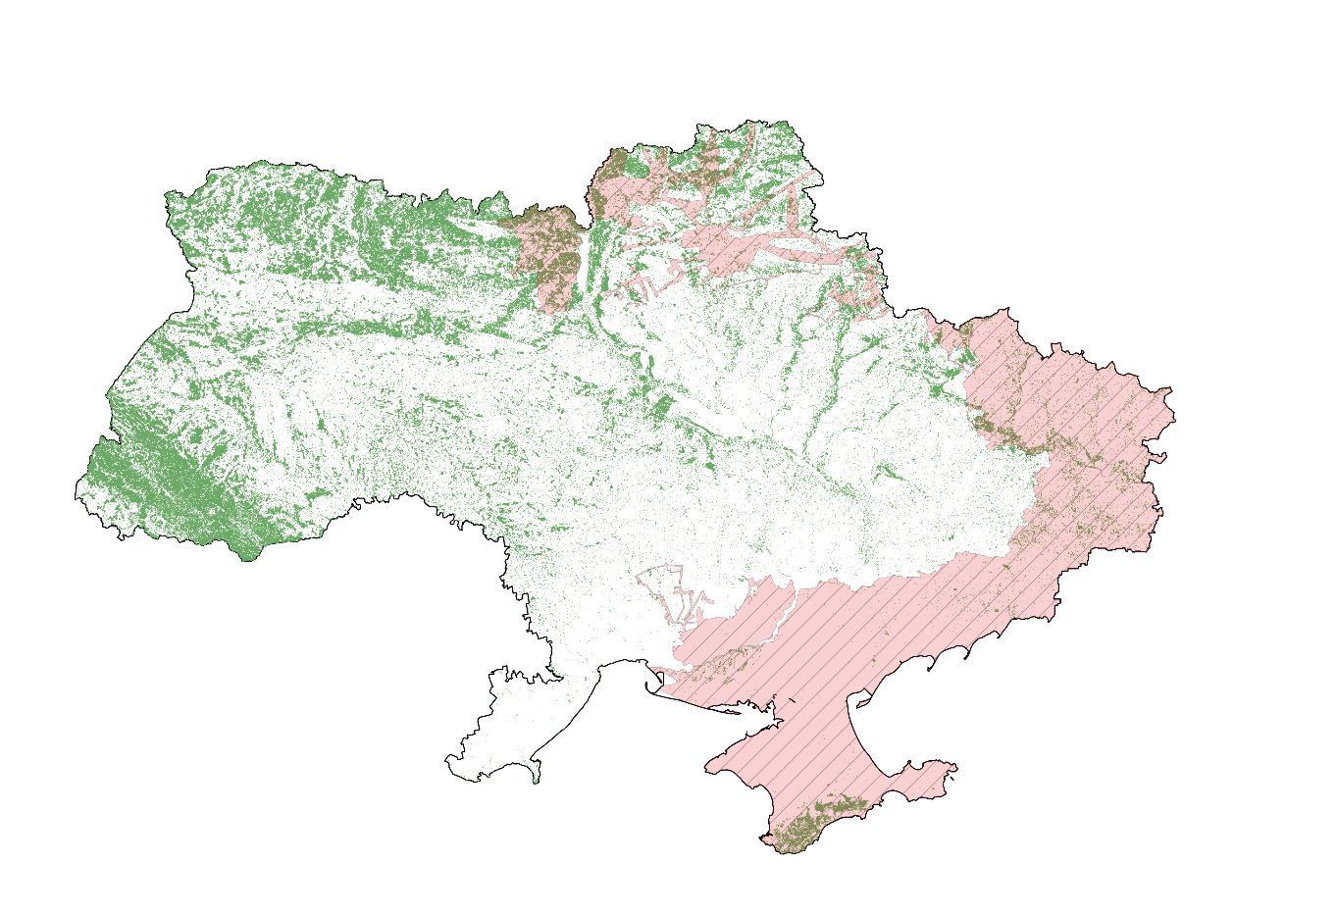
Results: War-affected forests
Approximately 1.7 million ha, or about 15% of the total forest area in Ukraine, are within territories affected by the war

Slide 19
Advantages and limitations of the approach
Wall-to-wall mapping
The developed maps include all tree vegetation, i.e., urban forests, trees in residential areas, etc.
Ability to map forest regardless their management status (ownership)
Mapping narrow shelterbelt with low canopy cover is still challenging
Forest attribute estimates for small areas (ecoregion, oblast, hromaga, etc.)
Accuracy of mapped attributes can be properly addressed when sufficient field observations are available for small areas of interest
Sentinel 2 satellite data are free
Optical satellite imagery have limitations in terms of signal saturation for dense and multi-layered forest stands

Slide 20
The website of the RS-Inventory can be accessed via nfi.lisproekt.gov.ua/en/

