Slide 1
Ukraine on the way to European approaches
towards National Forest Inventory
Viktor Melnychenko,
General Director of Ukrainian State Forest Management Planning Association
Remote-sensing based Forest Inventory (RS-Inventory) of Ukraine
26.04.2024, Kyiv
Notes:
Storozhuk

Slide 2
National Forest Inventory (NFI) and Remote Sensing (RS) data
Procedure for conducting the NFI (2021):
The National Forest Inventory of Ukraine is a system of regular sampling surveys to obtain statistically based generalized information on forests for planning purposes, including strategic planning, forest management, state forest cadastre, and forest monitoring.
Remote sensing data (aerial photography or space imagery) - data on Earth surface sensing objects recorded by aerospace and ground-based means using the properties of electromagnetic waves emitted, reflected or scattered by the sensed objects.
Notes:
Національна інвентаризація лісів – це…
Порядок проведення НІЛ також дає нормативне визначення даних дистанційного зондування землі.

Slide 3
NFI developments in Ukraine
Stage 1: Regional Forest Inventory (2007-2015): based on NFI methodology in two administrative Oblasts of Ukraine covering an area of about 1 million hectares
Stage 2: Legal, financial and institutional requirements (2020-2021)
Law “On amendments to the Forest Code of Ukraine” (2020)
CMU Resolution “On approval of the Procedure for NFI Conducting” (2021)
Stage 3: First circle of terrestrial NFI started (since 2021)
Stage 4: Impact by the war since February 2022
CMU Regulation “Some issues of conducting NFI during martial law” (2023)
Remote sensing-based forest inventory (RS-Inventory, 2023-2024)
NFI web-site: https://nfi.lisproekt.gov.ua/
Notes:
Storozhuk

Slide 4
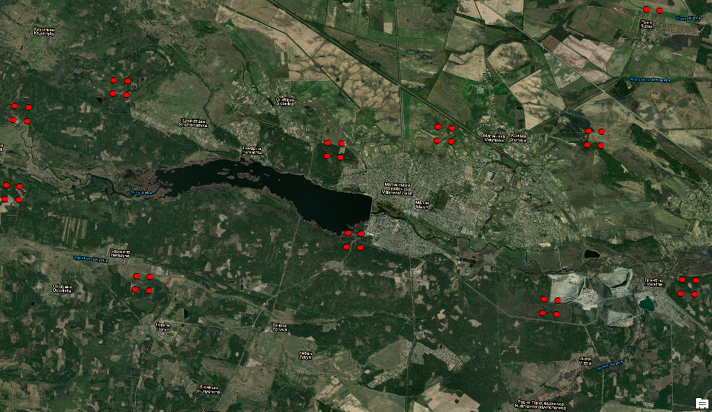
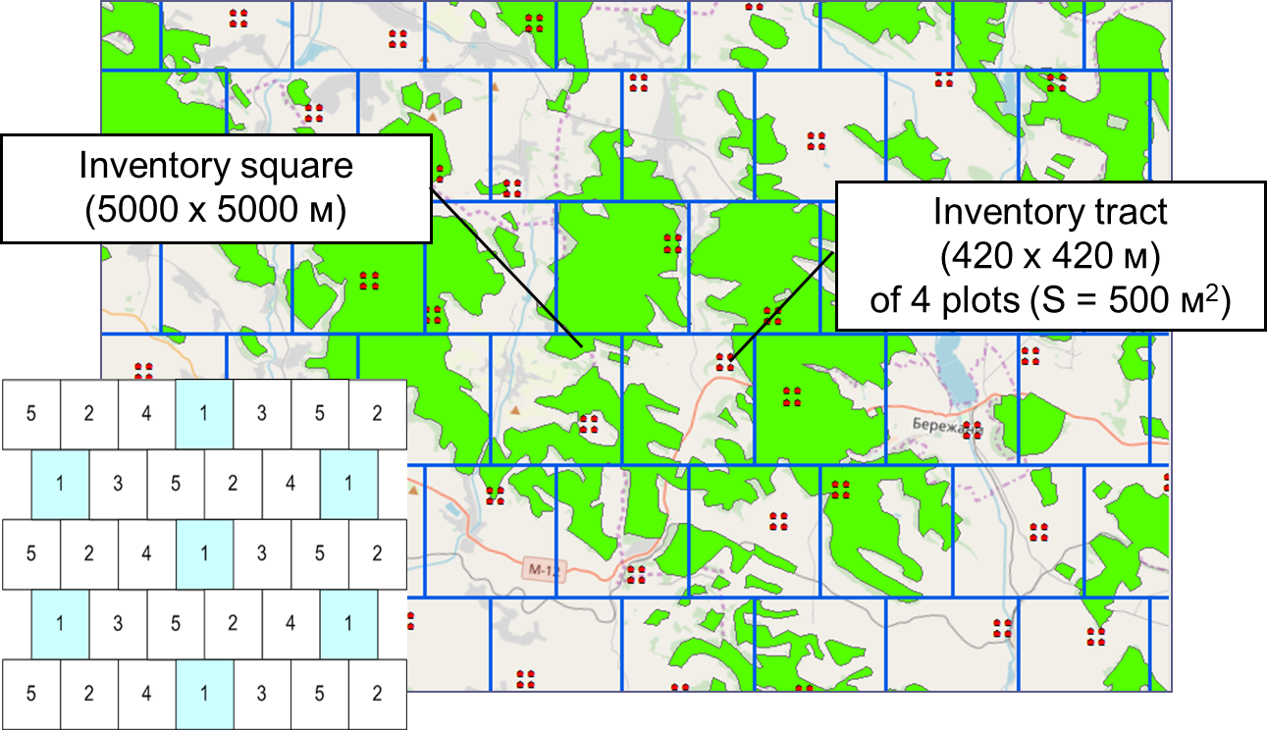
NFI grid (5*5 km)
Total number of plots in the grid - 96,6 thousand
out of which about 20 thousand plots in forests
out of which 4163 plots surveyed in field during 2021-2023
Notes:
Storozhuk
Стислий огляд що ж таке NFI як вибірково-статистичне обстеження?
Це маска лісів України в масштабі 1 до 10 млн.
На території країни, в мережі квадратів 5х5 км запроектовано близько 100 тис. інвентаризаційних ділянок, згрупованих у тракти (кластери) по 4 ділянки в кожному. В межах окремого квадрату розміщення інвентаризаційного тракту випадкове.
Щорічно планувалося обстежувати 1/5 частину ділянок. Дизайн вибірки передбачає, що набір ділянок окремого року формував свою регулярну мережу, і таким чином за результатами окремого року також можна було отримати оцінки показників для всіх лісів країни.

Slide 5
NFI obstacles during martial law
Financial constraints:
No baseline for annual planning or horizon for ending of field data collection
Instability of CNFI structure and staff
Lack of equipment and vehicles
Inaccessible sample plots:
Inaccessible territories relatively sample plots
Increased fieldwork costs without prior acquisition of local information
Require complex statistical methods to estimate missing observations
Notes:
Storozhuk

Slide 6
Stage 4: Specifics of RS-Inventory 2023
Information from all NFI forest inventory plots surveyed during 2021-2023 was processed according to a specially developed methodology and provided for use as reference data for remote sensing inventory
Compared to the NFI, the number of indicators of the RS-Inventory is limited, but has a national dimension and map representation
Remote sensing inventory uses biophysical definition of forest
Notes:
Storozhuk

Slide 7
Етап 4: Requirements for RS-Inventory
Further implementation of RS-Inventory requires the development of methodological and technological foundations of NFI with respect to:
Design of the network of plots, as well as optimization of their shape and size
Optimization of the number of collected indicators
Application of new statistical methods for assessing indicators
Notes:
Разом з тим, в процесі впровадження ДЗЗ-інвентаризації стали зрозумілі потреби розвитку методичних та технологічних засад НІЛ, щодо
«Проектування мережі ділянок, а також оптимізація їх форми та розміру» – застосування адаптивного дизайну вибірки, при якому на основі відомої інформації проектується збір меншої кількості ділянок, з отриманням максимально можливого доповнення до існуючої інформації
а також оптимізація форми та розміру інвентаризаційних ділянок – потрібно більше обмірів дерев, для наступного точнішого калібрування космічних знімків
Зміна методичних та технологічних підходів потребуватиме відповідного регулювання у законодавстві.

Slide 8
EU- Proposal for a Regulation on a monitoring framework for resilient European forests
Geographically explicit identification system for forest units
Data collected by the European Commission through standardisation using Copernicus
Forest monitoring framework
Forest data collection framework
Data collected by the Member States
based largely on NFIs, to be harmonised
Forest data sharing framework
Additional forest data
Methodologies to be developed through IA
Forest Information System for Europe
Notes:
Storozhuk

Slide 9
EU- Proposal for a Regulation on a monitoring framework for resilient European forests
Variables | Spatial resolution | Frequency
Forest Area | 10 m or finer | at least annual
Tree Cover Density | 10 m or finer | at least annual
Forest Type | 10 m or finer | at least 3 years
Forest Connectivity | 10 m or finer | at least annual
Defoliation | 300 m or finer | at least every two weeks
Forest Fires:
Fire events | 375 m or finer | at least once per week
Burnt forest areas | 20 m or finer | at least once per week
Fire severity | 20 m or finer | every two weeks
Post-fire soil erosion | 1 km² or finer | very two weeks
Post-fire event recovery | 20 m or finer | at least annual
Wildfire Risk Assessment:
Dead fuel moisture content | 8 km or finer | yearly data from accumulated daily values
Live fuel moisture content | 500 m or finer | at least monthly
Fuel type map | 100 m or finer | at least every 2 years
Tree Cover Disturbances | 10m or finer | at least annual
The list of forest data to be standardised using Copernicus provided for in the draft Regulation identifies opportunities for further development of remote sensing inventory, in particular, to expand the number of indicators and use satellite images of different spatial resolutions.
Notes:
Storozhuk

Slide 10
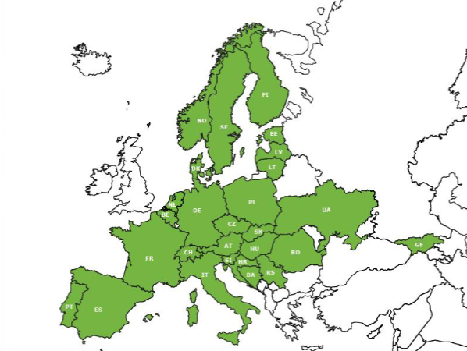
European National Forest Inventory Network - ENFIN
ENFIN Memberships
Ukraine became a member of ENFIN in 2023, benefitting now from international experiences in National Forest Inventories
ENFIN can assist in cost-efficient methodology to combine terrestrial data and satellite images for NFI purposes
Notes:
Storozhuk

Slide 11
Conclusions
RS-Inventory approaches need to a substantive element of NFI in Ukraine during coming years, details are to be reviewed in a “Concept on further developments of NFI in Ukraine”
Essential requirements
Legal regulations on NFI (as less as possible, as much as necessary!)
Human capacities
Financial resources
Institutional integration of NFI into state administration
There is a risk of missing the EU- Integration in the area of NFI!
Notes:
Storozhuk

