Slide 1





Introduction to Open Foris Arena
Innovative monitoring tools from FAO Forestry Division
Lauri Vesa, Ramiro Blazquez Gonzalez,
Stefano Ricci, Falgoonee Kumar
5 June 2024

Slide 2



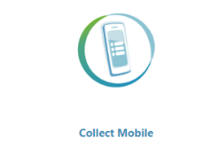





FAO Open Foris Initiative
http://openforis.org/
Free and open software for environmental monitoring
Easy and flexible survey
design and data management
Online platform for data management,
utilization and processing
Data collection app
with Collect (Android)
Data collection app with
Arena (Android and iOS)
Map-first data
collection
mobile application
High resolution satellite
image viewing and interpretation
systems
System for earth observation
data access, processing,
analysis for land monitoring
Google Earth Engine
without coding
Notes:
Open Foris is a set of free and open-source software tools that facilitates flexible and efficient data collection, analysis and reporting.

Slide 3
Key principles
FAO-led initiative, launched in 2011
Free and open source: approx. 35,000 downloads since 2016;
source codes are available in GitHub.
Software development: new and improved versions of the tools are released periodically.
Collaboration: FAO Hand-in-Hand Initiative; private and public partners
(e.g. Google, NASA-Servir); academic institutions; projects.
Country testing: OF tools have been used in more than 180 countries.
Capacity building: training sessions on all OF tools in all regions of the world.
Notes:
Hand-in-Hand is FAO’s evidence-based, country-led and country-owned initiative to accelerate agricultural transformation and sustainable rural development to eradicate poverty (SDG 1) and end hunger and all forms of malnutrition (SDG2). In doing so, it contributes to attaining all of the Sustainable Development Goals. The initiative prioritizes countries where national capacities and international support are the most limited or where operational challenges, including natural- or man-made crises, are the greatest.

Slide 4



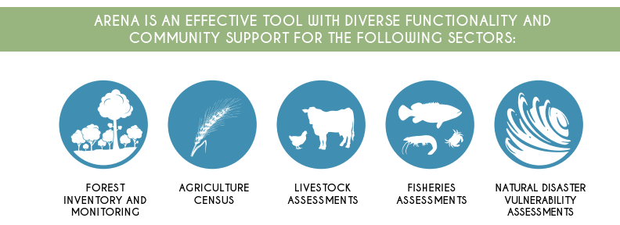



Arena
Online platform for survey design, data management, utilization and processing

Slide 5
Advantages of using Arena
Using Arena is beneficial because the tool:
• allows users to quickly set up and start data entry,
• guarantees data quality assurance with validation rules,
• provides access to very high-resolution satellite images,
• features integrated computing with R and Rstudio,
• it is online database management tool, and it relies on secure hosting by
Amazon Web Services,
• accepts multilingual data entry forms,
• manages multicycle data,
• does not require local installation to access or use.

Slide 6
Main features of data entry
Real-time data validation:
  Data type checks,
  Possibility to add data validation rules.
Code lists can be applied
Species lists
System concurrency: same record can be edited by several users
Activity log history: keep track of changes to data

Slide 7
Form designer for making surveys
The main features are the following:
WYSIWYG: What You See Is What You Get
Drag & drop form elements
Several attribute data types:
  Text, numeric, boolean, coordinate, taxon, file, coded, etc.
Fully customizable:
  Validation rules (e.g. tree_height > 1.3, bole_height < tree_height)
  Visibility rules (e.g. stem_form gets visible if tree_status == ‘alive’ )
  Default values / calculated values
Expression builder

Slide 8
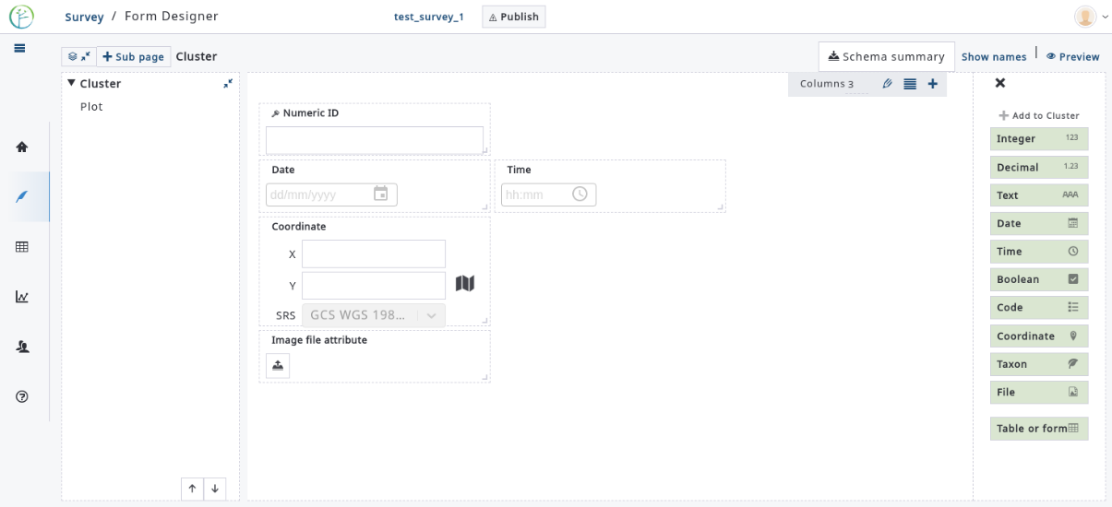
Form designer

Slide 9
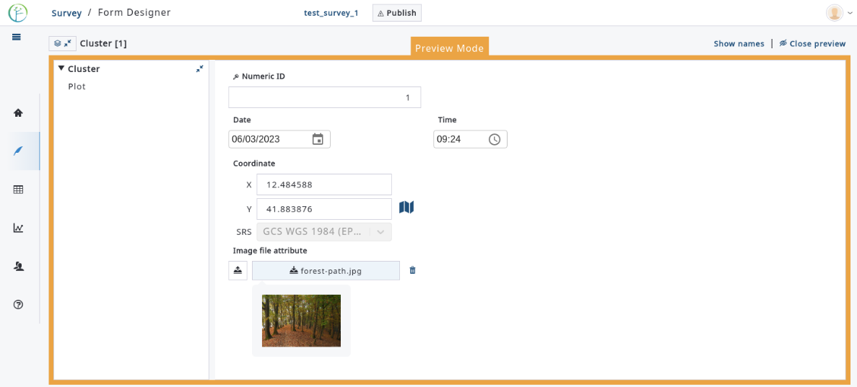
Form designer in preview mode

Slide 10
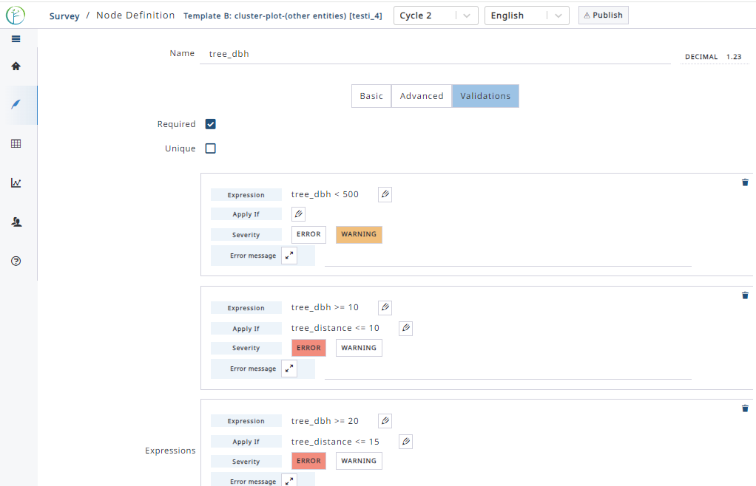
Attribute with validation rules

Slide 11
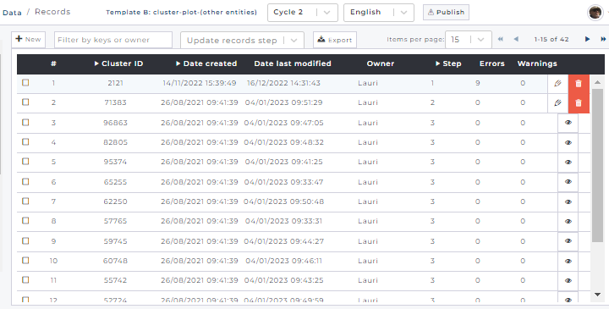
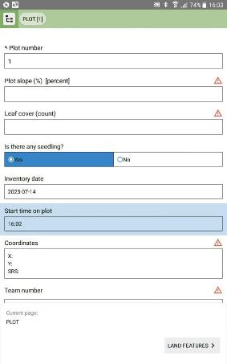
Data entry – multiple options
1) Manually on the screen
2) with Mobile app
3) Import data: CSV / Collect / Arena

Slide 12
Data Explorer
Easy query tool to the stored data. You can have a view on
  Raw data,
  Processed data (computed with R),
  Aggregated data (sum, average, count, etc.),
  Charts (bar and pie charts, scatter plot).
In addition, you can filter and sort data, and
Export generated tables to CSV.

Slide 13
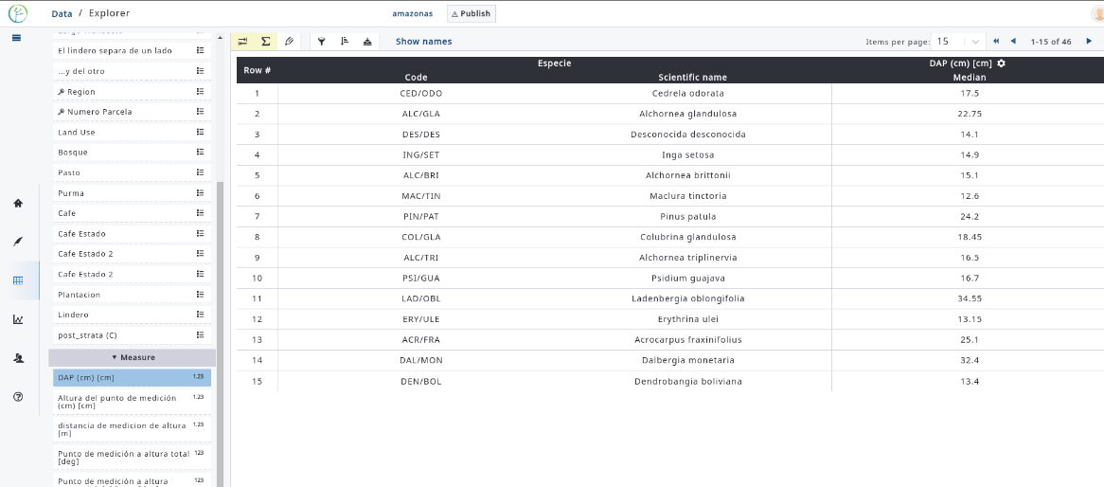
Data Explorer with aggregated data

Slide 14
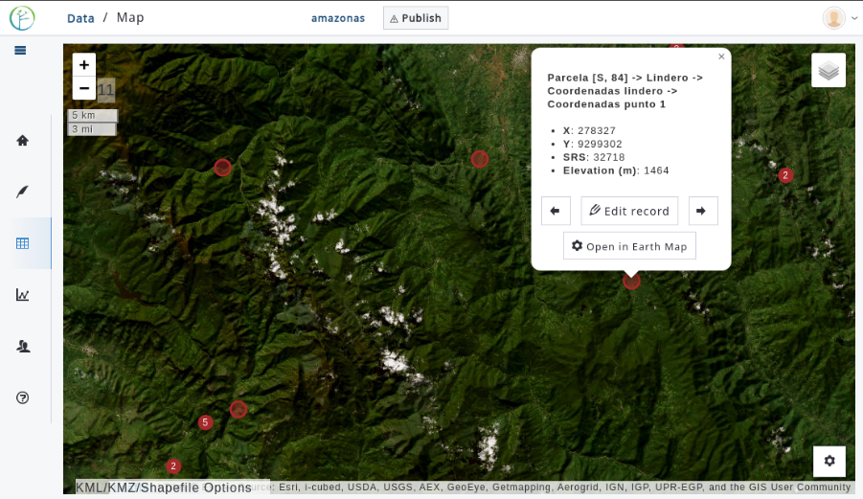
View data on map
On the map view, we can
open different map and satellite image layers,
view and edit data,
do visual assessments,
verify collected data,
make queries to Google
Earth Engine data via Earth Map tool.

Slide 15
Analytical tools
Define a calculation chain to compute new result attributes, such as stem volume or biomass.
Mean estimates (per hectare) can be computed for result attributes.
On sampling-based assessment, you can specify options such as:
  Areas (= area of interest),
  Clustered/ Non-clustered sampling,
  Stratified/Non-stratified sampling,
  non-response bias correction.
Calculations are run with R in RStudio

Slide 16
How to access Arena?
Request access to enter as a Survey Manager into Arena at
https://www.openforis-arena.org
  Then you can create and manage up to 5 surveys,
  After setting up a survey, you can invite new users to your survey.
Different roles of invited users are as follows:
    Data editor,
    Data cleanser,
    Data analyst,
    Survey administrator.
  Users can access only those surveys to which they are invited.

Slide 17

Thank you!

