Slide 1
National Forest Inventory in Austria with special regard to segmented plots
Alexandra Freudenschuß, Ambros Berger, Thomas Gschwantner
Department of Forest Inventory
SFI Meeting via Zoom
18 September 2024

Slide 2
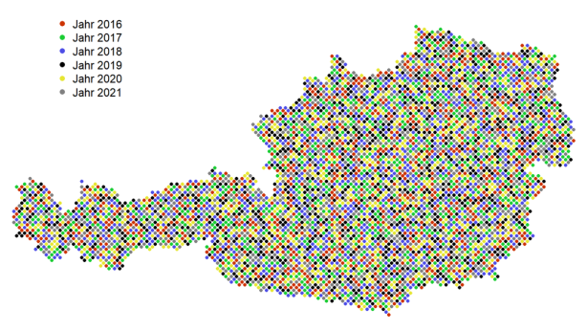
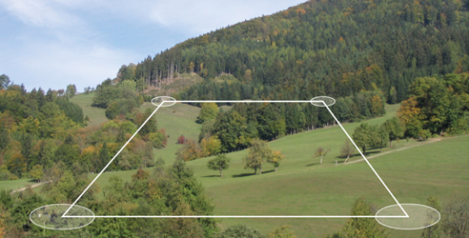
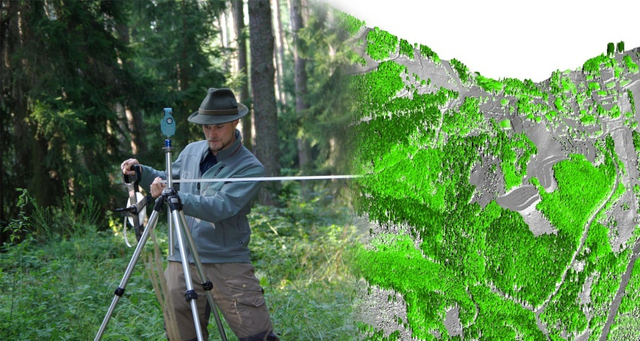
The Austrian NFI - overview
Eight NFI complete cycles:
1961-70, 1971-1980, 1981-85, 1986-1990, 1992-96, 2000-02, 2007-09, 2016-21, 2022-
Continuous system since 2016
1/6 of plots inventoried each year, i.e. field plots visited 6-year intervall

Slide 3
The Austrian NFI - overview
5,500 square-shaped clusters and 22,000 permanent plots
~50 % of plots on forest land
Increasing integration of remote sensing methods
Segmented plots

Slide 4
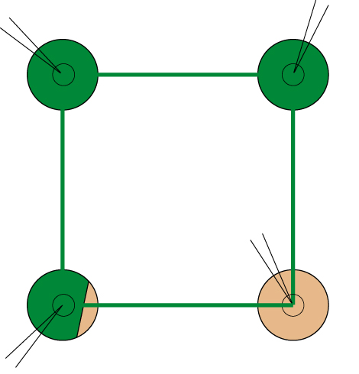
Sampling methods
200 m
Forest plot
Non-forest plot
Segmented plot
Angle count sampling: BAF = 4, sample trees with dbh > 10.4 cm
Fixed area plot: r = 9.77 m, a = 300 m²
Fixed area plot: r = 2.60 m, sample trees with 5.0 ≤ dbh ≤ 10.4 cm

Slide 5
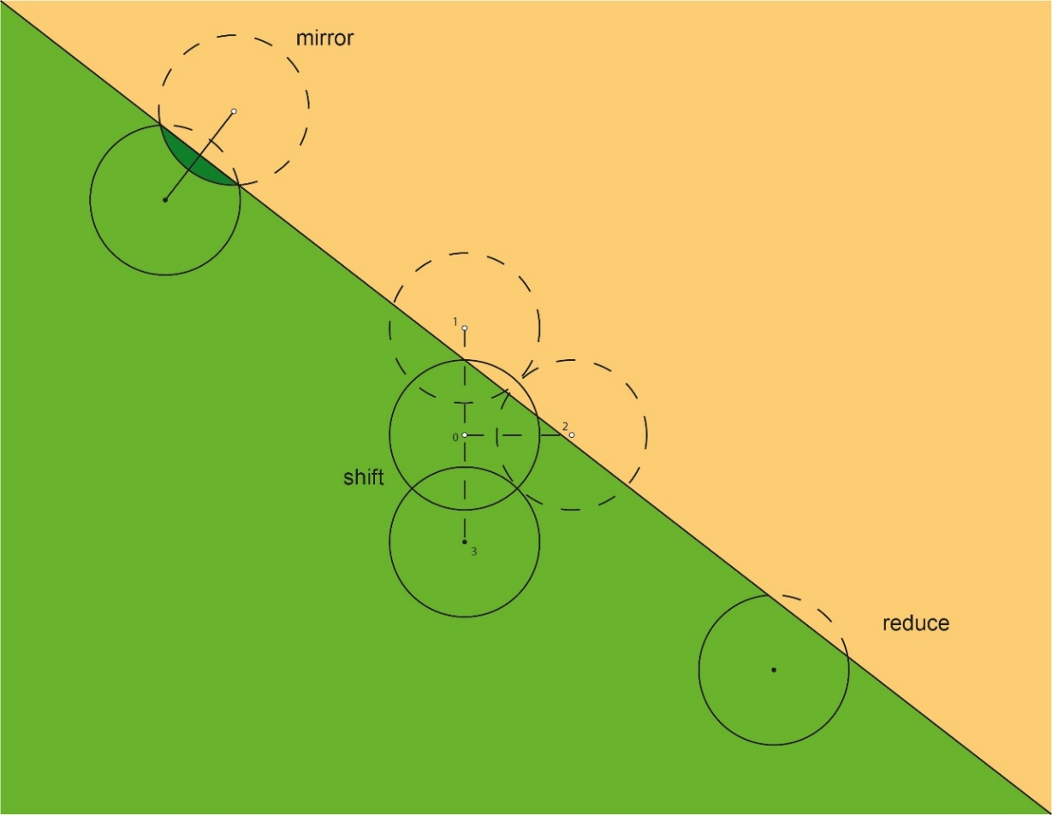
Border situations - approaches

Slide 6

Border situation – Austrian NFI
consider all segments on forest land

Slide 7
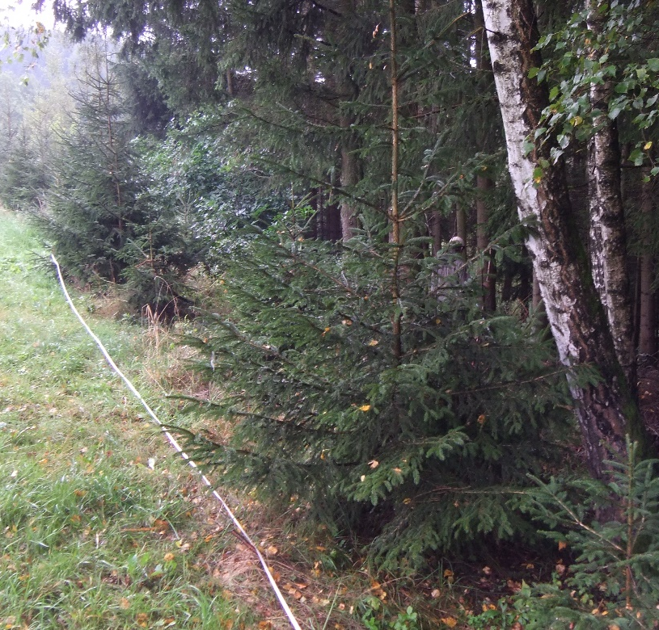
Reasons for segmentation
Travel costs have a high share on total costs (approx. 50%)
Efficient approach to achieve representativity and to reduce statistic noise
Allows a more detailed description of border situations and capture of forest conditions
Good experience and done since 1st NFI
Applied for ARD-assessment for GHG-Reporting (afforested and deforested 1/10 shares)

Slide 8
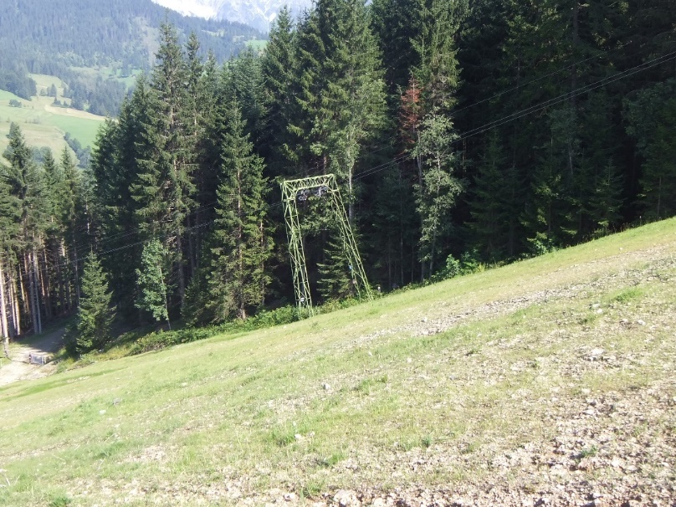
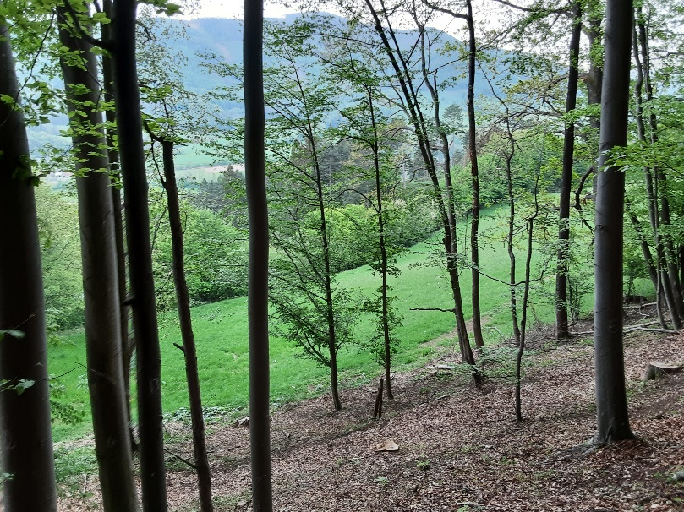
Basic types of segmented plots
  Forest / non-forest border
Skiing slope
Grassland

Slide 9
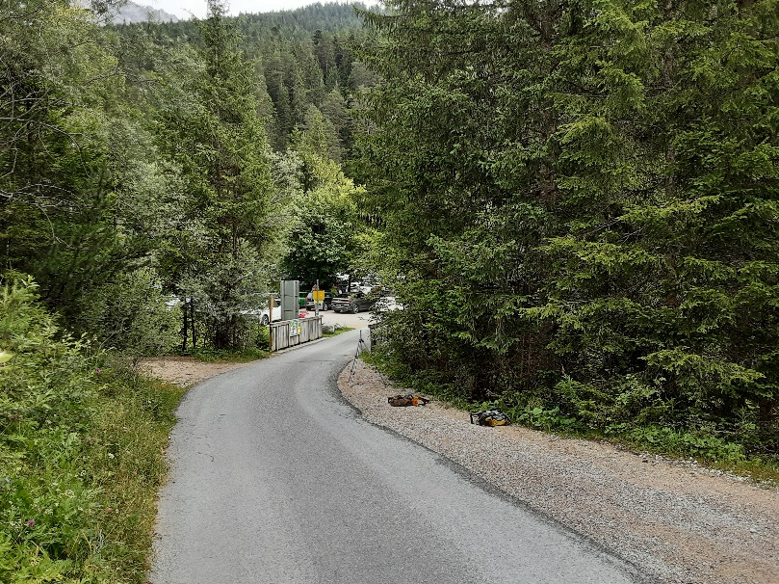
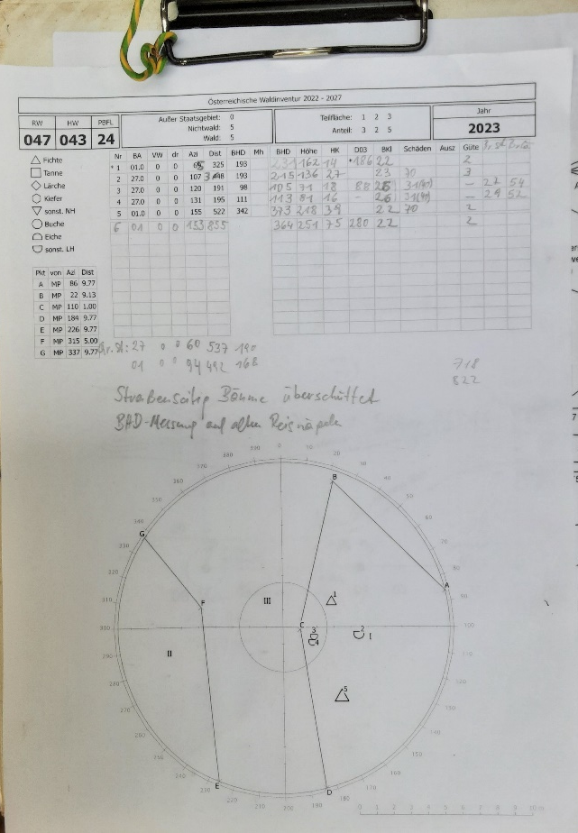
Basic types of segmented plots
  Forest / non-forest border
Public road
Plot sketch

Slide 10
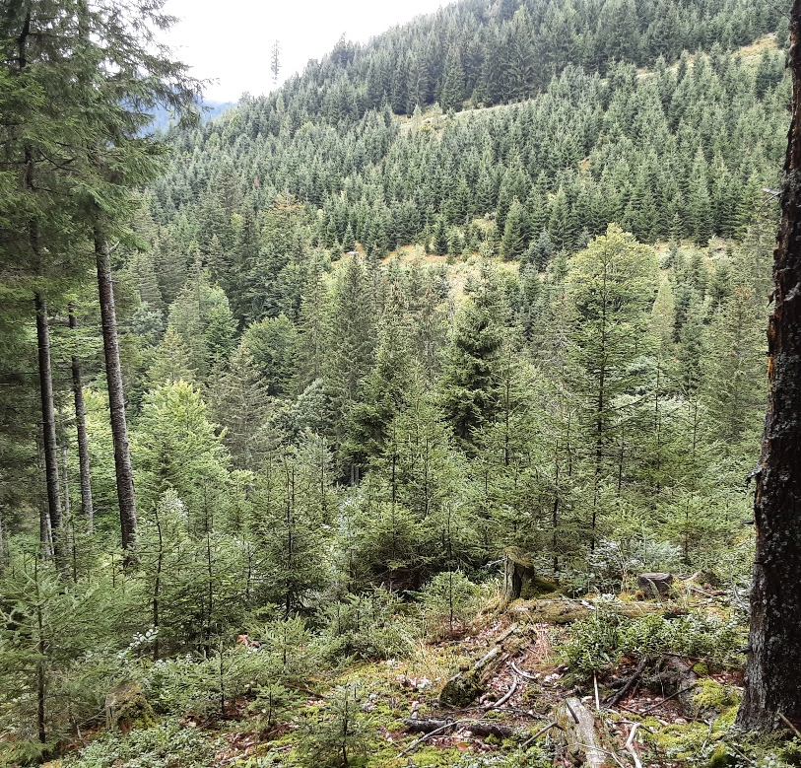
Basic types of segmented plots
Borders between forest categories
Administrative regions
Ownership categories (small private < 200 ha, enterprises 200-1000 ha, enterprises > 1000 ha, federal state forests, regional authorities)
Management categories (e.g. production forest, protective forest, coppice)
Stand features (growth classes, age-classes, tree species, …)
Age-class

Slide 11
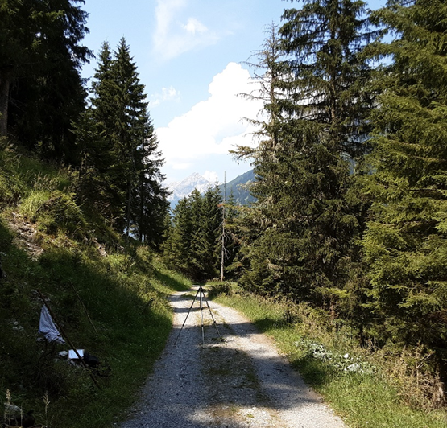
Basic types of segmented plots
Borders between forest categories
Administrative regions
Ownership categories (small private < 200 ha, enterprises 200-1000 ha, enterprises > 1000 ha, federal state forests, regional authorities)
Management categories (e.g. production forest, protective forest, coppice)
Stand features (growth classes, age-classes, tree species, …)
Forest road

Slide 12
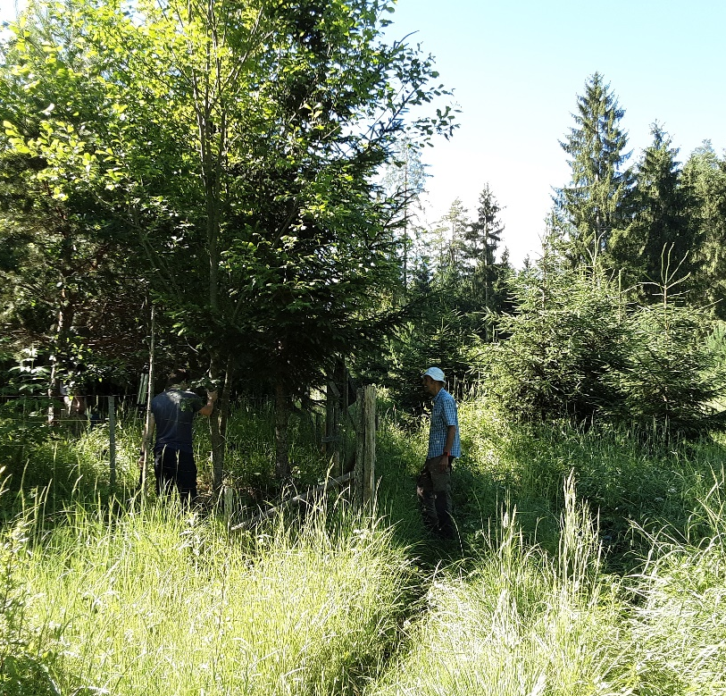
Basic types of segmented plots
Borders between forest categories
Administrative regions
Ownership categories (small private < 200 ha, enterprises 200-1000 ha, enterprises > 1000 ha, federal state forests, regional authorities)
Management categories (e.g. production forest, protective forest, coppice)
Stand features (growth classes, age-classes, tree species, …)
Tree species, growth-class

Slide 13
Overview on plot numbers
Total number of plots | 22,239
Non-Forest plots | 10,961
Forest plots | 11,278 | 100%
Segmentation Forest/Non-Forest | 1,306 | 12%
Segmentation at country border | 1 | 0%
Full forest plots (10/10 forest) | 9,971 | 88%
Not segmented (10/10 forest) | 7,801 | 69%
Segmented (10/10 forest) | 2,170 | 19%
~30% of forest plots are segmented

Slide 14
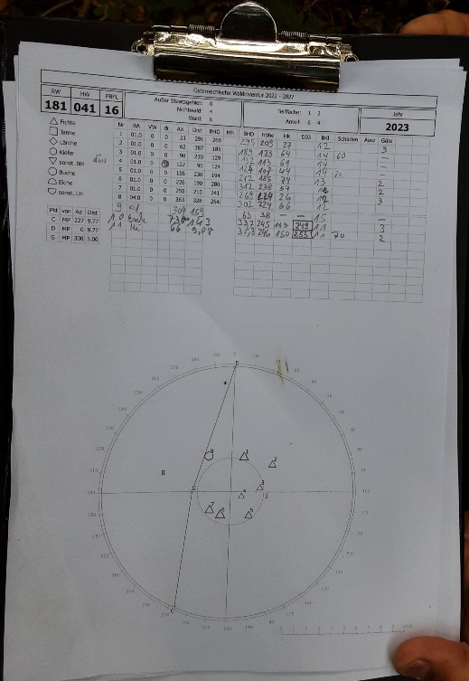
How is the segmentation done in the field
Borderline definition: field instructions
Determination of the borderline:
forest/non-forest: - border of agricultural treatment
- pasture fence
- boundary forest ground vegetation
- specific cases and expert assessment
within the forest: - administrative borders
- ownership borders
- forest management
(compartments, forest roads, …)
- stand border
Measure and draw the borderline on plot sketch
Size of segments: assessed in 1/10 shares
Segments per plot: up to four

Slide 15
Consequences of segmentation
Field work: Assessments and measurements on plot segments
Data base: Table record for each individual plot segment
Calculation of estimates: formulae for per-ha values, totals, standard errors
Data use for modelling: forest growth, remote sensing models, scientific studies

Slide 16
Assessments on segments
General information:
  Administrative regions, growth region, management type, ownership
Stand-related variables:
General: growth classes, age-classes, tree species in age-classes
Forest structure: canopy closure, vertical stand structure, development stage, coverage of shrubs, actual woodland community, natural woodland community …
Stand stability: damage, required tending, factors that influence game
Regeneration: necessity, occurrence, further specific assessments
Site-related variables:
  Exposition, slope, relief category, vegetation type, soil type, soil moisture, soil depth, humus type, humic layer thickness …

Slide 17
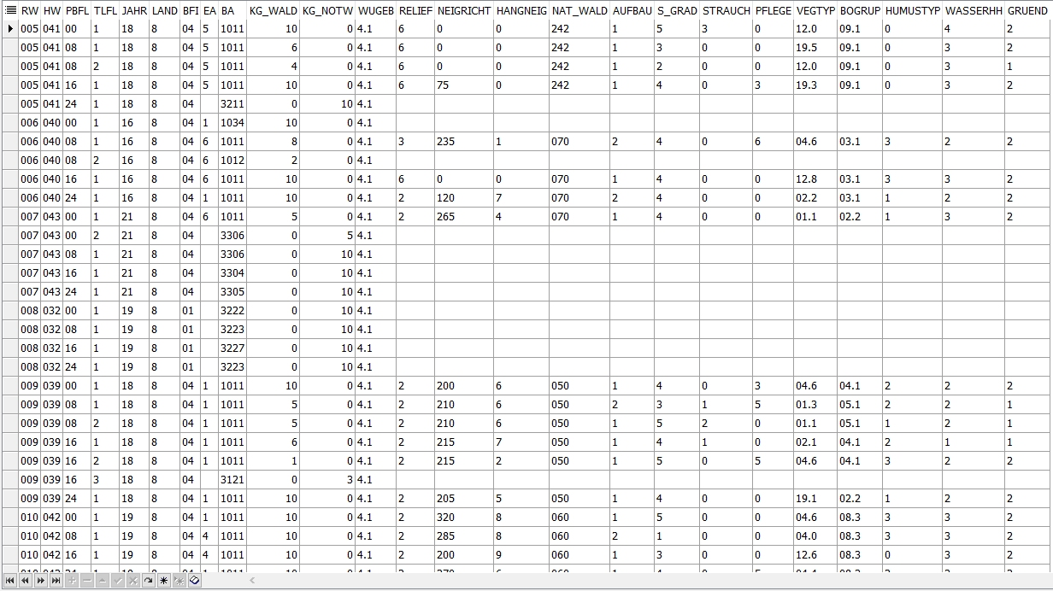
Data base: table records
age-, growth-class
forest stand / forest road
forest / non-forest
age-class, tree species
forest / non-forest,
tree species composition

Slide 18
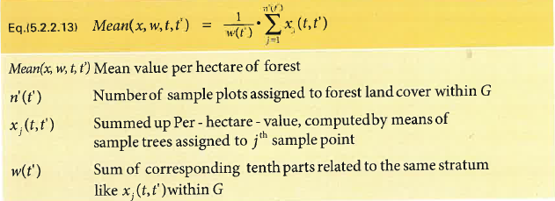
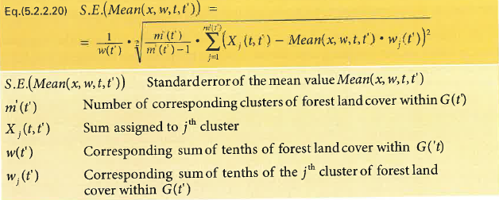
Estimates: mean per ha forest, standard error
Growing stock
Increment
Harvest
Stem numbers

Slide 19
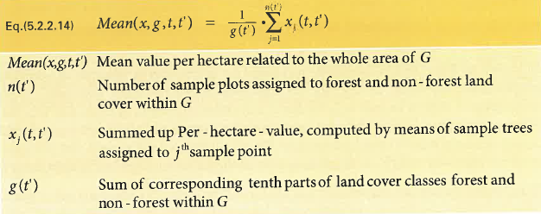
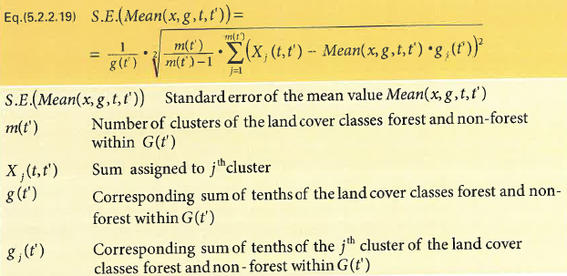
Estimates: mean per ha, total, standard error
Gabler K., Schadauer K., 2008: Methods of the Austrian Forest Inventory 2000/02. BFW Berichte 142, 121 p.

Slide 20
Data use for modelling
Model parameterisation:
Forest growth simulators:
Model components for tree growth, ingrowth, harvest, mortality
Remote sensing:
Models for mapping
Scientific studies using NFI data:
Multivariate data analyses
Explanatory variables assessed at segments
Decision how to deal with plot segments in parameterisation data
Depends on model purpose and application
Minimum size of segments (e.g. ≥ 7/10 forest)
Skip segmented plots
Larger segment representing the plot

Slide 21
Sampling at successive occasions
t1 t2
Changes of plot segmentation
Size, location, shape
Change estimation
Increment
Harvest
Estimation approaches
Initial-value method: time reference = t1
Final-value method: time reference = t2
Growth components
Survivor trees
Ingrowth, on-growth, non-growth trees
Cut, mortality trees

Slide 22
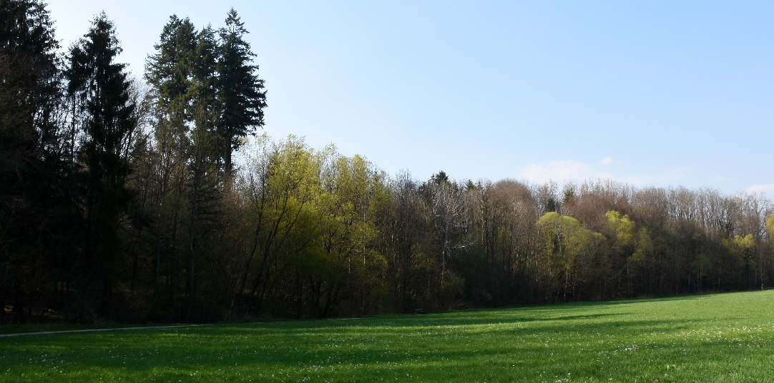
Thank you!

