Slide 1
Overview on NFI/RS-Inventory approaches in Ukraine - achievements and challenges
Andrii Shamrai,
Head of Center of National Forest Inventory of Ukrainian State Forest Management Planning Association «Ukrderzhlisproject»
Experiences in implementing the second National Forest Inventories in Kyrgyzstan
17.05.2024 Bishkek/ Berlin / Kyiv /
Notes:
Shamrai
Introducing

Slide 2
Regulatory Framework of the NFI Ukraine
LAW OF UKRAINE "On Amendments to the Forest Code of Ukraine on Conducting a National Forest Inventory" of 02.06.2020 No. 643-IX
RESOLUTION of the Cabinet of Ministers of Ukraine "On Approval of the Order for Conducting a National Forest Inventory and Amendments to the Annex to the Regulation on Data Sets to be Disclosed in the Form of Open Data" of 21 April 2021 No. 392
RESOLUTION of the Cabinet of Ministers of Ukraine "On Amendments to the Order for the Use of Funds Provided in the State Budget for Financing Measures for Forestry and Hunting, Protection and Conservation of Forests in the Forest Fund, Creation of Protective Forest Plantations and Shelterbelts" of 9 June 2021 No. 602
RESOLUTION of the Cabinet of Ministers of Ukraine "Some issues of conducting a National Forest Inventory during martial law" of 25 April 2023, No. 388
Notes:
Shamrai
On the screen, you see a list of important legislative documents and resolutions that regulate the process of national forest inventory in Ukraine. The National Forest Inventory, established in Ukrainian legislation in 2020, operates as a system of selective-statistical surveys of Ukraine's forest resources. It replaces the previous state forest inventory, which relied on data from forest management plans. The last state forest inventory in Ukraine was conducted in 2011. In 2021, the Cabinet of Ministers of Ukraine approved the Procedure for conducting the national forest inventory, marking the beginning of its first cycle. Due to Russia's military aggression, conditions for the inventory significantly changed, necessitating legislative adjustments. In early 2023, the government decided that the national forest inventory would continue even during periods of martial law, focusing on accessible and safe areas. Essentially, given possible budget constraints, this means that the national forest inventory will temporarily take the form of regional inventories. The national forest inventory follows rules set by laws and government decisions. These rules outline how the inventory is done, what methods are used, and how it's funded. They also cover things like making the data available to everyone in a format that's easy to access, and what happens during times of war or emergency.

Slide 3
NFI developments in Ukraine
Stage 1: Regional Forest Inventory (2007-2015): based on NFI methodology in two administrative Oblasts of Ukraine covering an area of about 1 million hectares
Stage 2: Legal, financial and institutional requirements (2020-2021)
Law “On amendments to the Forest Code of Ukraine” (2020)
CMU Resolution “On approval of the Procedure for NFI Conducting” (2021)
Stage 3: First circle of terrestrial NFI started (since 2021)
Stage 4: Impact by the war since February 2022
CMU Regulation “Some issues of conducting NFI during martial law” (2023)
Remote sensing-based forest inventory (RS-Inventory, 2023-2024)
NFI web-site: https://nfi.lisproekt.gov.ua/
Notes:
Storozhuk

Slide 4
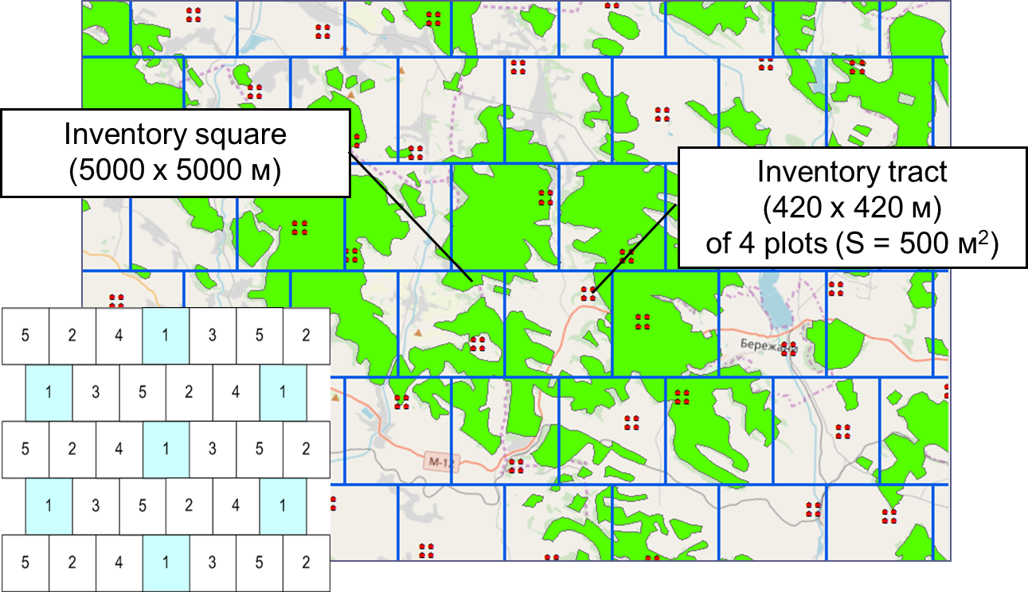
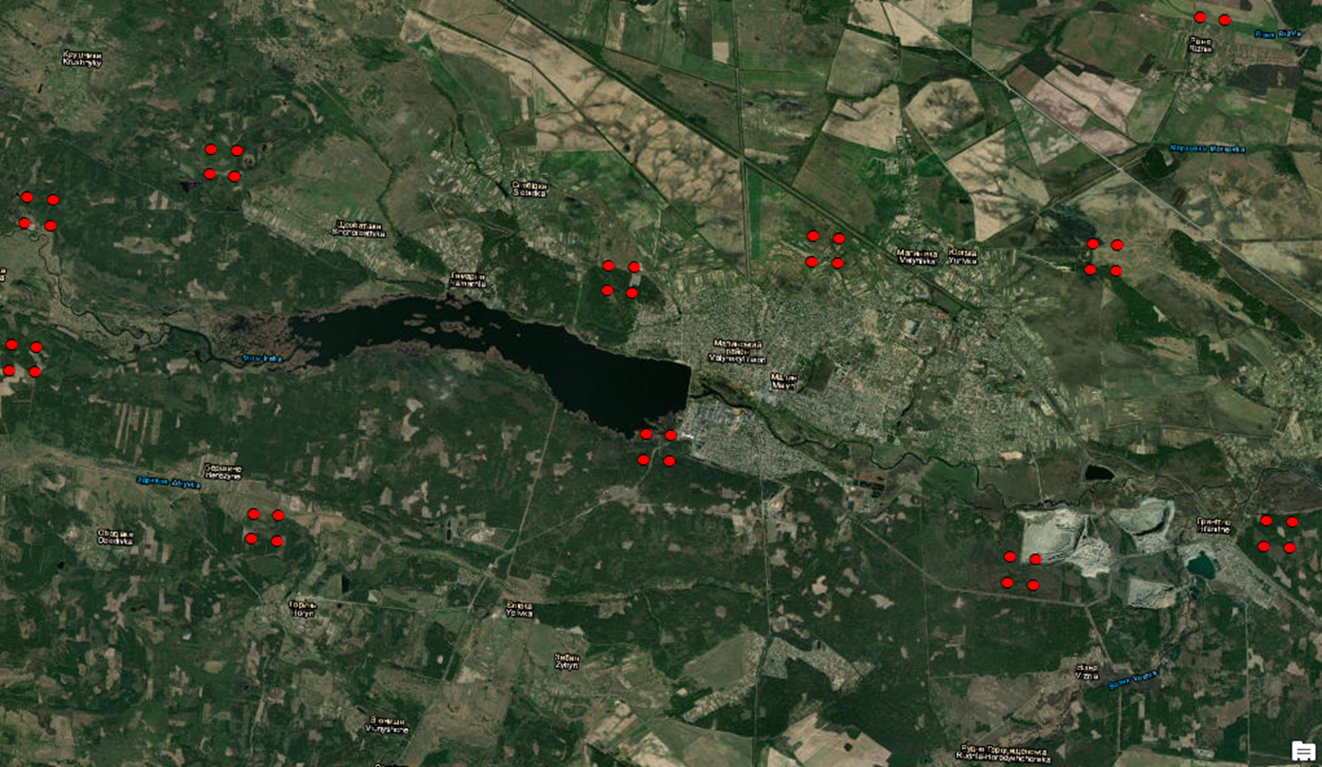
NFI grid (5*5 km)
Total number of plots in the grid - 96,6 thousand
out of which about 20 thousand plots in forests
out of which 4163 plots surveyed in field during 2021-2023
Notes:
Storozhuk
Стислий огляд що ж таке NFI як вибірково-статистичне обстеження?
Це маска лісів України в масштабі 1 до 10 млн.
На території країни, в мережі квадратів 5х5 км запроектовано близько 100 тис. інвентаризаційних ділянок, згрупованих у тракти (кластери) по 4 ділянки в кожному. В межах окремого квадрату розміщення інвентаризаційного тракту випадкове.
Щорічно планувалося обстежувати 1/5 частину ділянок. Дизайн вибірки передбачає, що набір ділянок окремого року формував свою регулярну мережу, і таким чином за результатами окремого року також можна було отримати оцінки показників для всіх лісів країни.

Slide 5
NFI obstacles during martial law
Financial constraints:
No baseline for annual planning or horizon for ending of field data collection
Instability of CNFI structure and staff
Lack of equipment and vehicles
Inaccessible sample plots:
Inaccessible territories relatively sample plots
Increased fieldwork costs without prior acquisition of local information
Require complex statistical methods to estimate missing observations
Notes:
Storozhuk

Slide 6
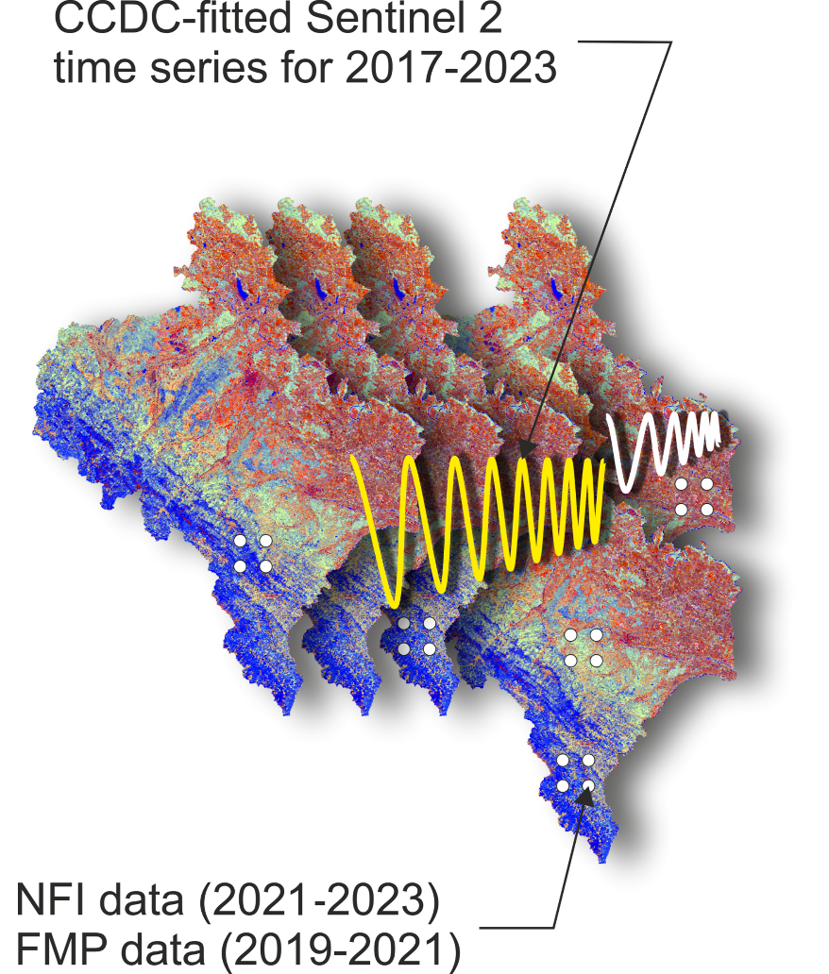
Objectives of the RS-Inventory 2023
Support for the national forest inventory reporting with limited resources
First spatially explicit assessment of forest resources in Ukraine
Mapping of forests regardless of their legal status
Improved capacity for continuous forest monitoring in Ukraine and decision making

Slide 7
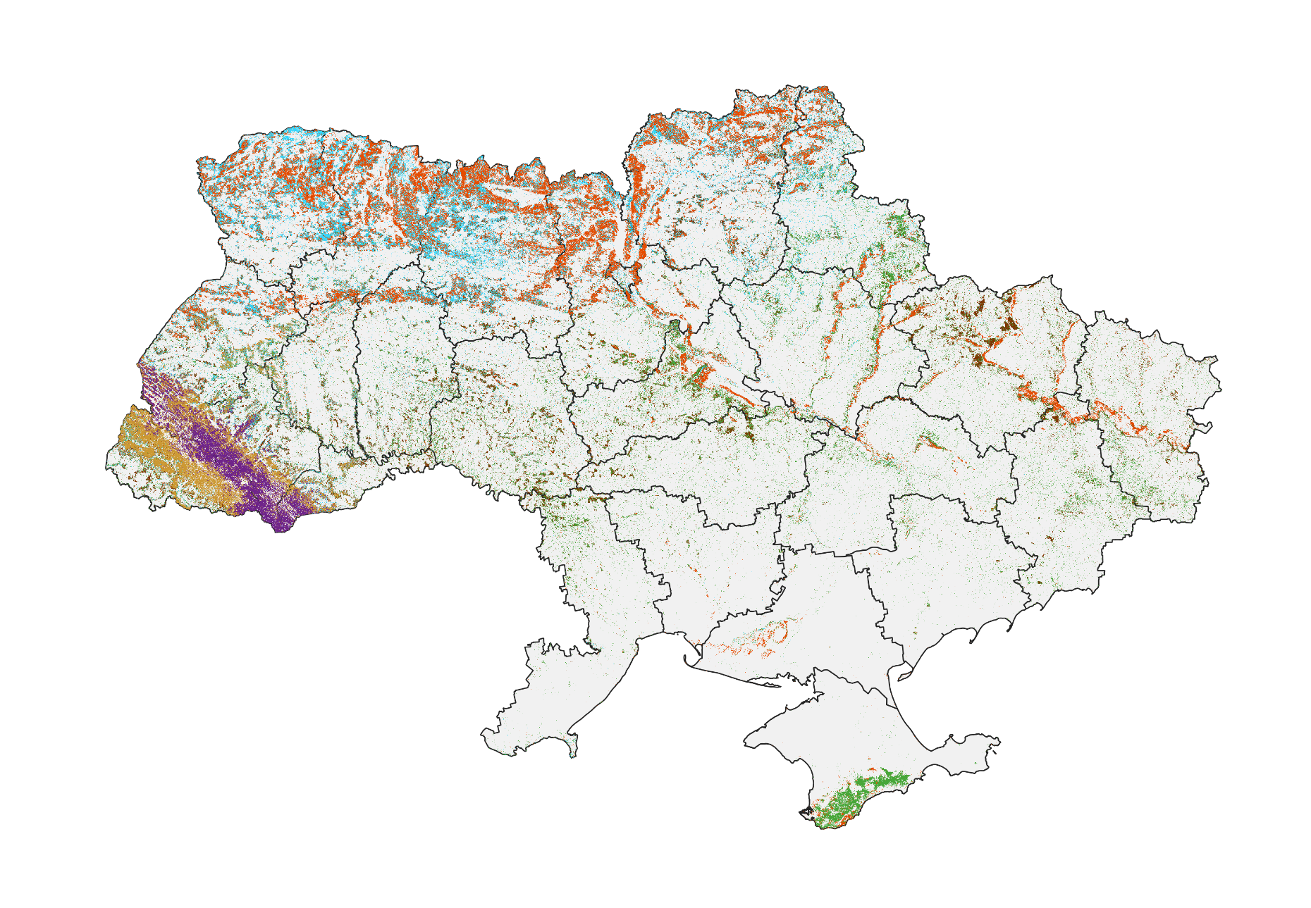
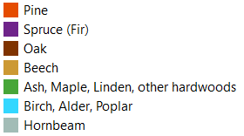
RS-Inventory: Forest area and Dominant species
Total forest area in 2023:
11,209 ± 166 thousand ha
Forest cover in 2023:
18.8 ± 0.3%
This study used the biophysical definition of forest as an area covered by woody vegetation with a predefined minimum canopy cover (>50%) observed at 20×20 m pixel level regardless of its legal status.

Slide 8
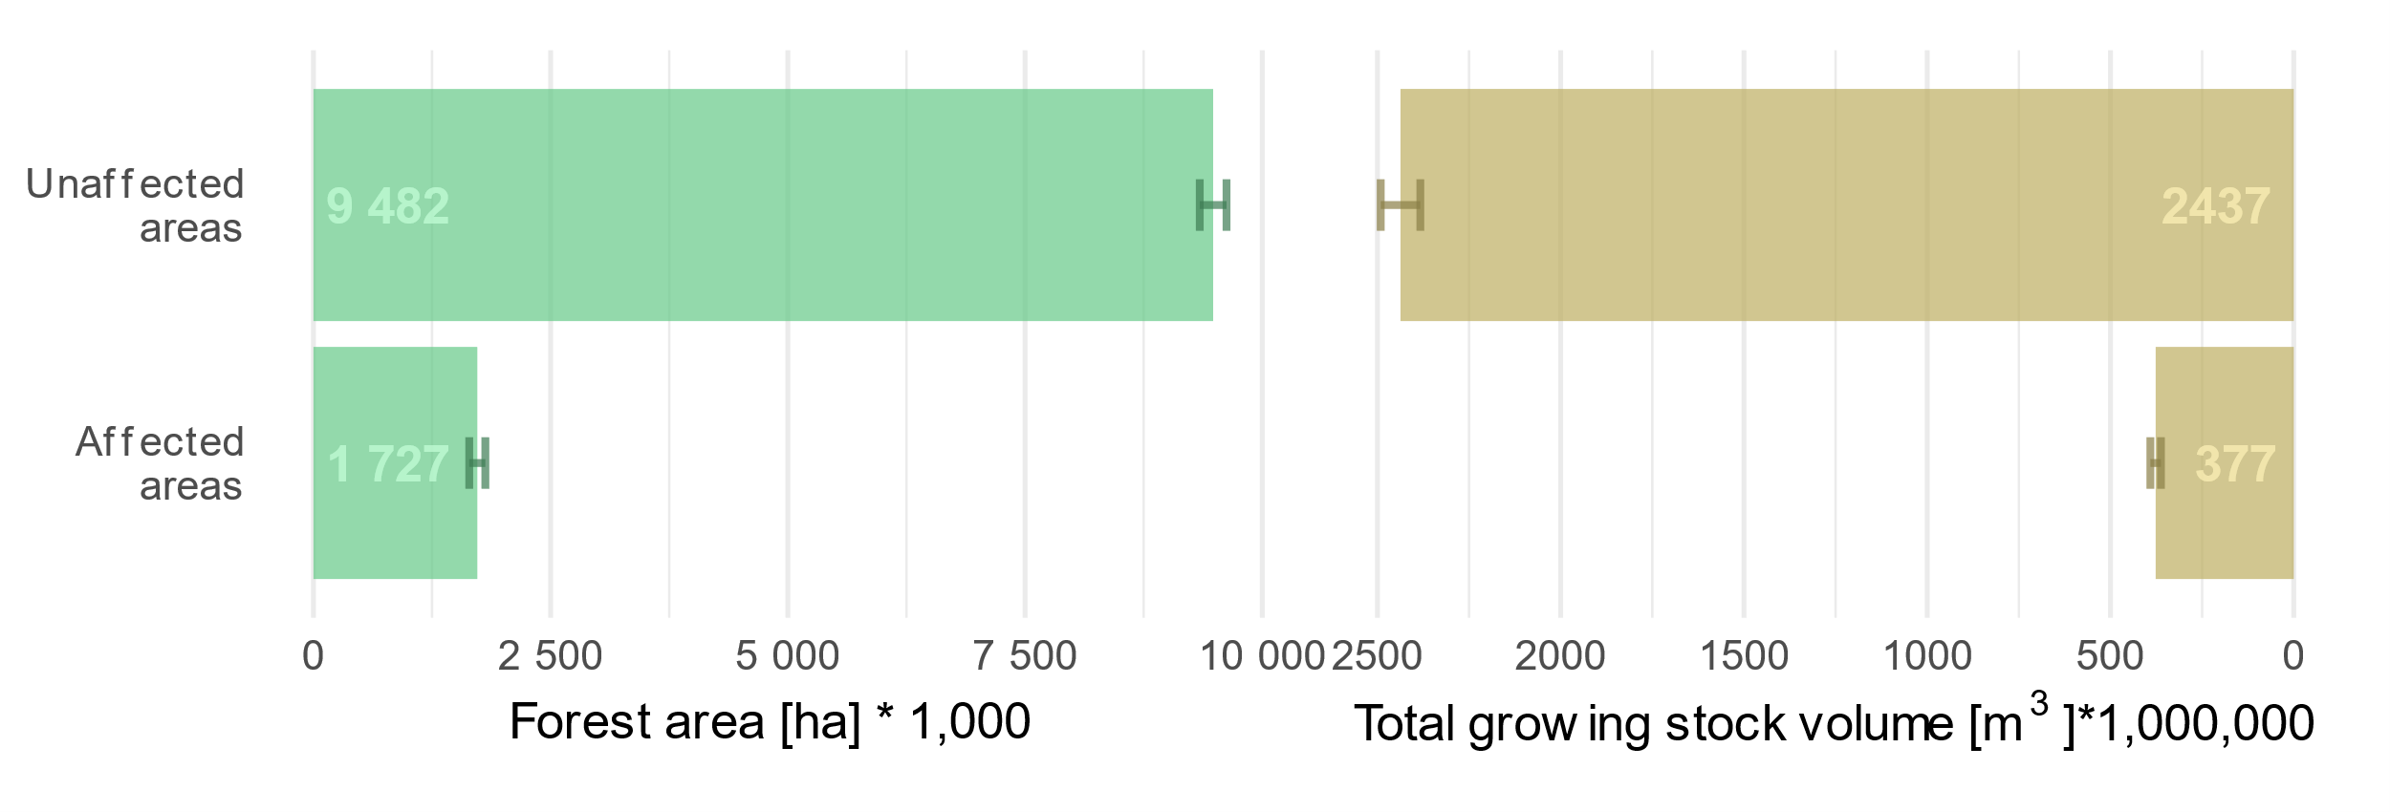
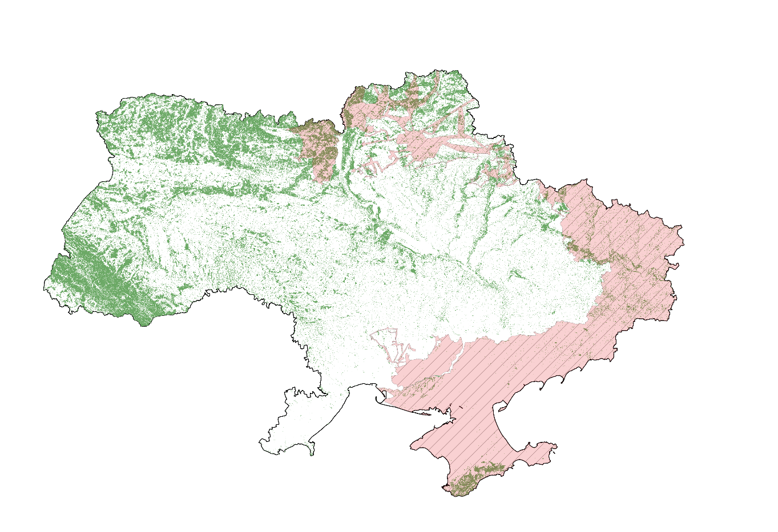
RS-Inventory: War-affected forests
Approximately 1.7 million ha, or about 15% of the total forest area in Ukraine, are within territories affected by the war

Slide 9
Prospects of using RS-Inventory
RS-Inventory provides reliable input data, scientifically based methodology and robust outputs on all Ukrainian forests
Using RS-Technologies on a regular base for the National Forest Inventory considering a slightly lower accuracy in comparison to saving money and time

Slide 10
The website of the Ukrainian NFI and RS-Inventory can be accessed via nfi.lisproekt.gov.ua/
Thank for your attention!

