Slide 1


RS-Inventory of Ukrainian forests:
Methodology and Major Outcomes
Viktor Myroniuk,
National University of Life and Environmental Sciences of Ukraine

Slide 2
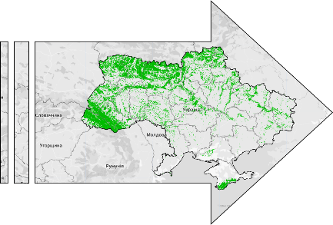
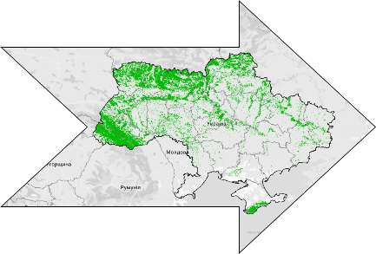
Objectives of the RS-Inventory
Support for the national forest inventory reporting with limited resources
First spatially explicit assessment of forest resources in Ukraine
Mapping of forests regardless of their legal status
Improved capacity for continuous forest monitoring in Ukraine and decision making
This study used the biophysical definition of forest as an area covered by woody vegetation with a predefined minimum canopy cover (>50%) observed at 20×20 m pixel level regardless of its legal status.
2023
2024
2025

Slide 3
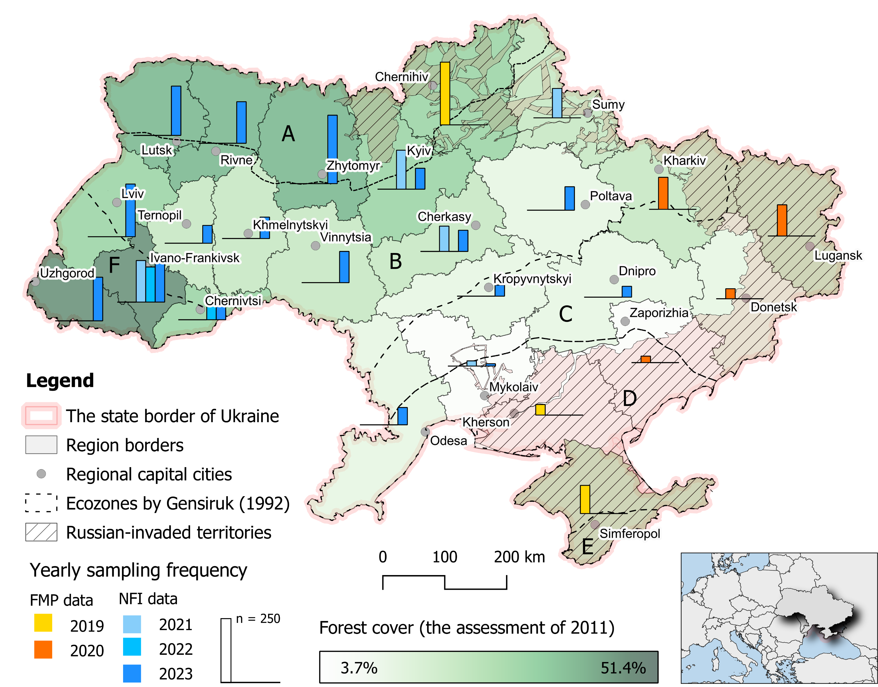
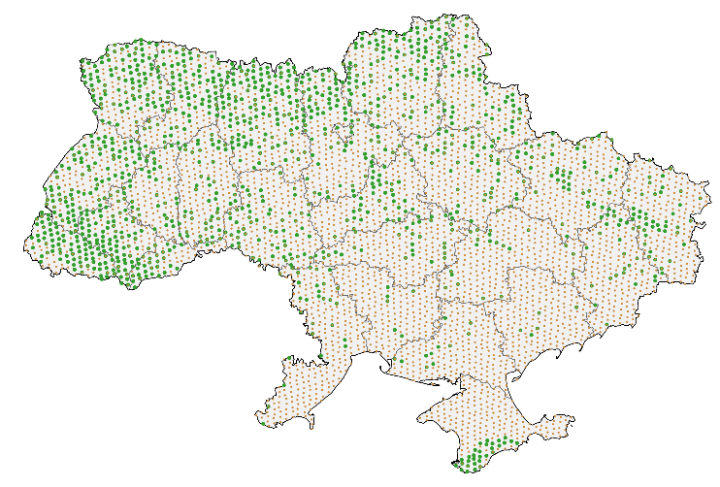
Methodology: Types of field data
NFI plots (4 000 surveyed in 2021-2023)
Collected across safe areas
Represent different years of field visits
More than 75% forested
FMP plots (retrospective data from 700 forest stands)
Occupied or unsafe territories
Expert interpretation of FMP attributes
Data collected in 2019-2021
Original NFI grid

Slide 4
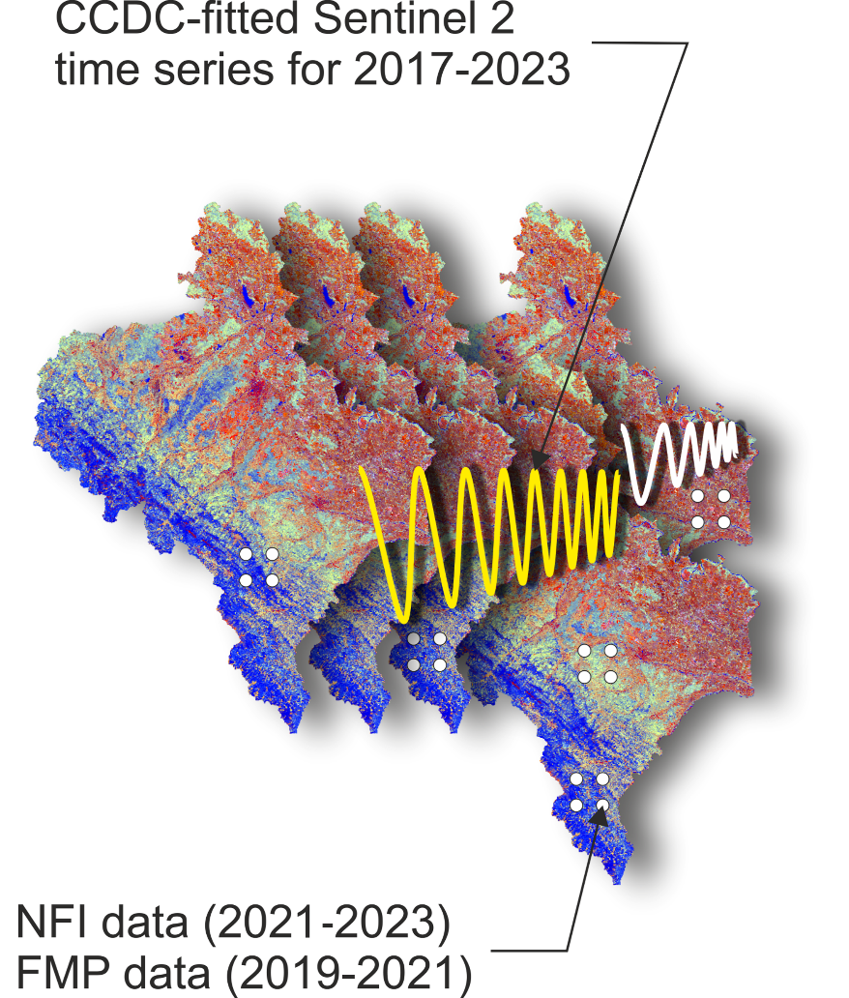
Methodology: Satellite time series
Free data sources
Sentinel 2 time series for 2017–2023
Сlimatіс and topography rasters
Spatial resolution (pixel size)
Sentinel 2 imagery resampled at 20-m
Temporally smoothed time series
CCDC segmentation algorithm (Zhu&Woodcock, 2014)
Image processing platform
Google Earth Engine cloud computing platform

Slide 5
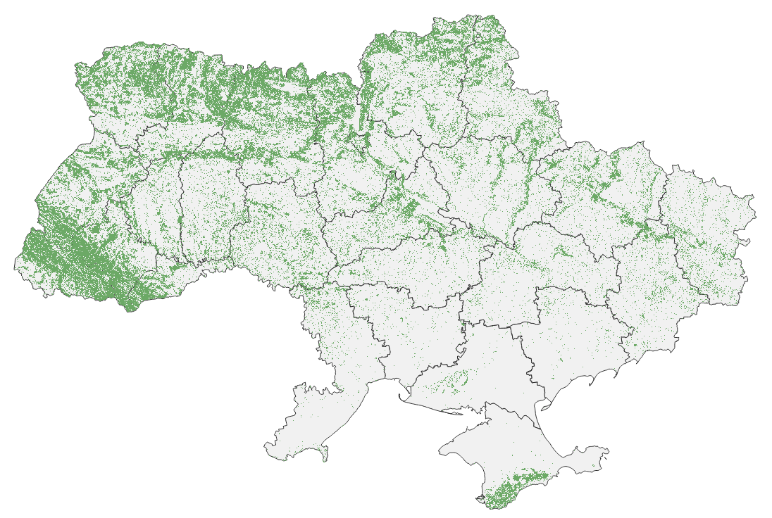
Output 1: Forest area
Tables
Regional-scale estimates of forest area and forest cover with 95% confidence intervals
Total forest area in 2023:
11,209 ± 166 thousand ha
Forest cover in 2023:
18.8 ± 0.3%
This study used the biophysical definition of forest as an area covered by woody vegetation with a predefined minimum canopy cover (>50%) observed at 20×20 m pixel level regardless of its legal status

Slide 6
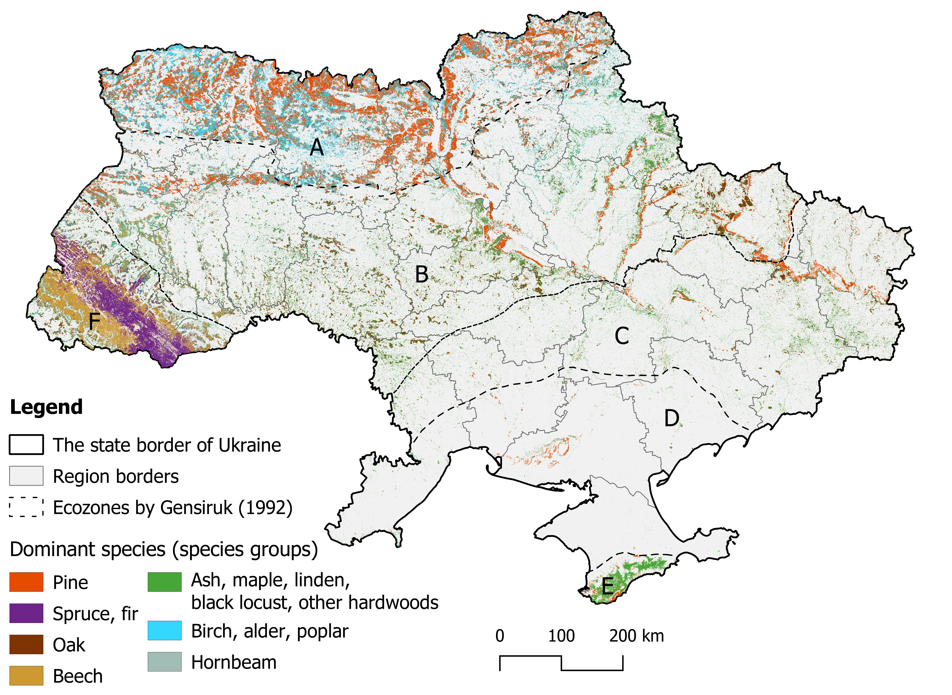
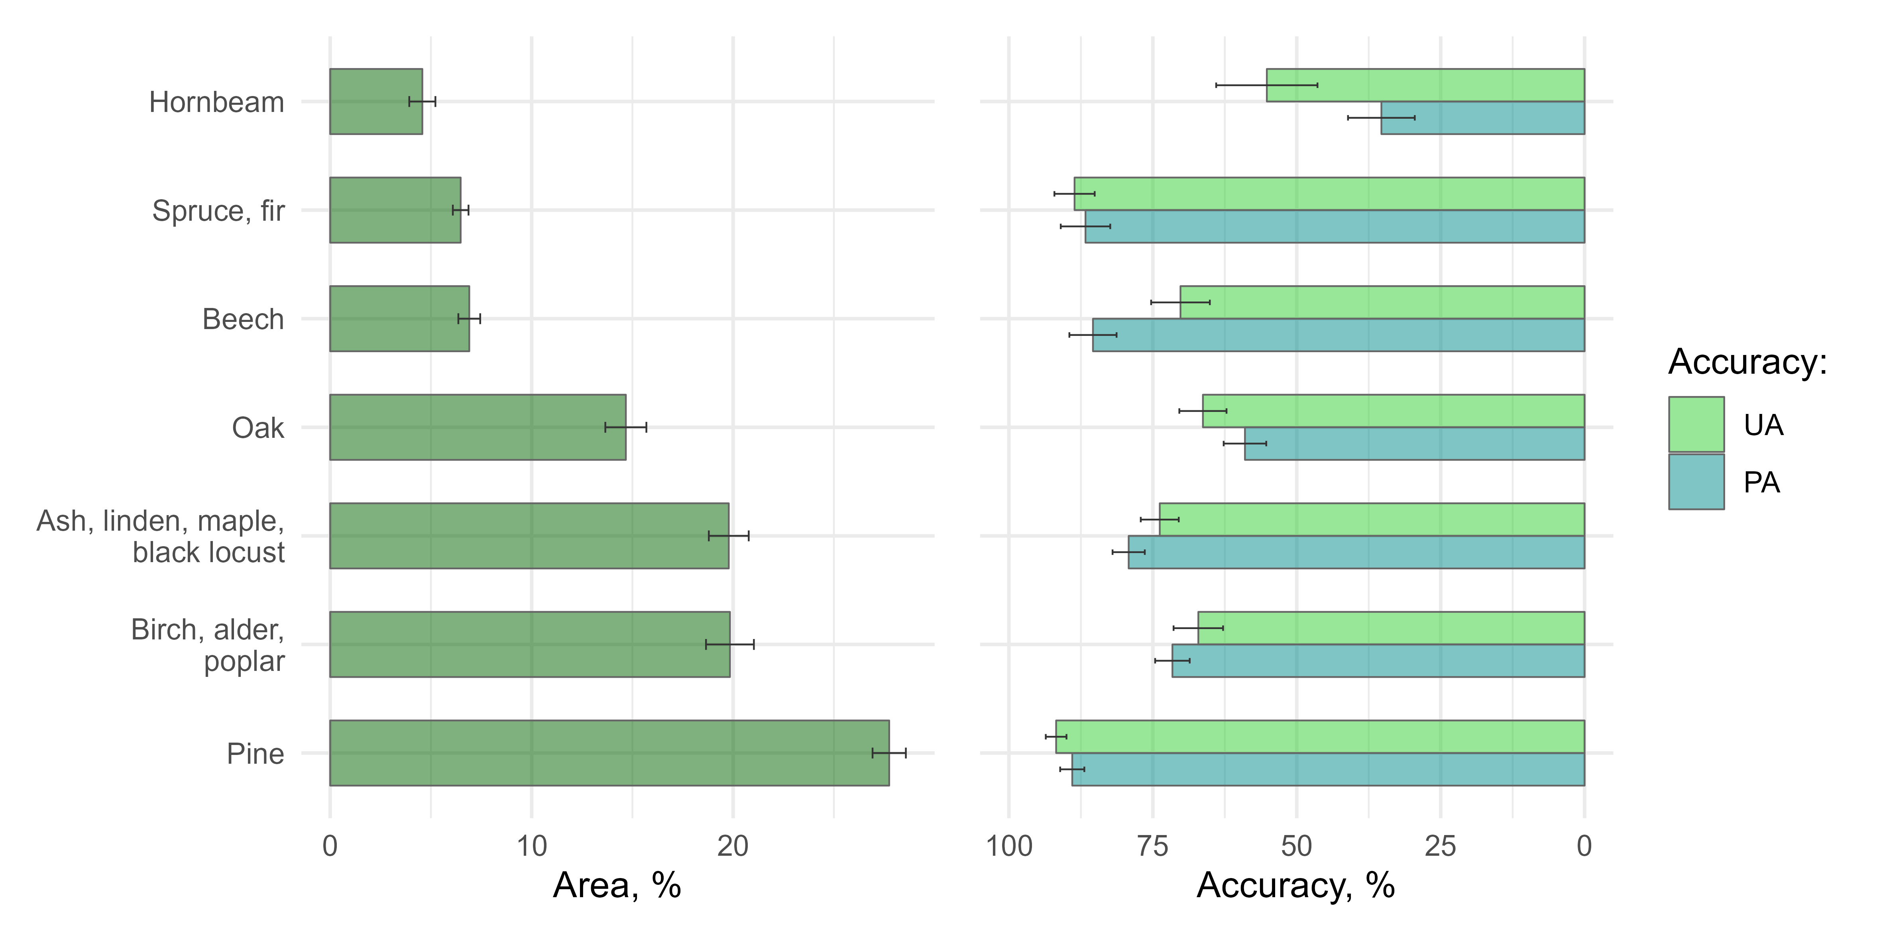
Output 2: Dominant species
Seven groups of dominant species
Estimates of forest area by dominant species at ecoregion and whole-Ukraine level:
A – Polissia; B – Forest Steppe; C, D – Steppe;
E – Crimean Mountains; F – Carpathian Mountains

Slide 7
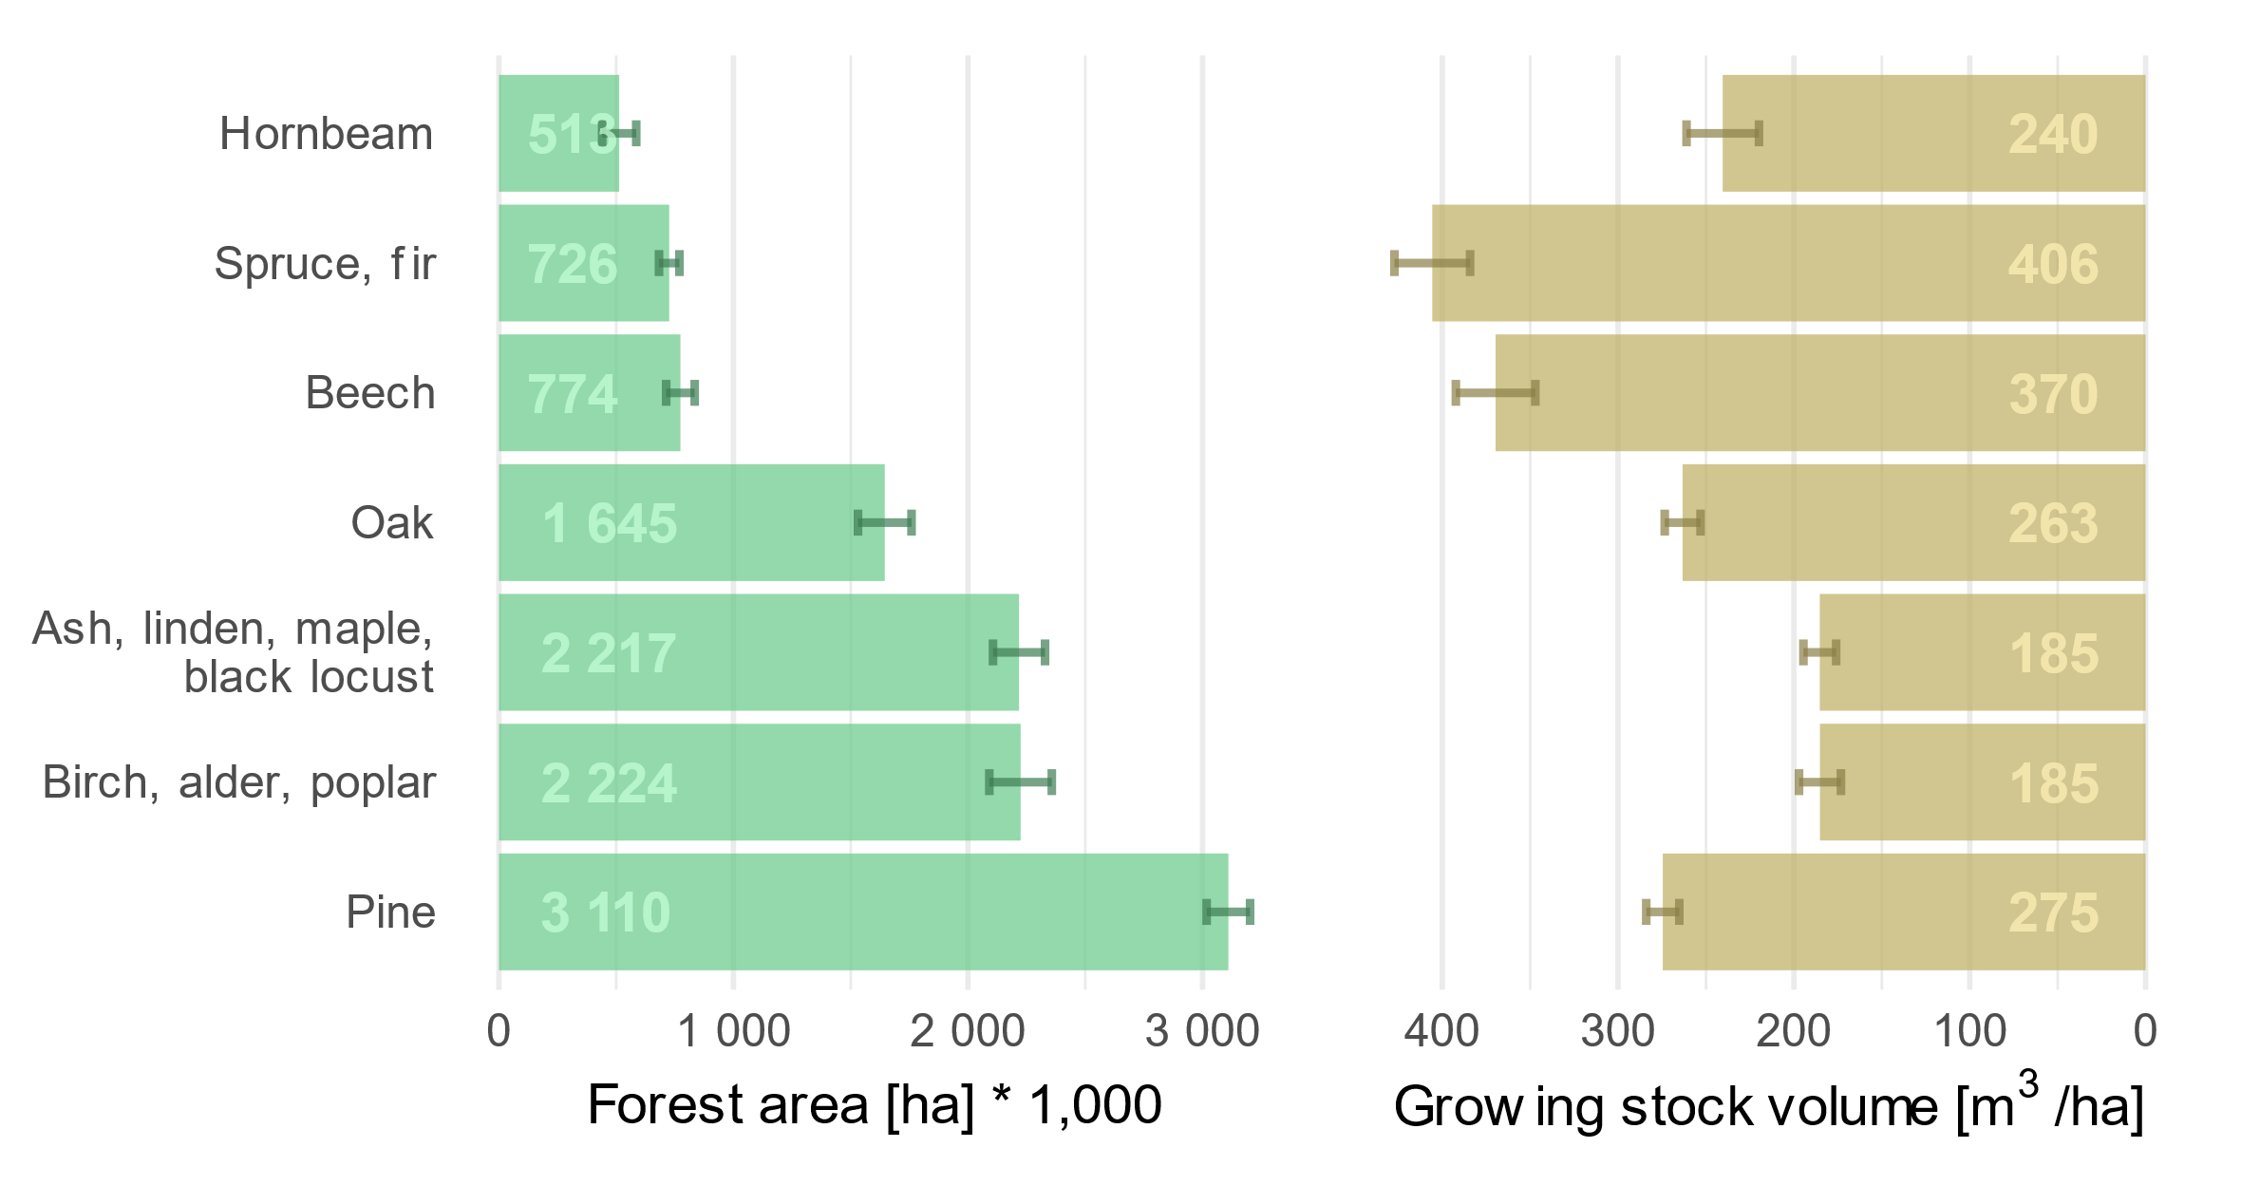
Results: Area and GSV for dominant species
Two thirds of the forest area is dominated by deciduous tree species. Pine forests occupy about 28%.
Growing stock is the highest in spruce and fir forests, followed by beech,
pine, and oak. Obtained mean values of GSV are within confidence intervals of 3-7%.

Slide 8
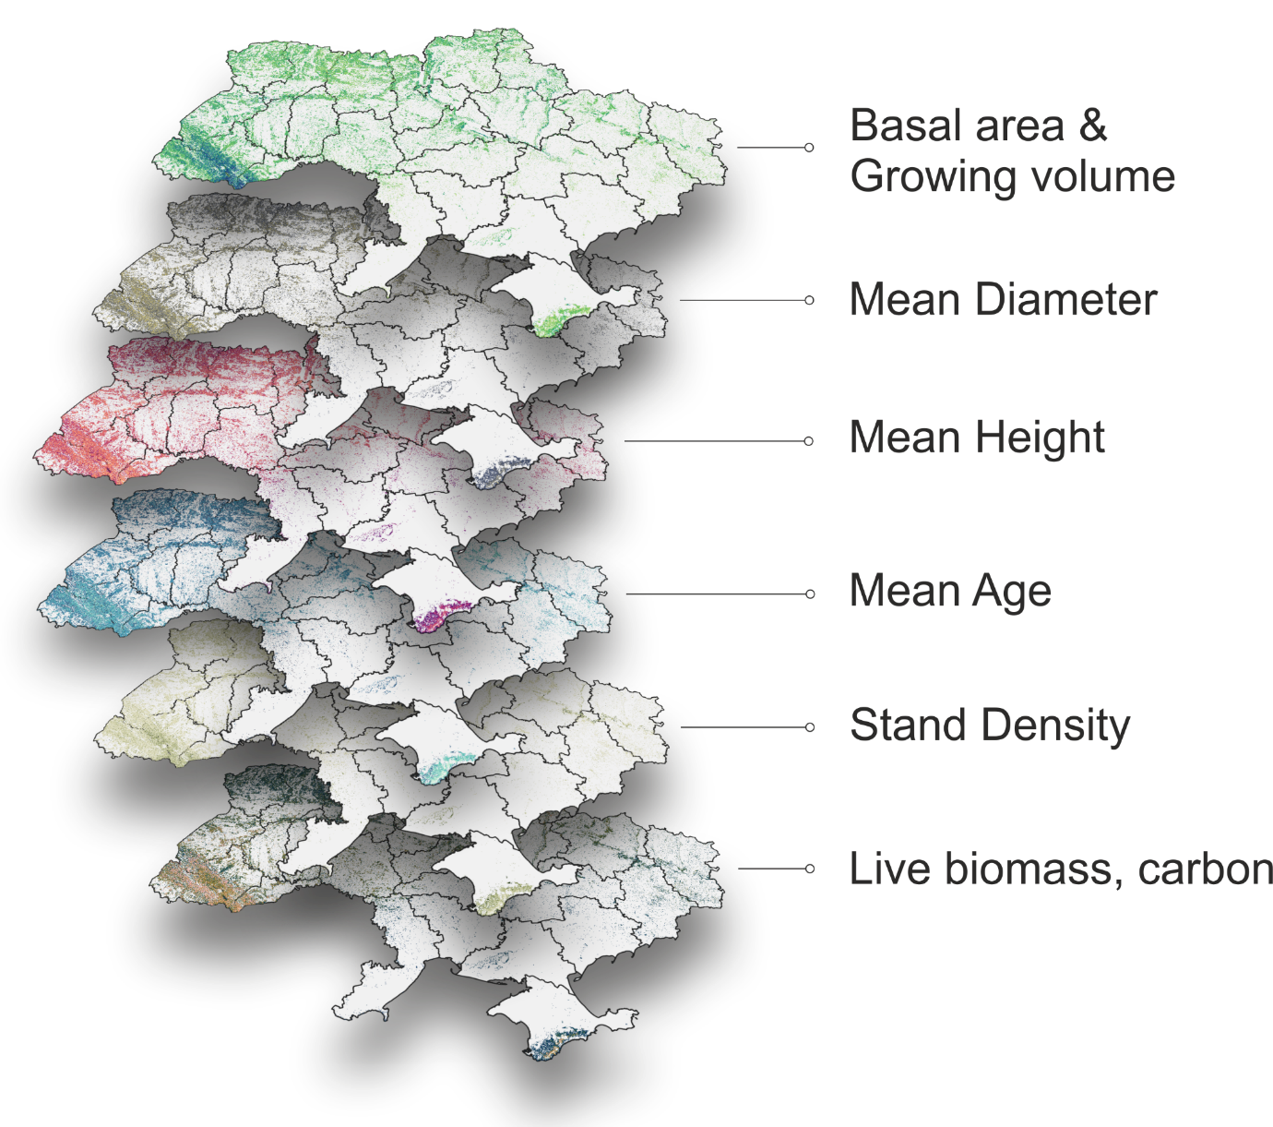
Results: Structural forest attributes
Mean growing volume
251 ± 5 m³/ha
Total growing volume
2 813 ± 55 M m³
Mean age
57 ± 1 years
Total accumulated carbon
944 ± 20 M t
The SFI project provided first spatial assessment of carbon stock accumulated in Ukrainian forest using reliable field data

Slide 9
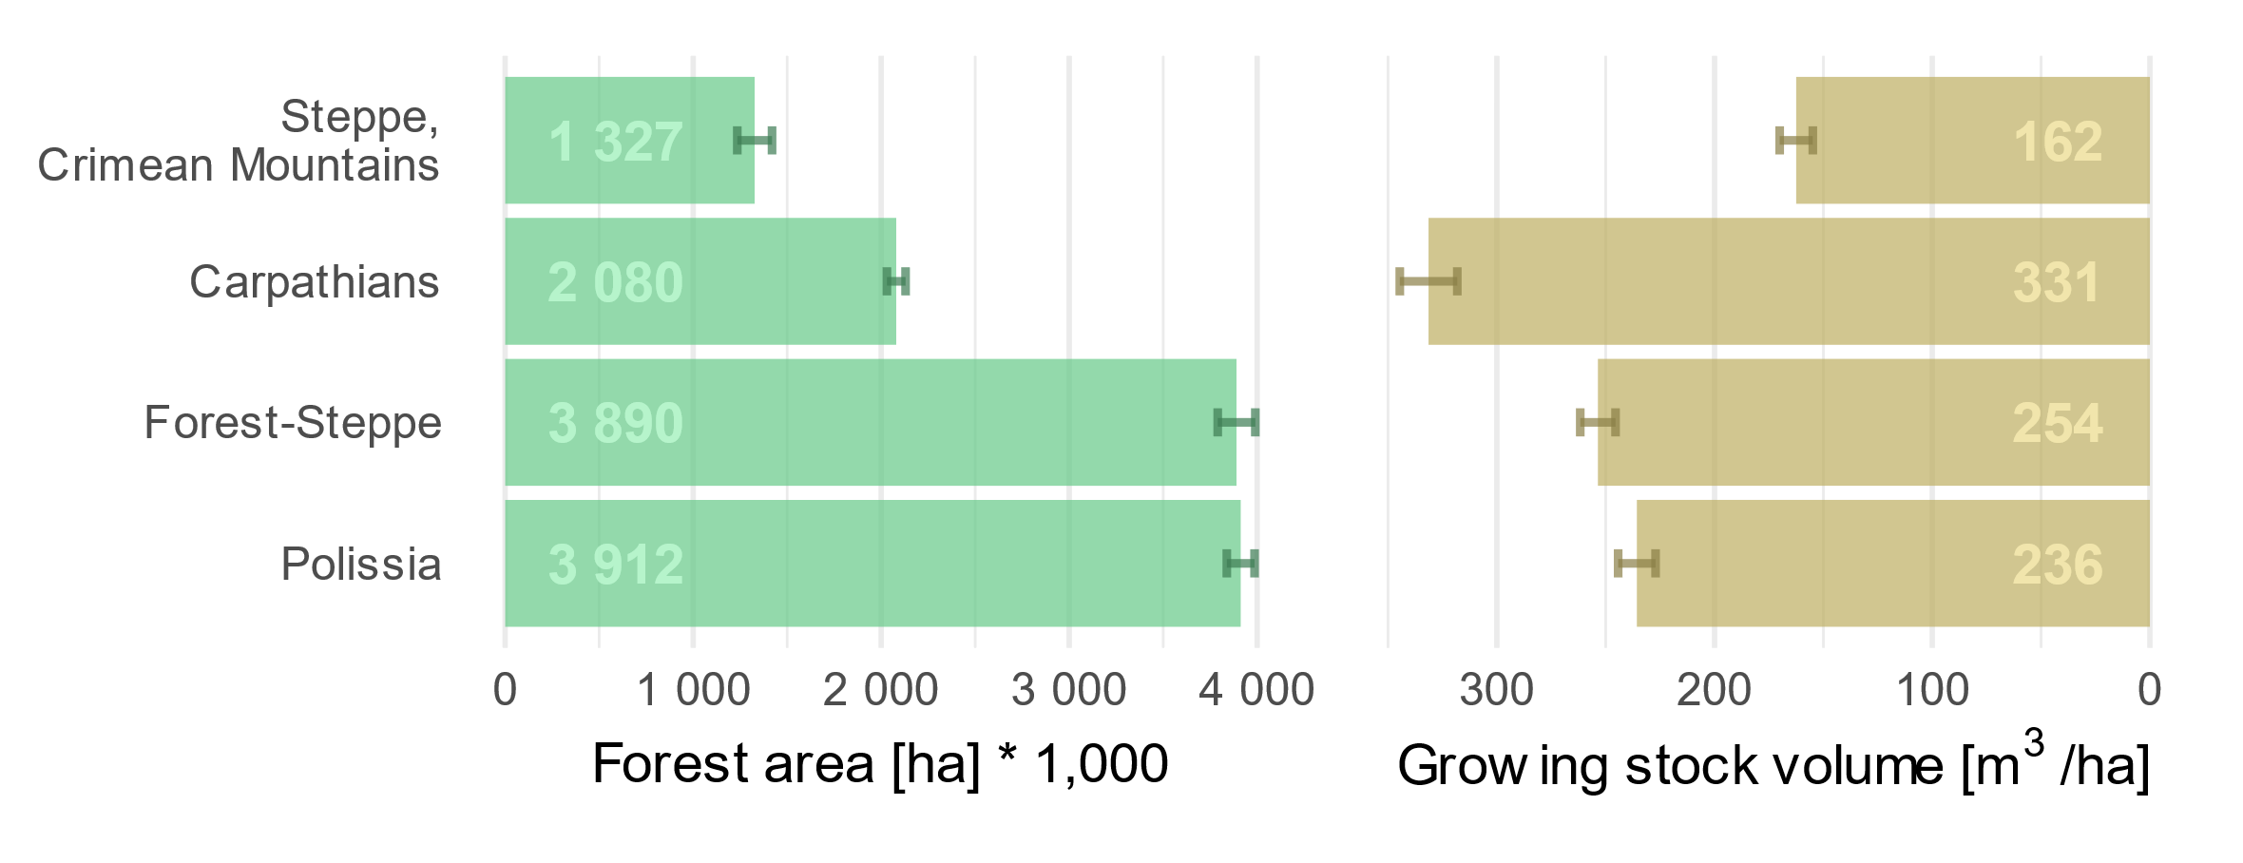
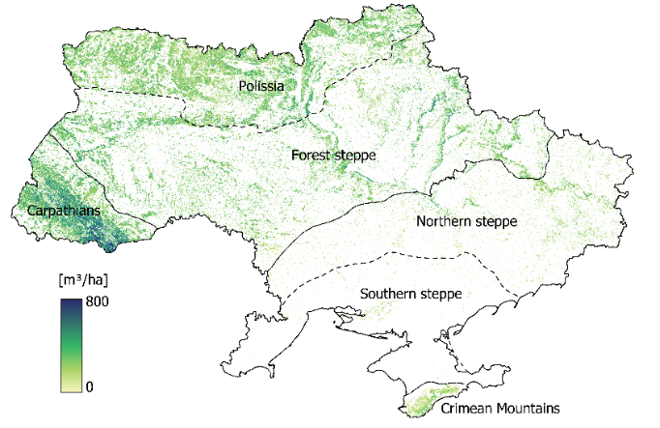
Results: Forest resources by ecozones
Carpathians have the highest percentage of forest cover (> 50%), followed by Polissia (about 40%)
About 92% of the total GSV are accumulated in the forests of Polissia, Forest steppe, and Carpathians

Slide 10
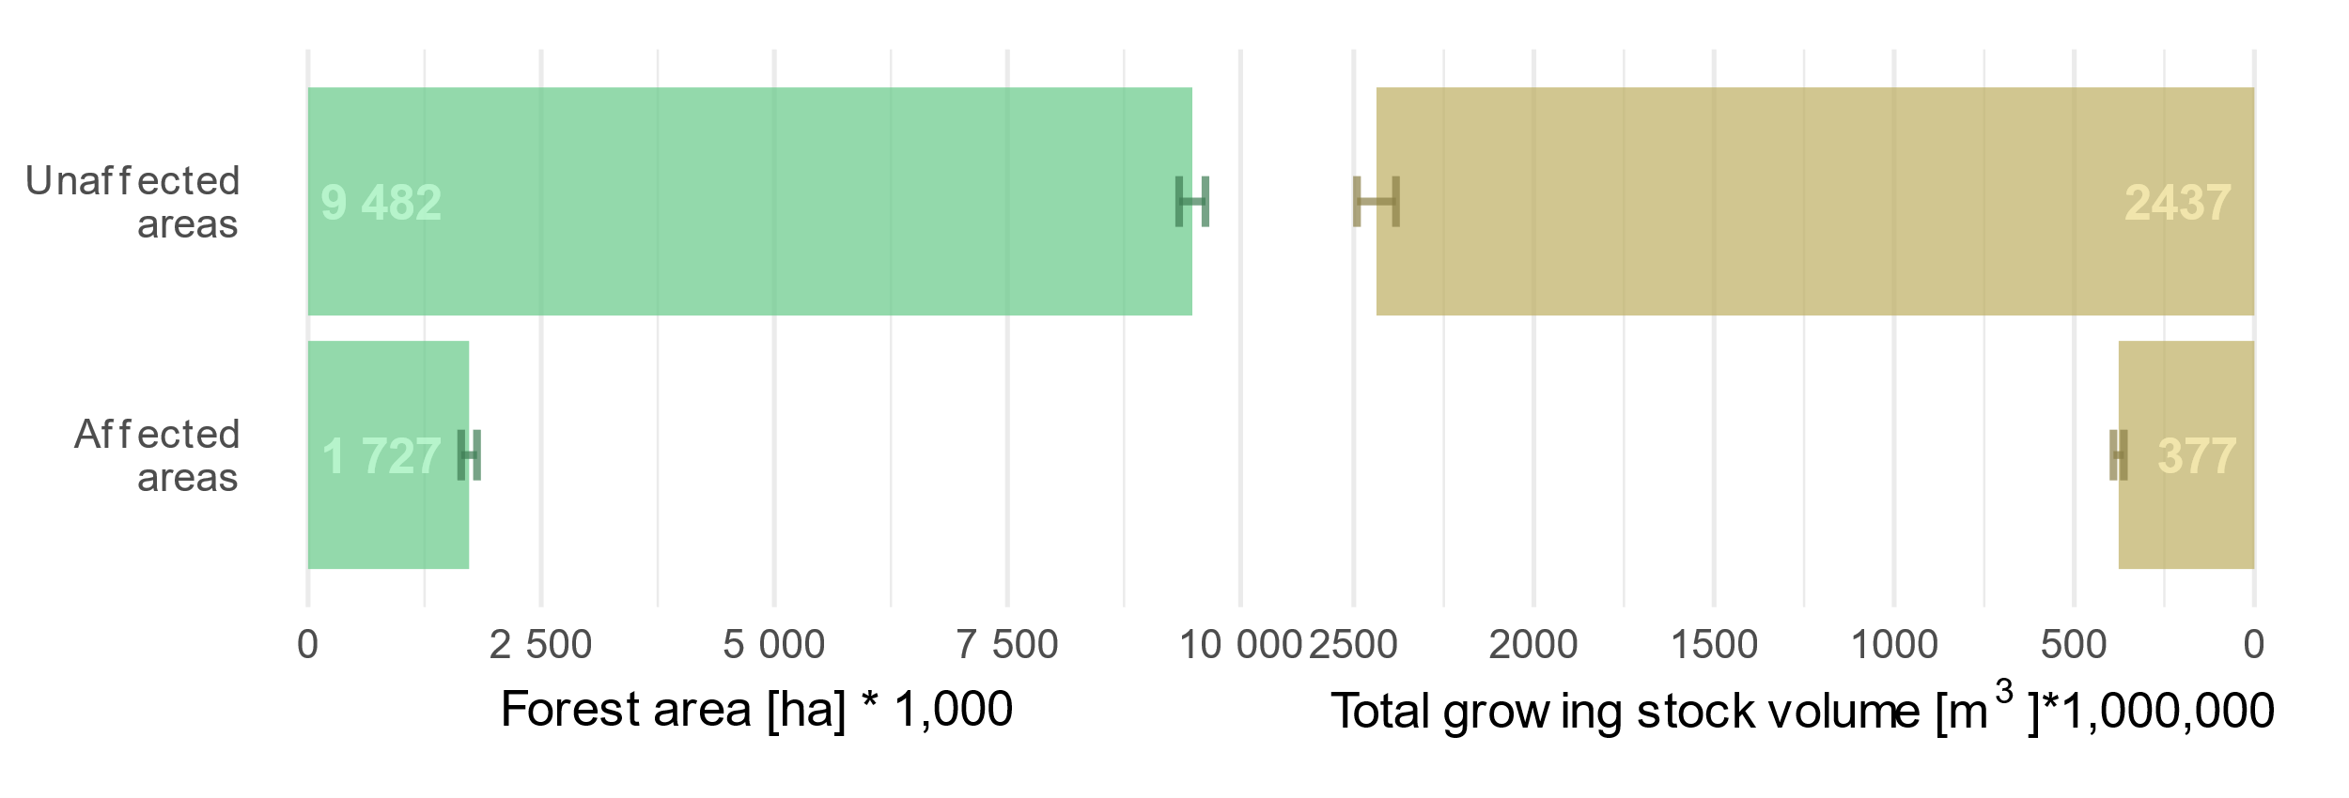
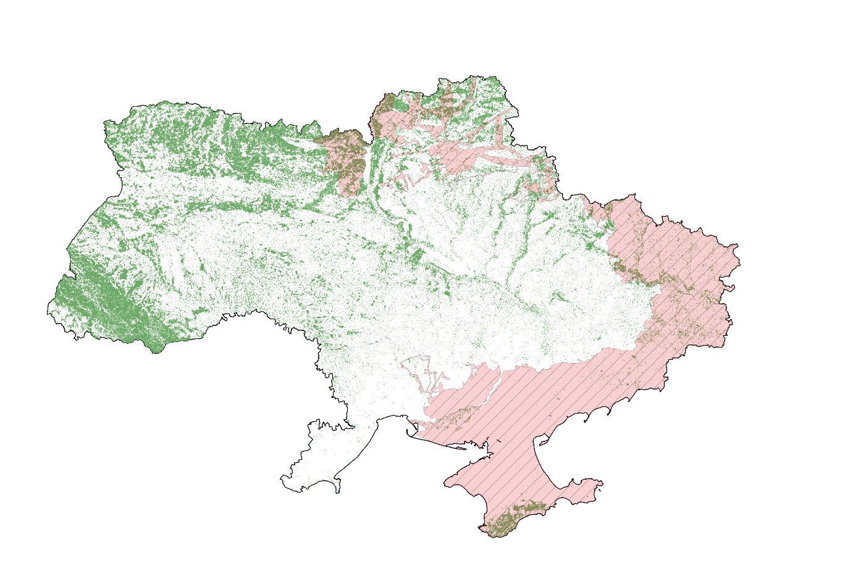
Results: War-affected forests
Approximately 1.7 million ha, or about 15% of the total forest area in Ukraine, are within territories affected by the war

Slide 11
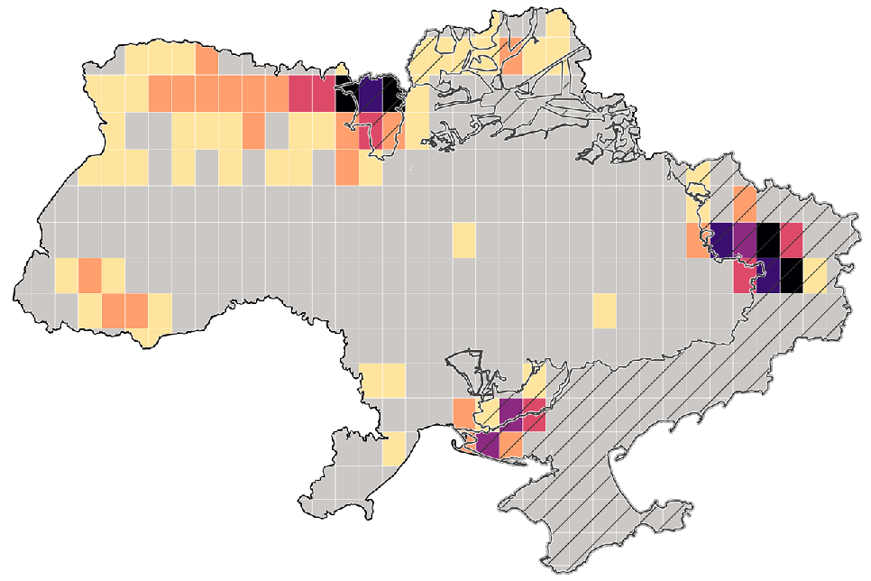
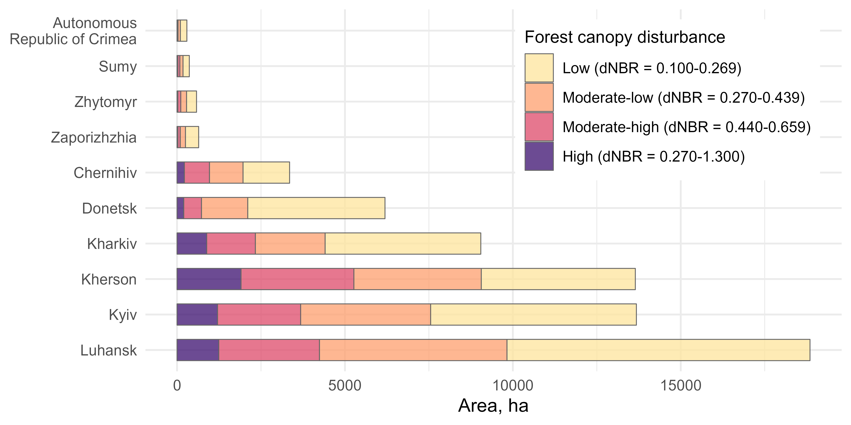
Forest damage assessment after 2022
The study created framework for accounting war effects to Ukrainian forest. For example, in 2023 we revealed about 67 000 ha of forests damaged in war zones.

Slide 12
Further prospects of the approach
Continuous wall-to-wall mapping of Ukrainian forests
The new maps will be created as new satellite images become available, while their accuracy will improve as more NFI plots are collected.
Ability to map forest regardless their management status (ownership)
Assessing “true” forest area within official boundaries of land use categories
Forest attribute estimates for small areas (ecoregion, oblast, hromaga, etc.)
Accuracy of mapped attributes can be properly addressed when sufficient field observations are available for small areas of interest
Incorporation more advanced RS-based approaches into NFI
Accuracy of forest maps can be improved using low-density LiDAR data across Ukraine

Slide 13
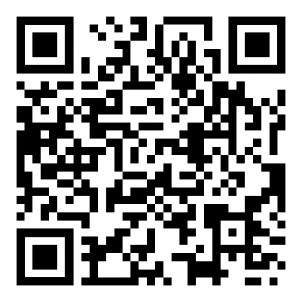

The website of the RS-Inventory can be accessed via nfi.lisproekt.gov.ua/en/

