Slide 1


How to step ahead with defoliation estimation?
Vitaliy Storozhuk National Coordinator, SFI Project
Round table “Monitoring Ukrainian forests based on ICP Forests”
05.11.2025

Slide 2
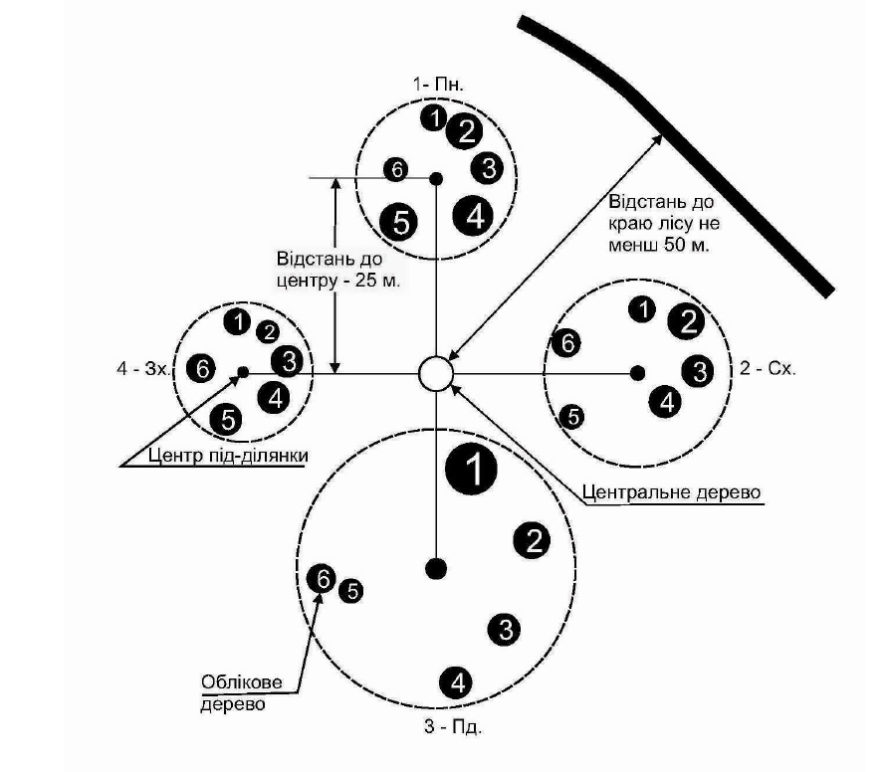
Defoliation ICPF 1/ UA-NFI: Characteristics of the sample or population?
In each ICPF 1 subplot, select the 6 trees closest to the centre of the subplot that belong to Kraft classes I–III and have no serious mechanical damage (e.g., broken trunk, large open wounds on the trunk, etc.). There should be at least 24 trees in each plot.
On NFI plot, ‘model’ trees are selected from sampled living trees of each species for the purpose of measuring their heights and describing additional indicators (e.g. defoliation): ~ 5-10 trees with an upright trunk of varying diameters, evenly lit, normally developed (not suppressed, with an intact tops, without broken trunks or obvious defects).
Critically, ICPF 1 does not encompass any area-based procedure to statistically infer population attributes over the forest area considered (Bontemps at all, 2022).
As UA-NFI uses a manually selected model trees, it also lacks a procedure for statistically inferring population attributes.

Slide 3
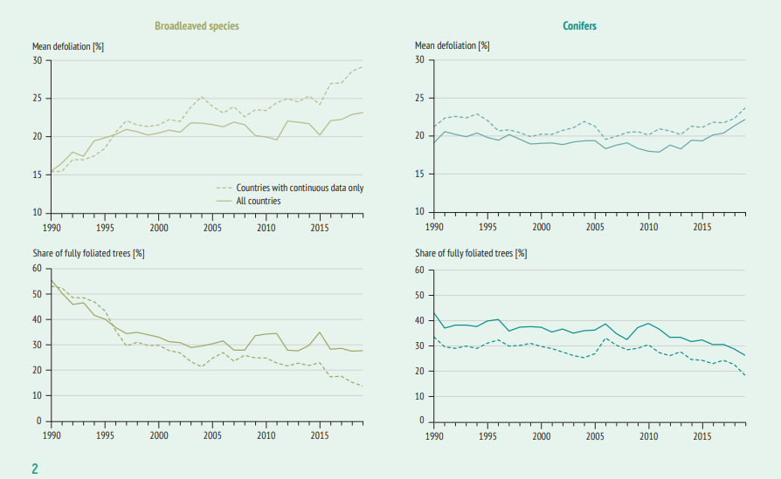
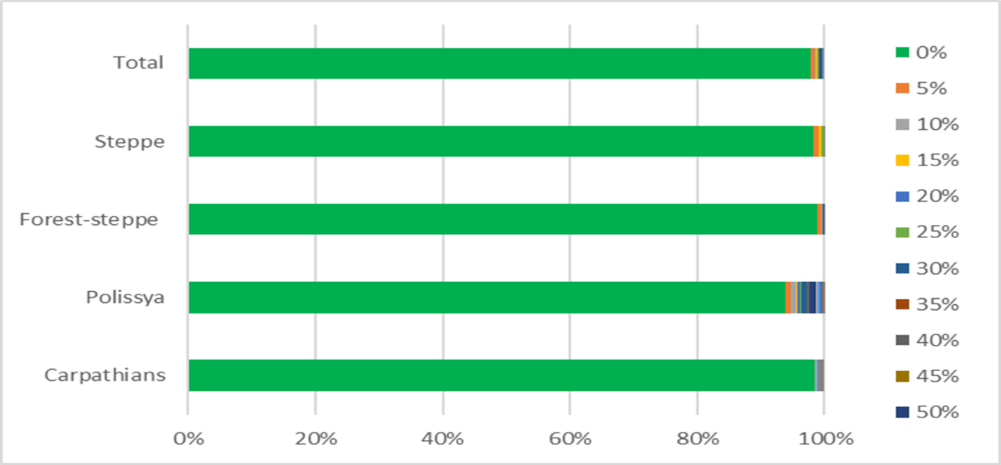
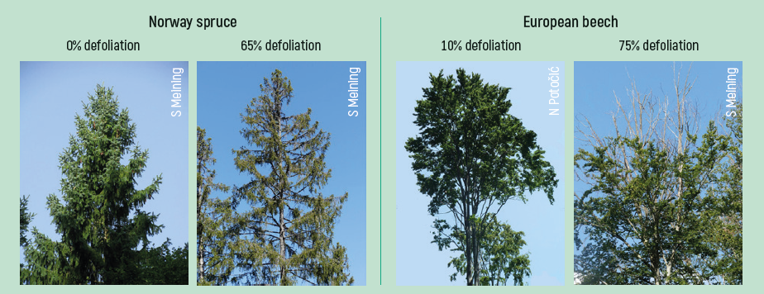
Snapshot of defoliation UA NFI in light of ICPF data temporal trends
UA-NFI 2023 | ICPF 1
Enhance the NFI staff training, implement robust QA/QC procedures
Should the methodology be changed for assess the entire forest population?

Slide 4
Defoliation: time to shift estimation ‘from the ground’
to ‘remote sensing-based estimation'?
EU- Proposal for a Regulation on a monitoring framework for resilient European forests
Variables | Spatial resolution | Frequency
Tree Cover Density | 10 m or finer | at least annual
Defoliation | 300 m or finer | at least every two weeks
Options and paths for reaching effective Ukrainian forest monitoring
Criteria for current monitoring priorities* | Proposals for Defoliation Estimation ICPF1 +
Scale / Timeframe | National wide coverage/ population estimations (not ‘sample’). Yearly estimation?
Integration of inventorying and monitoring (I&M) | Calibration of satellite images on the base ICPF1 and NFI data
Methodology | Increase number of tree for ground measurements on I&M plots (for better calibration of satellite images)
Precision | Training of personal for estimation “from the ground” Preparing personal for conducting “remote-sensing estimation”

