Slide 1
Forests Monitoring under the programme
ICP Forests in Ukraine:
Current status and ways of development
Buksha I.F., Head of the Department of Forest Inventory, Monitoring, Certification and Forest Management Planning
Ukrainian Scientific Research Institute of Forestry and Agroforestry named after H.M. Vysotsky (URIFFM), Kharkiv
Round table within the framework of the project "Promoting of multifunctionable sustainable forest management planning and implementation in Ukraine",
5 November 2025

Slide 2
Legal framework for forest monitoring in Ukraine
Regulatory and legal act | Article and its content
Forest Code of Ukraine (enacted on 21.01.1994) | Article 55. Forest monitoring. Defines forest monitoring as a system of regular observation, assessment and forecasting of the dynamics of quantitative and qualitative state of forests. It establishes that monitoring is a component of the state environmental monitoring system and is carried out for information and analytical support of forest management and decision-making on prevention of negative changes.
 | Article 55-1. National forest inventory. Defines the national forest inventory as a system of selective statistical surveys of the forest fund, which is conducted to obtain generalised information, including for the needs of forest monitoring.
Law of Ukraine "On Environmental Protection" (enacted on 25.06.1991) | Article 22. Environmental monitoring. Sets out the general legal framework for environmental monitoring, of which forest monitoring is a part.
Resolution of the Cabinet of Ministers of Ukraine (CMU) of 30.03.1998 No. 391 "On Approval of the Regulation on the State Environmental Monitoring System" | Clauses 2, 8 of the Regulation. Sets out that forest monitoring is an integral part of the state environmental monitoring system. The central executive body responsible for implementing the state policy in the field of forestry, the State Agency of Forest Resources of Ukraine, is among the monitoring entities responsible for monitoring the state of forests.

Slide 3
Legal framework for forest monitoring in Ukraine (2)
Regulatory and legal act | Article and its content
Resolution of the Cabinet of Ministers of Ukraine of 21.04.2021 No. 392 "On Approval of the Procedure for Conducting a National Forest Inventory..." | The entire text of the Procedure. Details the procedures, organisational principles, methods and objects of the national forest inventory, the results of which are an important source of data for the monitoring system.
The Law of Ukraine "On Amendments to Certain Legislative Acts of Ukraine on the State System of Environmental Monitoring, Information on the State of the Environment (Environmental Information) and Information Support for Environmental Management" No. 2973-IX of 20.03.2023 | The entire text of the Law. It is the basis for reforming and modernising the entire environmental monitoring system in Ukraine. The Law provides for the creation of an integrated and functional state environmental monitoring system that meets European approaches, supplements the Forest Code with Article 552 on information support for forestry management and stipulates the need for environmental monitoring subsystems, in particular, the forest monitoring subsystem.
CMU Resolution No. 684 of 13 June 2024 "Some Issues of Functioning of the State Environmental Monitoring System and its Subsystems" | The Resolution approves the Procedure for the functioning of the updated state environmental monitoring system and its subsystems, in particular, the forest monitoring subsystem.
Resolution of the Cabinet of Ministers of Ukraine dated 17.01.2025 No. 45 "On Approval of the Procedure for Monitoring Biological and Landscape Diversity" | Establishes the Procedure for Monitoring Biological and Landscape Diversity, including natural ecosystems, including forests.

Slide 4
Organisational structure of level I forest monitoring in Ukraine
Ministry of Forestry
URIFFM - coordinator
Forest research station
Forest research station
Forest research station
State Committee of Forestry
URIFFM- coordinator
SE "Ukrderzhlis
project"
SE "Ukrderzhlis
project"
SE "Ukrderzhlis
project"
State forestry agency
URIFFM - coordinator
Forestry
Forestry
Forestry
1989-2000
2001-2010
2011-2015
Methodology, staff training, reporting
Methodology, staff training, reporting
Methodology, staff training, reporting
Field observations, database development - specialists of the Ukrainian Research Institute of Forestry and 10 research stations of the Ukrainian Research Institute of Forestry
Field observations - specialists of the UkrRFI and specialists of 5 forestry expeditions, database development - "Ukrderzhlisproekt"
Field observations - specialists of URIFFM and specialists of about 150 state forestry enterprises, database development - Ukrderzhlisproekt

Slide 5
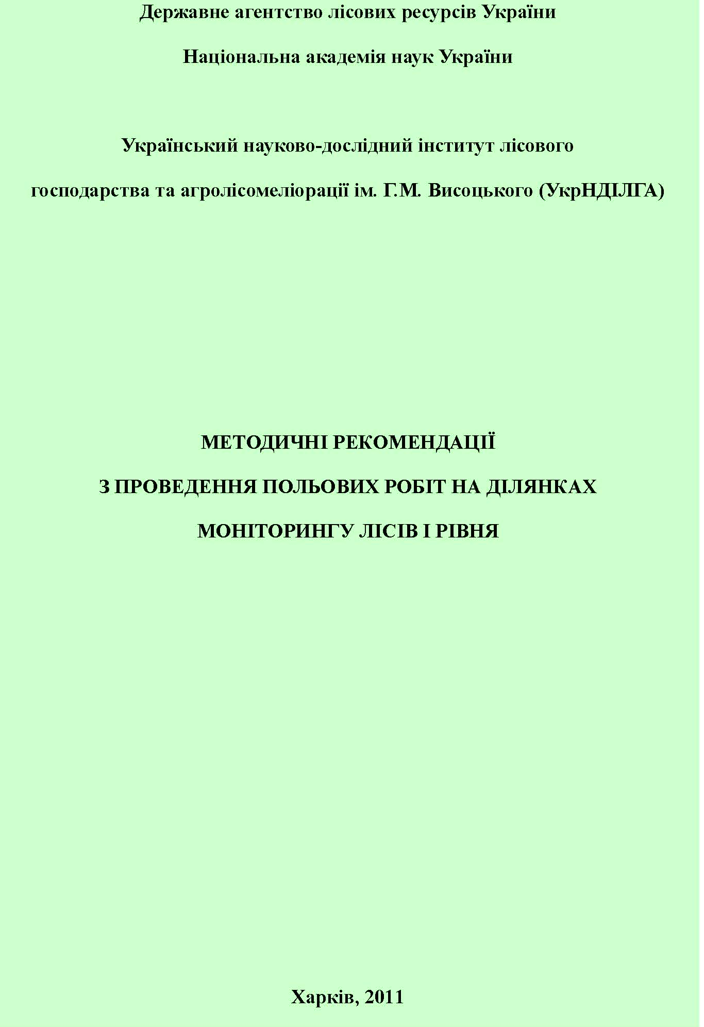
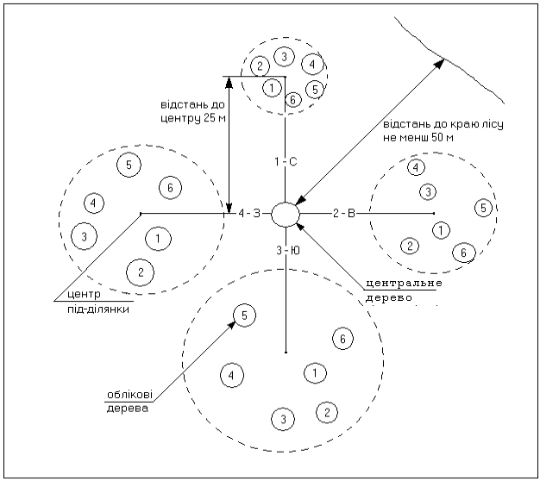
Methodology on forest monitoring in Ukraine, Level I - developed based on the ICP Forests Manual
Assessment indicators:
Forest stand characteristics.
Vegetation description.
Measurement and assessment of the accounting trees (defoliation, dechromation, presence, type and intensity of damage).
Not all indicators provided by the ICP Forests Manual were assessed
Scheme of the forest monitoring plot of the level I

Slide 6
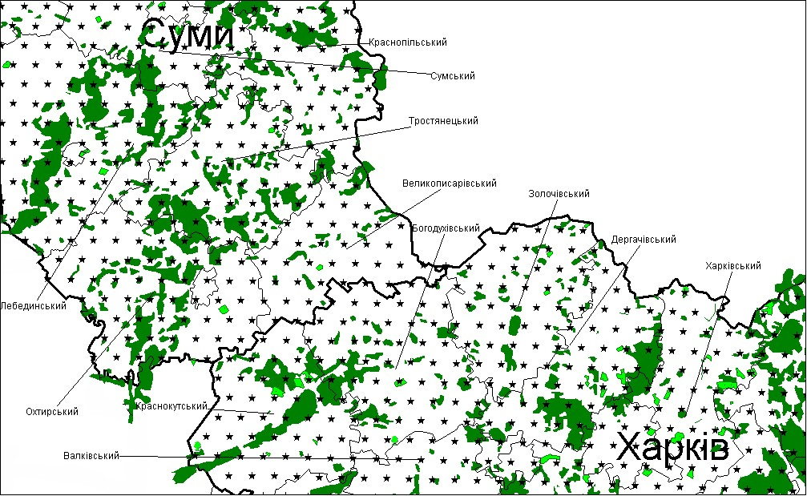
Level I forest monitoring network of Ukraine
 | Administrative units | Forest cover, %. | Estimated number of forest plots at network density
№ |  |  | 7.8x7.8 km
1 | Vinnytsia | 12,8 | 53
2 | Volyn | 30,9 | 139
3 | Dnipropetrovska | 5,2 | 23
4 | Donetsk | 6,7 | 26
5 | Zhytomyr | 32,6 | 199
6 | Transcarpathian | 50,8 | 146
7 | Zaporizhzhya region | 3,9 | 6
8 | Ivano-Frankivsk | 40,9 | 110
9 | Kyiv | 20,4 | 100
10 | Kirovogradska | 6,2 | 23
11 | Autonomous Republic of Crimea | 10,6 | 57
12 | Luhansk | 10,7 | 30
13 | Lviv | 28,5 | 124
14 | Mykolaivska | 3,7 | 4
15 | Odeska | 5,7 | 21
16 | Poltava | 8,5 | 38
17 | Rivne region | 36,5 | 171
18 | Sumy region | 17,4 | 87
19 | Ternopilska | 13,1 | 36
20 | Kharkiv | 12,1 | 62
21 | Kherson | 4,6 | 20
22 | Khmelnytskyi | 12,5 | 46
23 | Cherkasy | 15,2 | 63
24 | Chernivtsi | 29,2 | 59
25 | Chernihivska | 20,3 | 119
Total |  |  | 1762
Fragment of the project of the network of level I monitoring plots in Sumy and Kharkiv regions

Slide 7
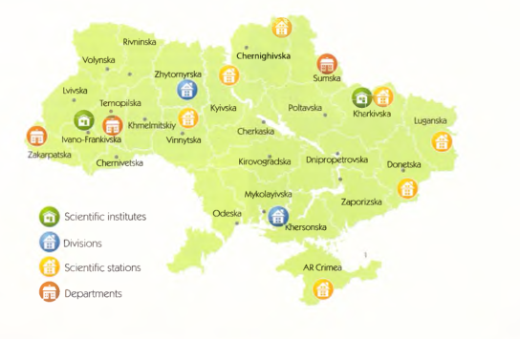
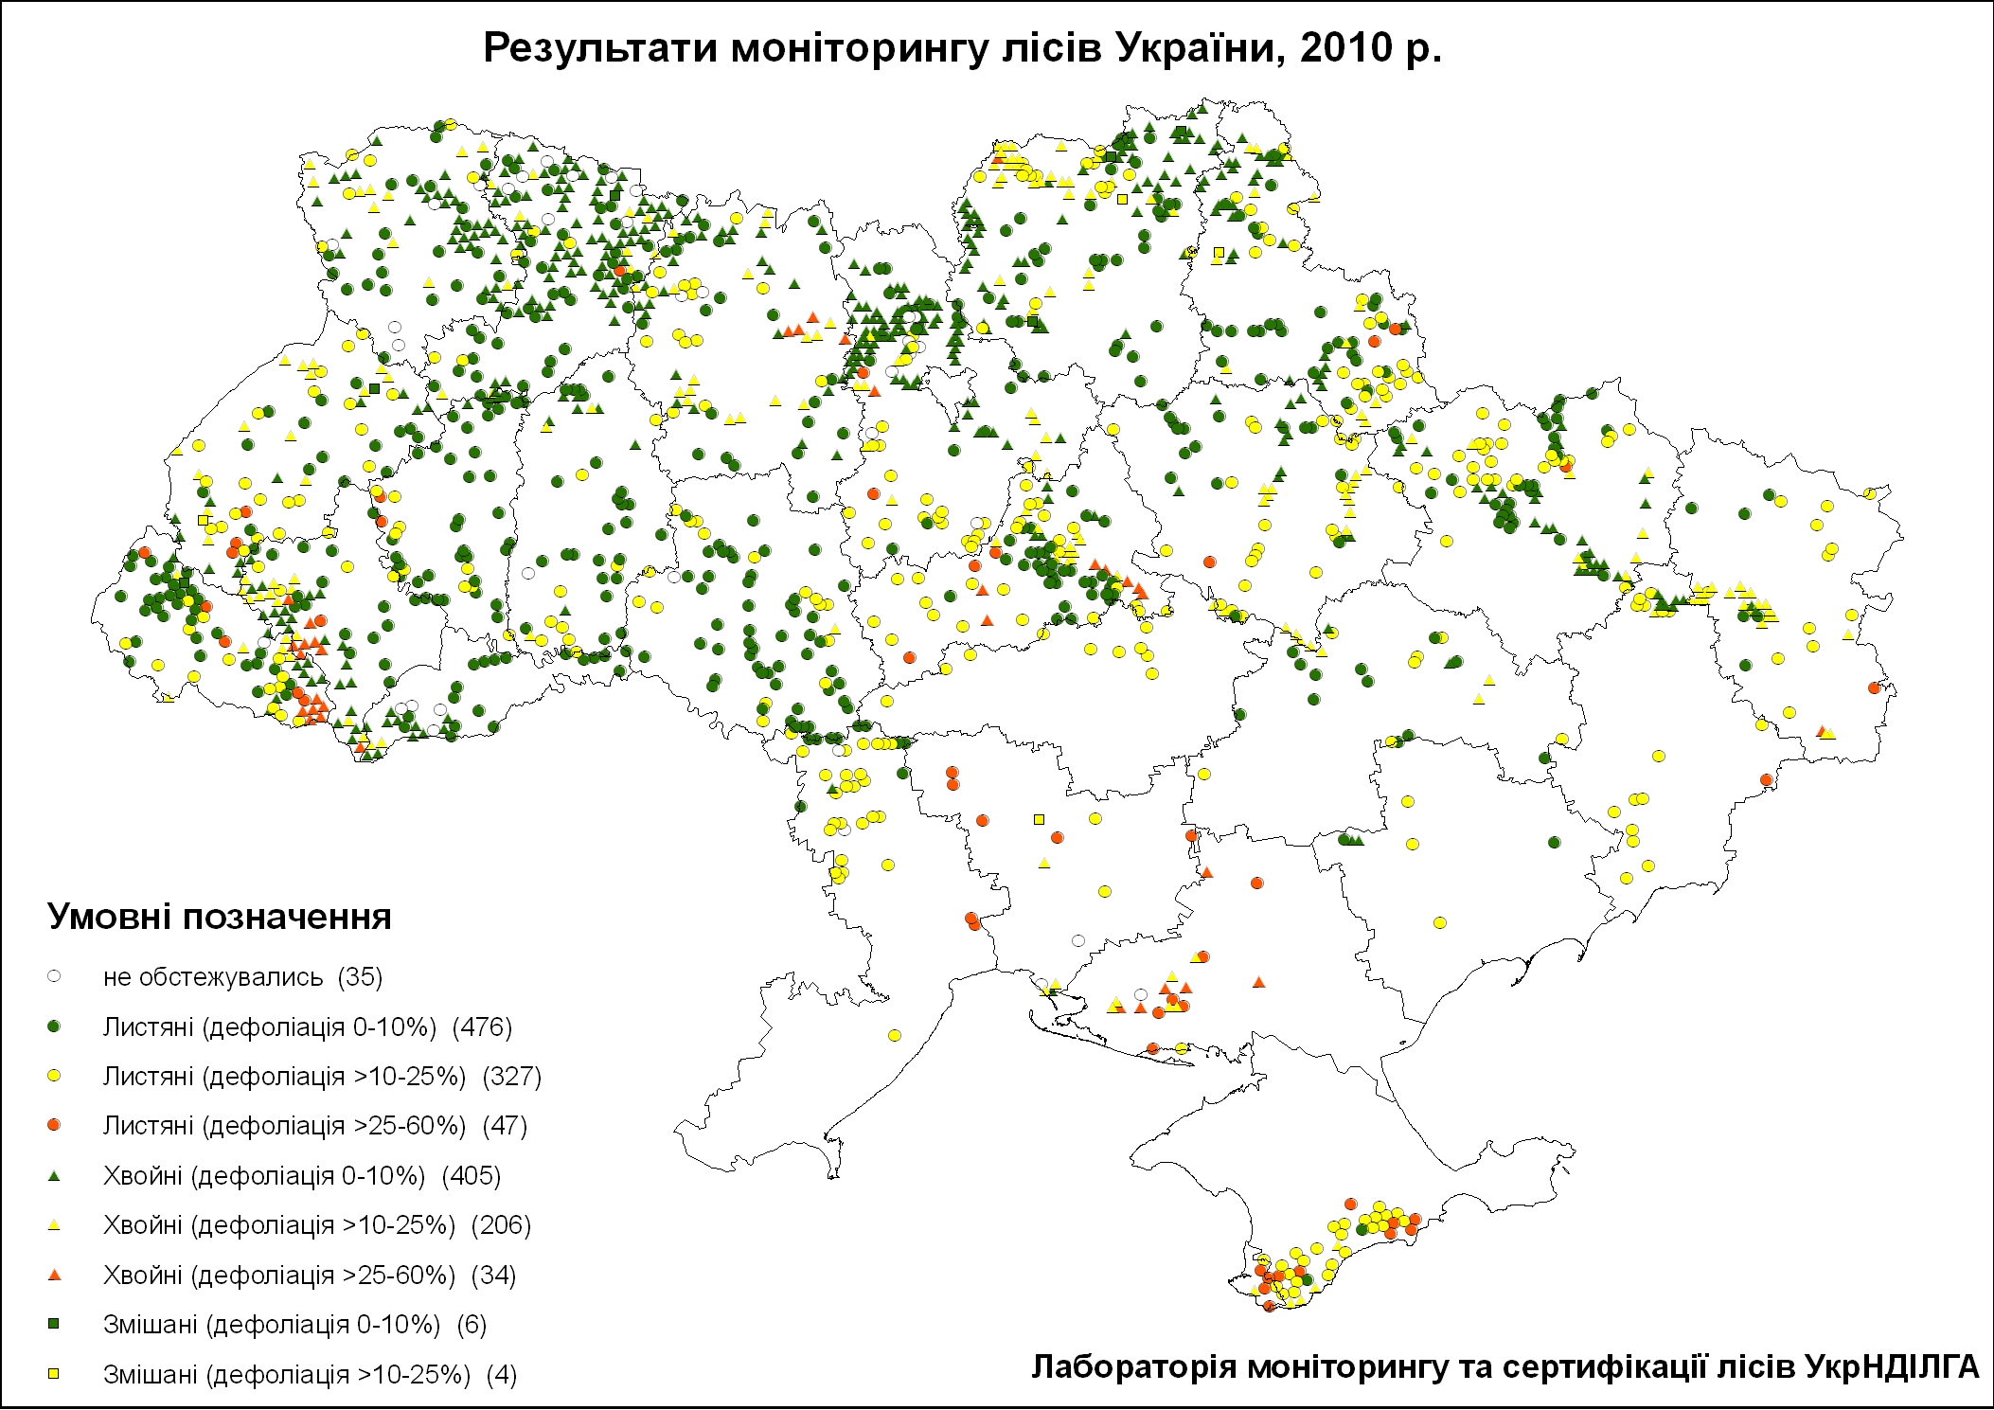
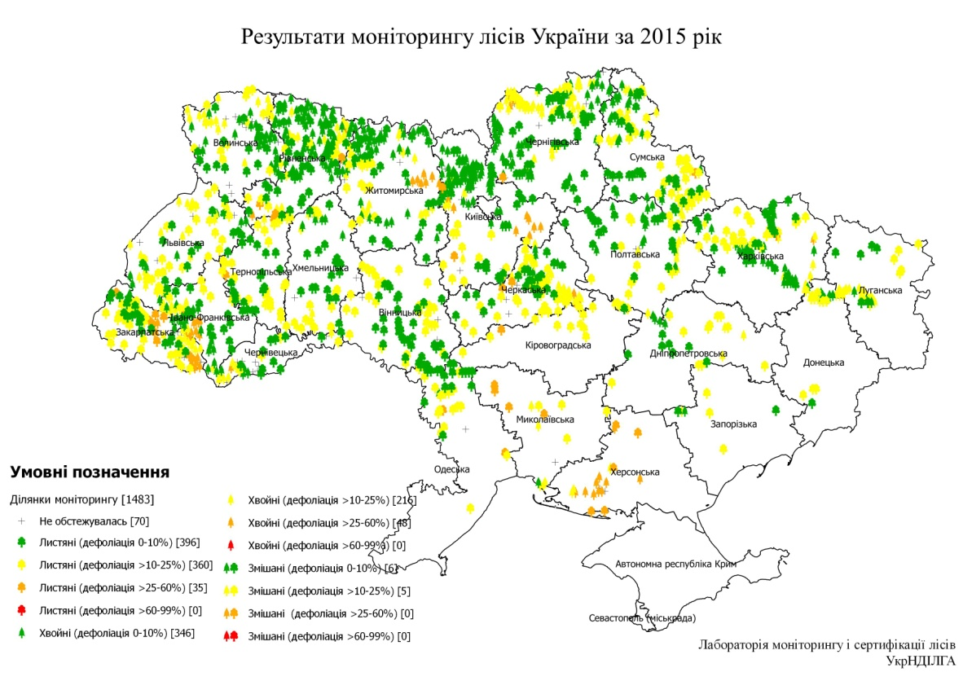
Stages of development of forest monitoring in Ukraine of the first level (based on the ICP Forests methodology)
1989-2000
2001-2010
2011-2015
Methodology, staff training, reporting
Field observations, database development - specialists of the URIFFM and 10 research stations
Field observations - specialists of the URIFFM and 5 forestry expeditions, database development - "Ukrderzhlisproekt"
Field observations - specialists of URIFFM and about 150 state forestry enterprises, database development – “Ukrderzhlisproekt”

Slide 8
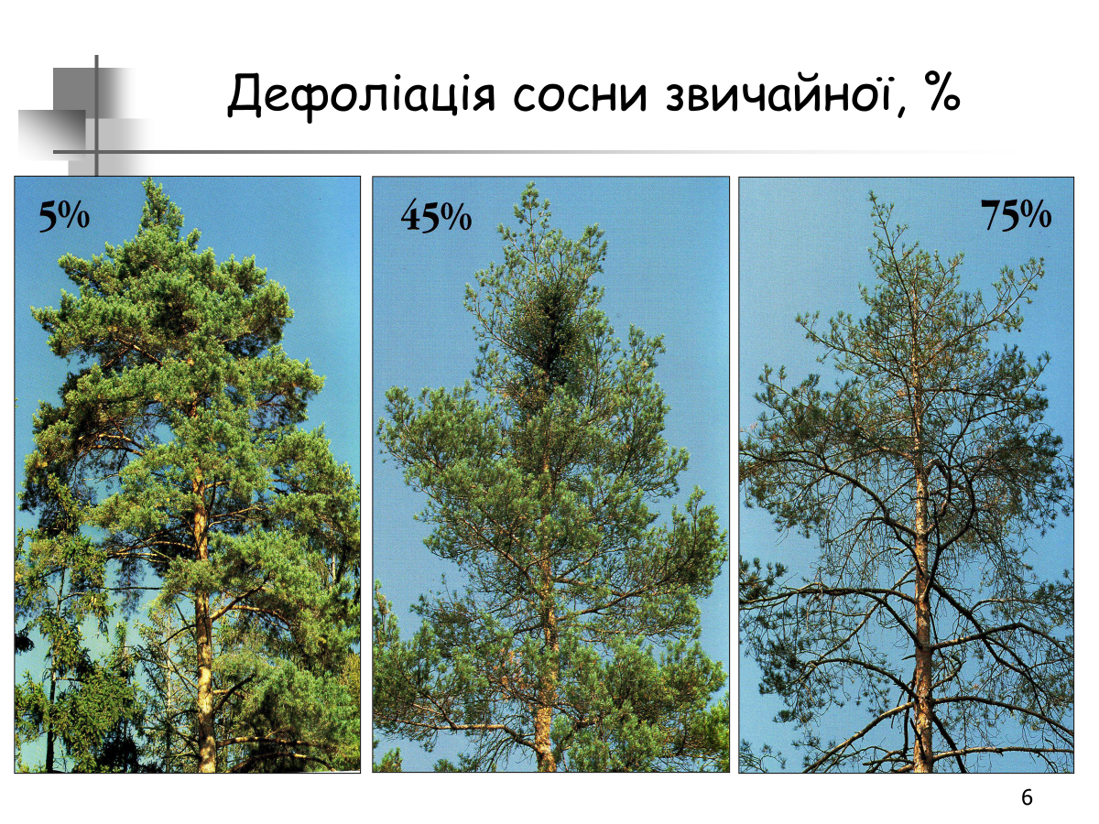
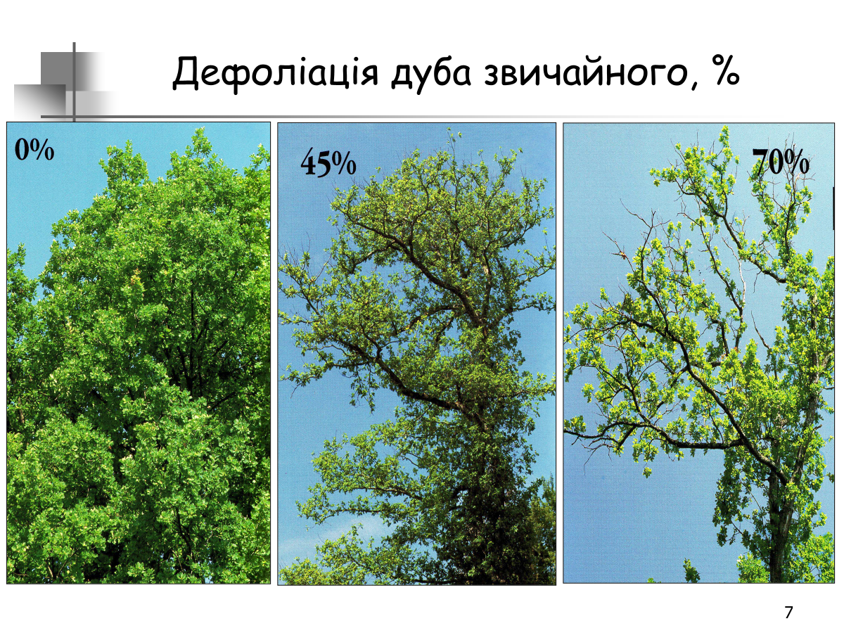
Crown defoliation is an indicator of tree health
Five classes of defoliation: undamaged - defoliation of 0-10% (class 0), slightly damaged - 11-25% (class 1), moderately damaged - 26-60% (class 2), severely damaged - 61-99% (class 3) and dried up - 100% (class 4).

Slide 9
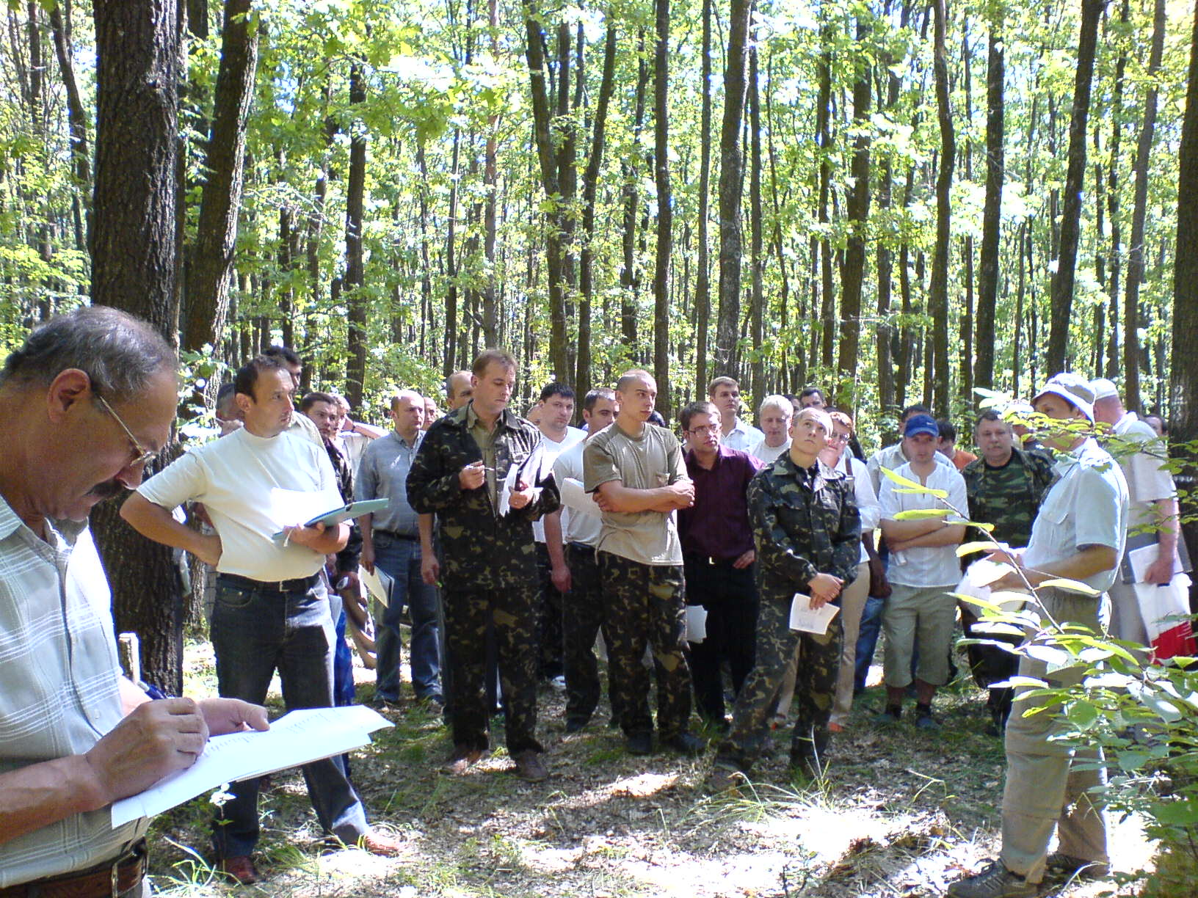
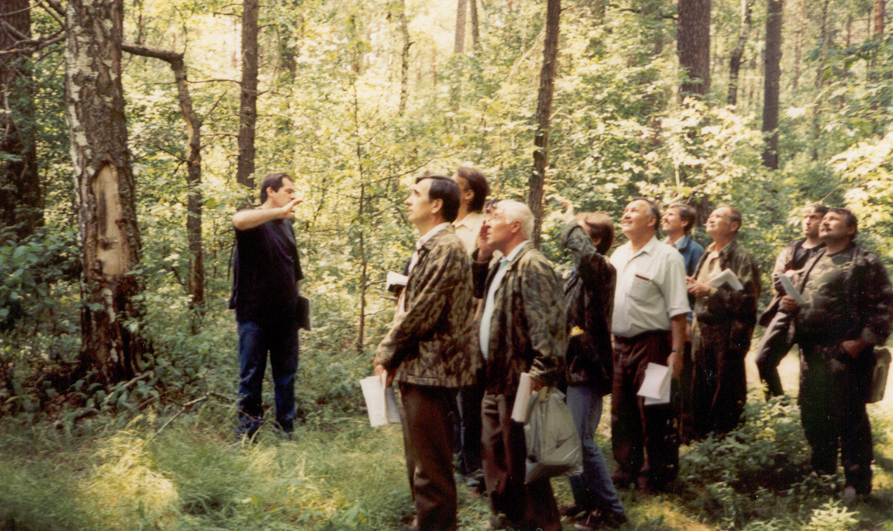
Assessment of crown defoliation: training of employees of Ukrderzhlisproekt (2001, 2006)

Slide 10
Evaluation of crown defoliation: results of training of employees of the State Enterprise "Ukrderzhlisproekt" (2001)

Slide 11
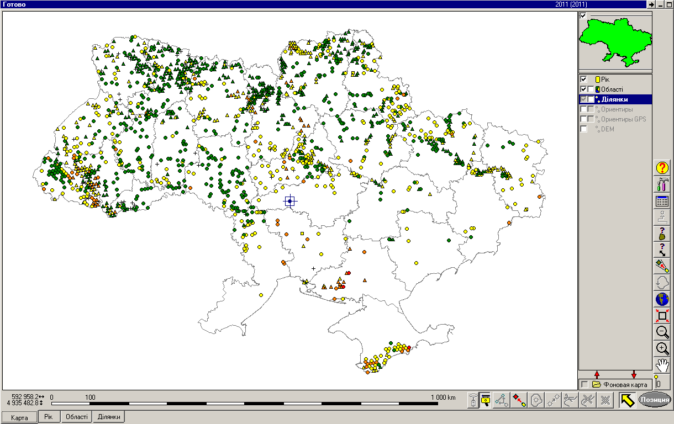
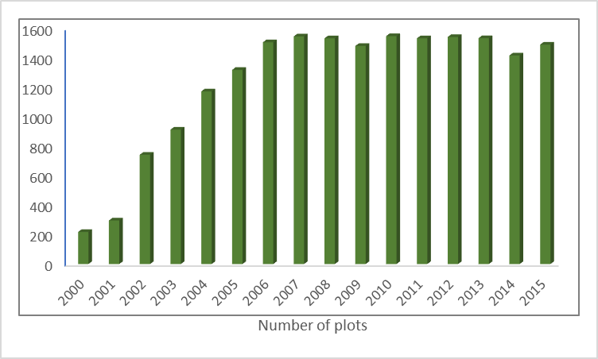
Ukrderzhlisproekt: development of a level I forest monitoring database in Ukraine (by GIS Field-Map)

Slide 12
Network of level I forest monitoring plotes in Ukraine by natural zones (2015)
Natural zone | Plots | Trees
Polissya | 543 | 13033
Forest-steppe | 537 | 12889
Steppe | 161 | 3834
Carpathians | 173 | 4132
Ukraine | 1414 | 33888

Slide 13
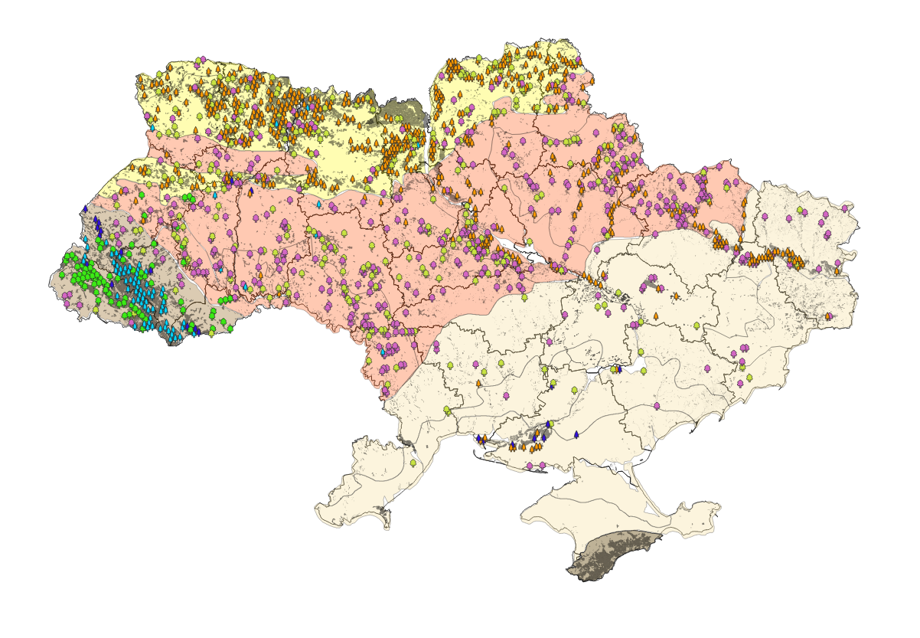
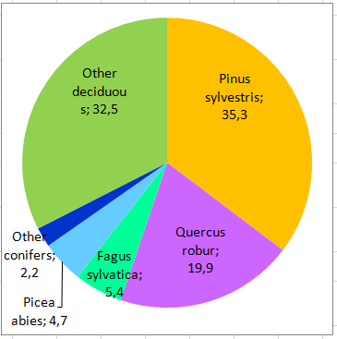
Distribution of Level I monitoring plots by dominant tree species
Share of tree species on monitoring plots

Slide 14
Results of Forest Monitoring in Ukraine, 2015

Slide 15
Average defoliation by natural zones, % (2015)
Ukraine: average defoliation of coniferous 11.7% and deciduous 12%

Slide 16
Defoliation of common oak and forest beech,% (2015)

Slide 17
Defoliation of Scots pine and European spruce, % (2015)

Slide 18
Damage to trees at Level I monitoring plots (2015)
Share of trees with damage, %.
Type of damage (all of Ukraine),%.

Slide 19
Damage to coniferous and deciduous trees at Level I monitoring plotes by natural zones, % (2015)
Damage to coniferous trees, %.
Damage to deciduous trees, %.

Slide 20
Dynamics of indicators of the state of accounting trees at the level I forest monitoring sites in Ukraine (2001-2012)
Dynamics of the proportion of trees with defoliation, registered damage (main axis) and drying trees (additional axis) of coniferous and deciduous tree species at forest monitoring sites

Slide 21
Tree deathback on monitoring plots by natural zones in 2015

Slide 22
Average defoliation dynamics of forests in Ukraine, % (2002-2015 рр.)

Slide 23
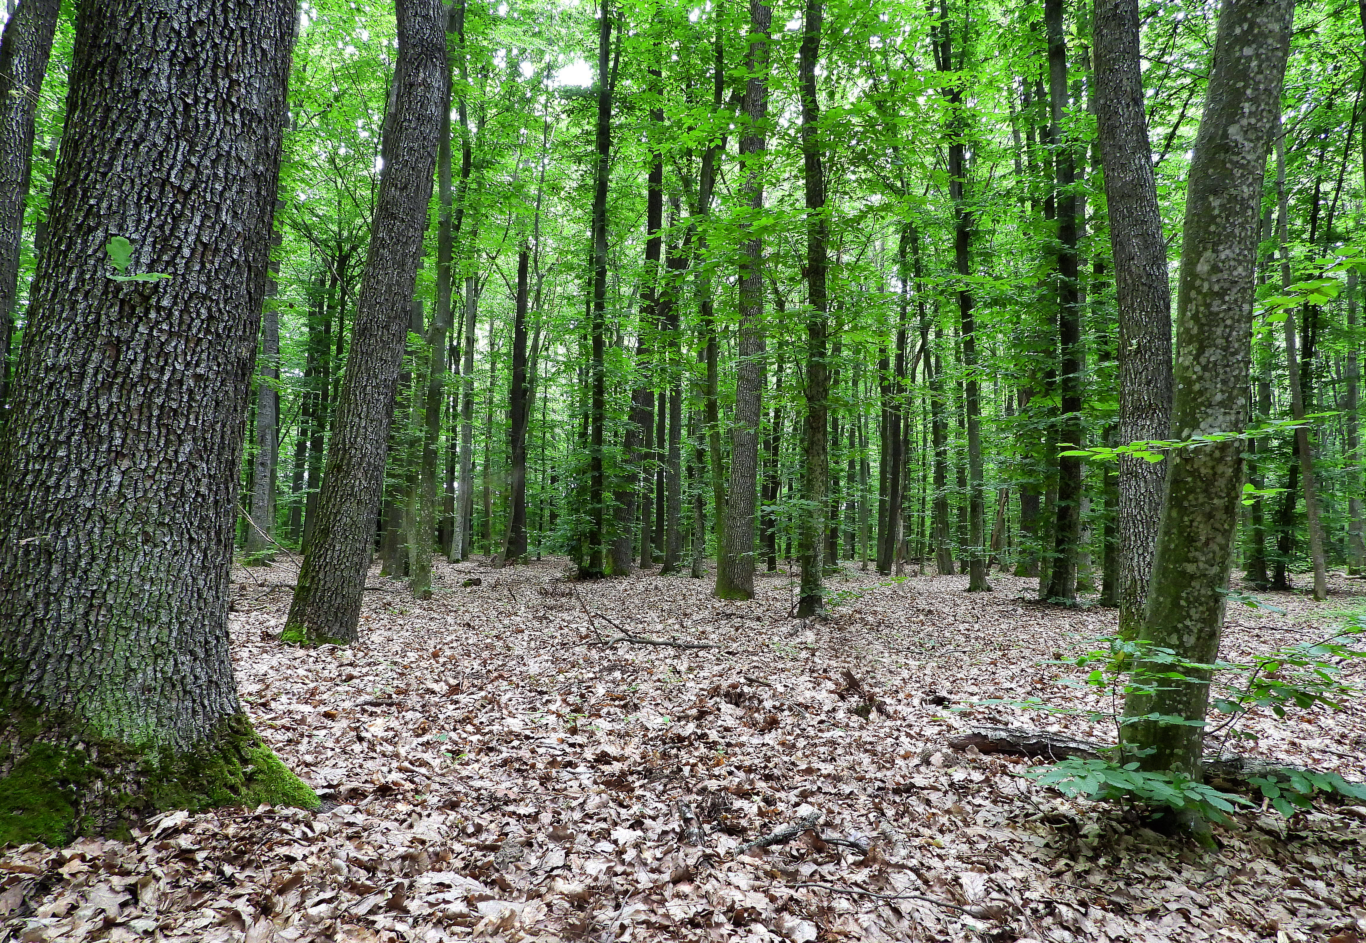
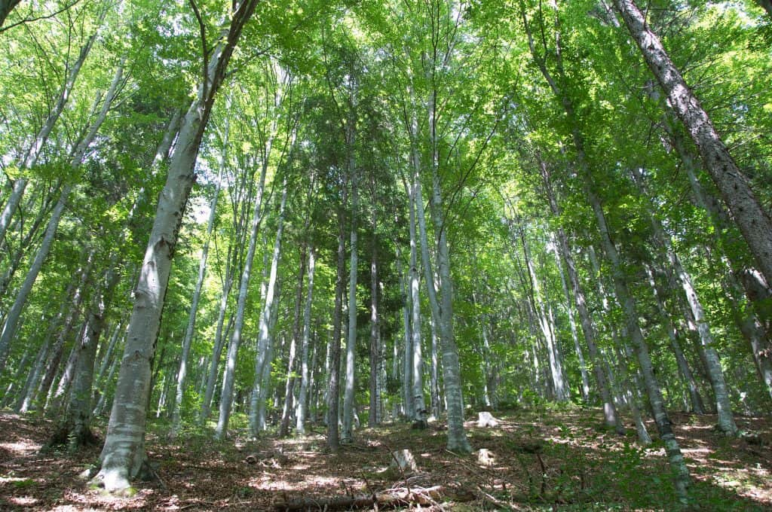
Defoliation dynamics of Common Oak and Common Beech, % (2004-2015)

Slide 24
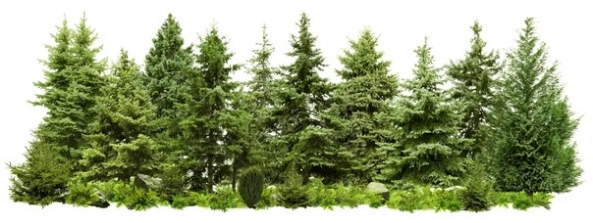
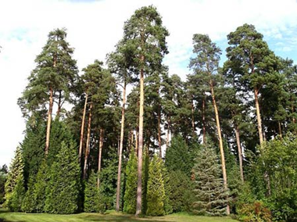
Defoliation dynamics of Norway spruce та Scots pine, % (2004-2015)

Slide 25
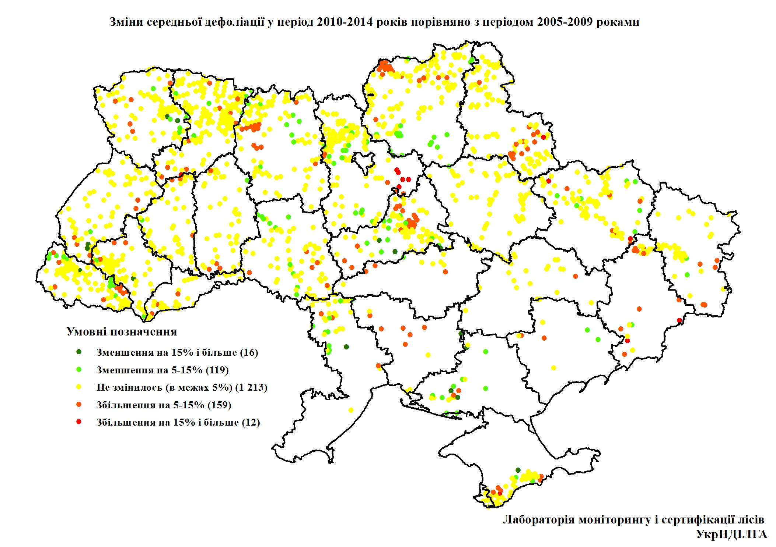
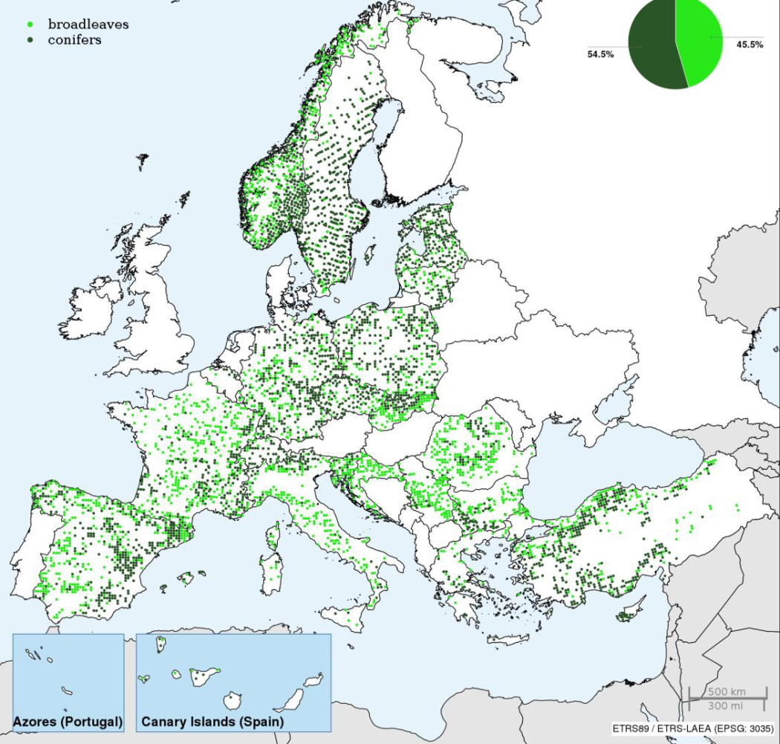
Average defoliation changes for period 2010-2014 vs 2005-2009

Slide 26
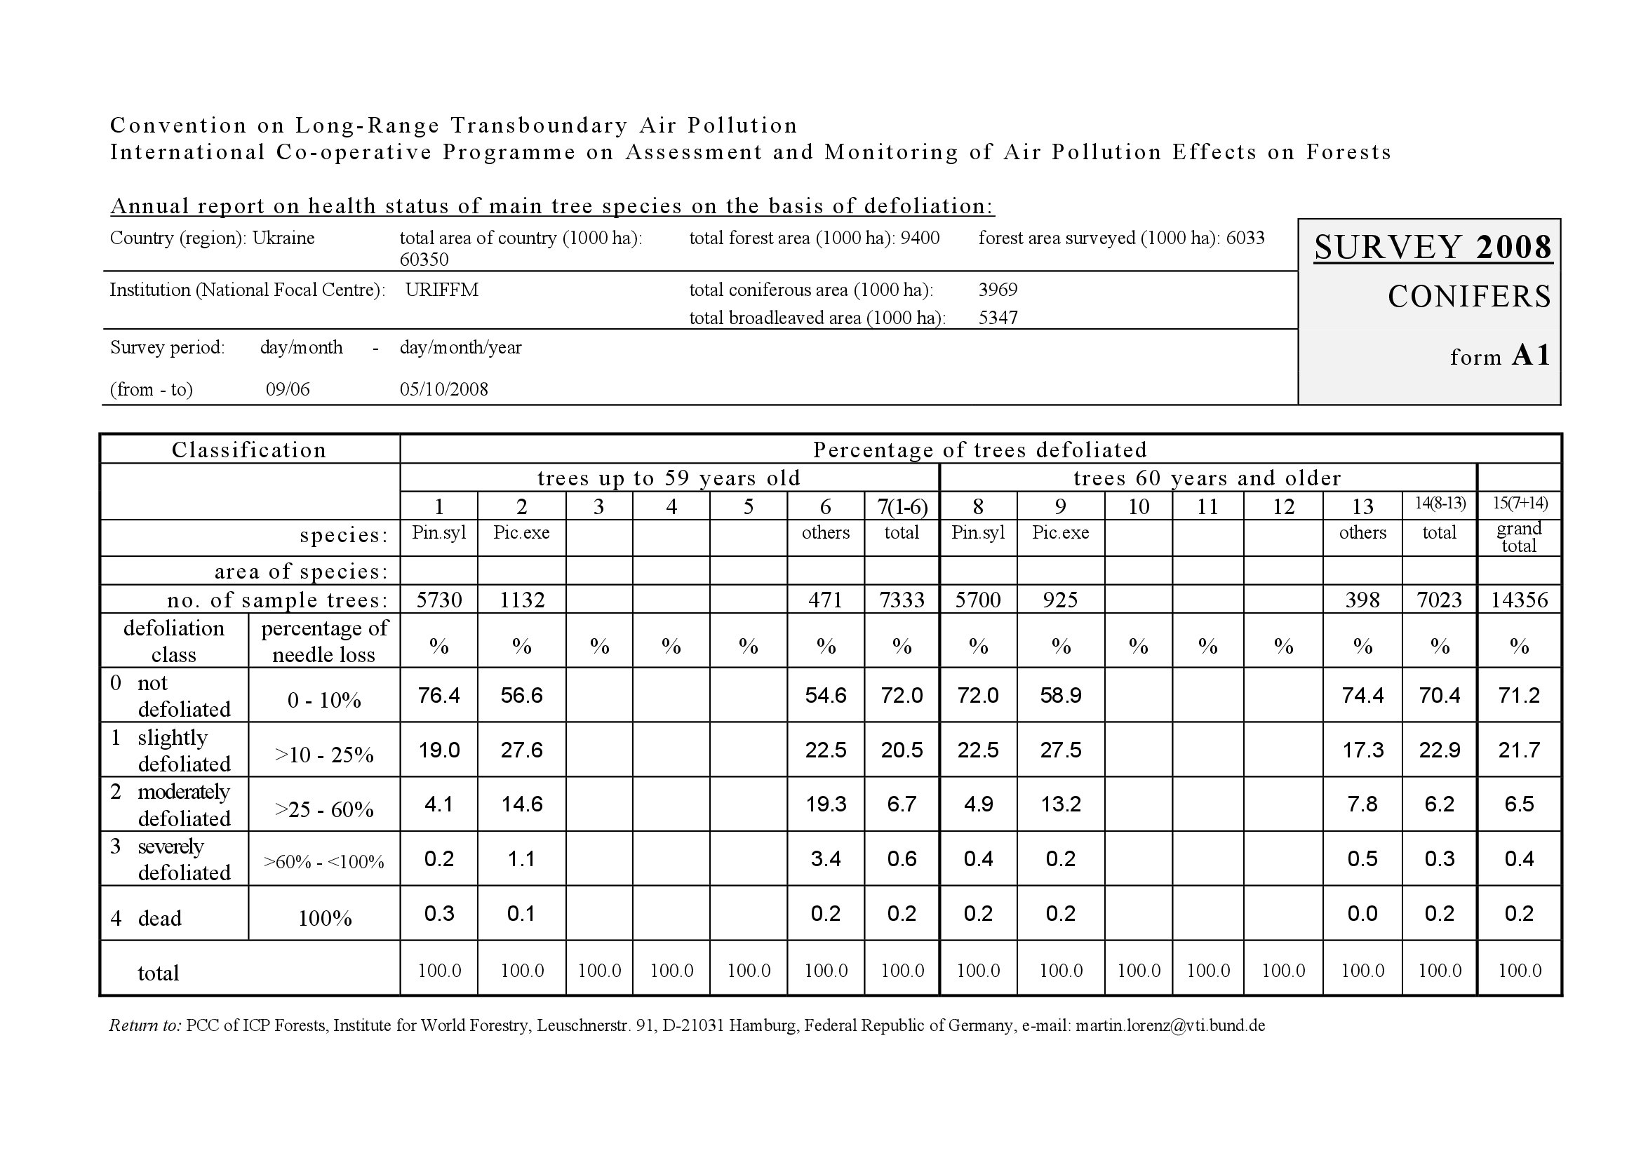
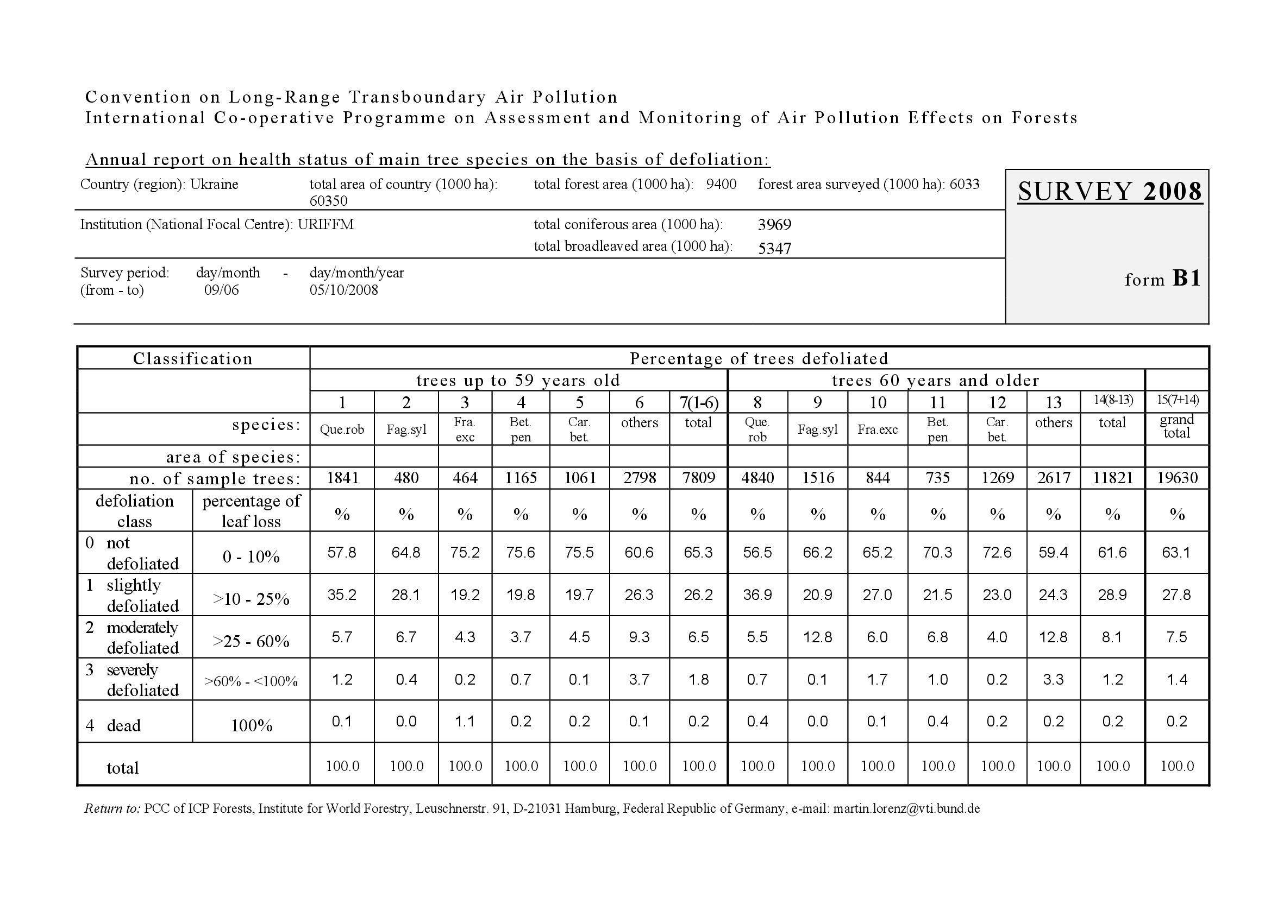
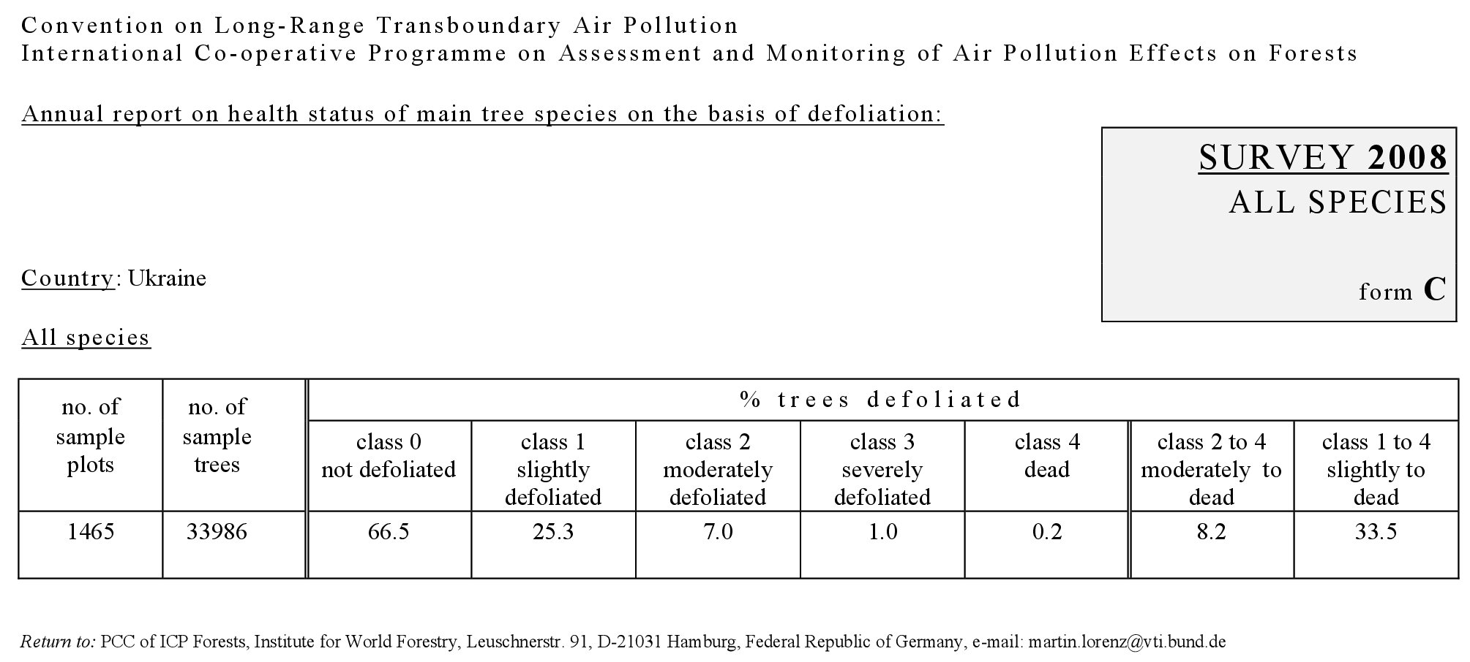
Reporting to ICP Forests (1991-2015)

Slide 27
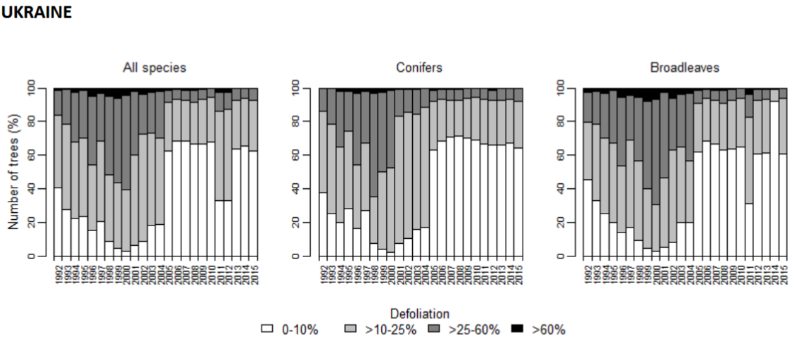
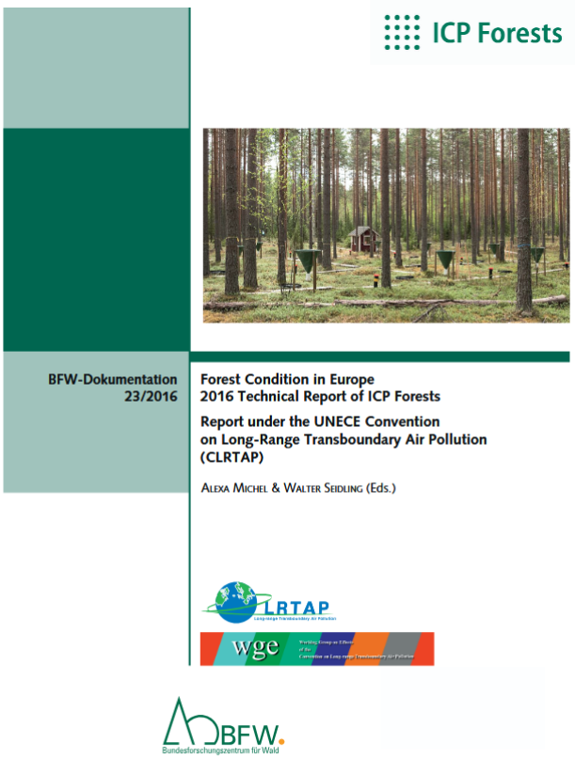
Technical Reports of ICP Forests consist the results of Ukrainian forest monitoring level I for period 1991-2015

Slide 28
Current issues of Ukraine's forest monitoring
Inadequate regulatory framework for forest monitoring.
A network of monitoring sites has been established in forests currently managed by the State Enterprise ‘Forests of Ukraine’, but more than a third of the country's forests have not been covered by monitoring.
Since 2016, observations have been suspended at all forest monitoring plots.
The low level of technical and technological support for forest monitoring makes it impossible to determine a number of important indicators, in particular, the pollution of forests with exogenous elements, the condition of forest soils, wood growth, the biodiversity of forest vegetation, etc.
There are no programmes for controlling and ensuring the quality of monitoring data (QA/QC).

Slide 29


Options for the development of ICP Forests monitoring in Ukraine
Option 1 - Resumption of monitoring activities within the existing network, supplementation of the list of indicators, field work carried out by relevant specialists of the State Enterprise ‘Forests of Ukraine’ (subject to the introduction of a staff training and monitoring data quality control system, as well as the development of technical solutions for remote database filling via a web application).
VS
Option 2 - Integration of monitoring observations and national forest inventory, involvement of the NIL Centre of the Ukrderzhlesproekt in field collection of monitoring indicators in NIL areas (formation of separate field teams for data collection in monitoring areas?).
+ Introduction of remote forest monitoring.
+ Development of Level II forest monitoring based on a network of research institutions and organisations of the State Forestry Agency of Ukraine.

Slide 30


The relationship between NFI and monitoring
National forest monitoring
National forest inventory (NFI)
Source: Voluntary guidelines on National Forest Monitoring. - FAO, 2017. - 76 p.

Slide 31
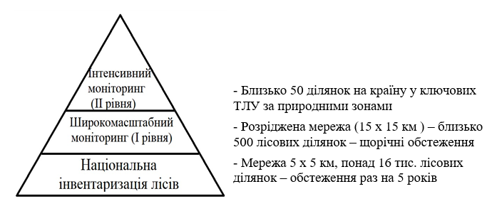
Possible design of forest monitoring development

Slide 32
Basic principles of forest monitoring development :
Involvement of various stakeholders in the development of forest monitoring.
Improvement of the legislative and regulatory framework for forest monitoring, development and approval of the "Procedure for forest monitoring".
Application of modern technologies (GIS, remote sensing).
Building institutional capacity and technical support.
Strengthening human resources, staff training.
Quality control and procedures for ensuring the quality of monitoring data.
Balancing the level of information and the costs of obtaining information.
Improvement of monitoring methods depending on changes in information needs, ongoing scientific support.
Integration with forestry information systems and environmental monitoring information systems.
A policy on data sharing and information dissemination.
A national monitoring programme and adequate and stable funding.

Slide 33
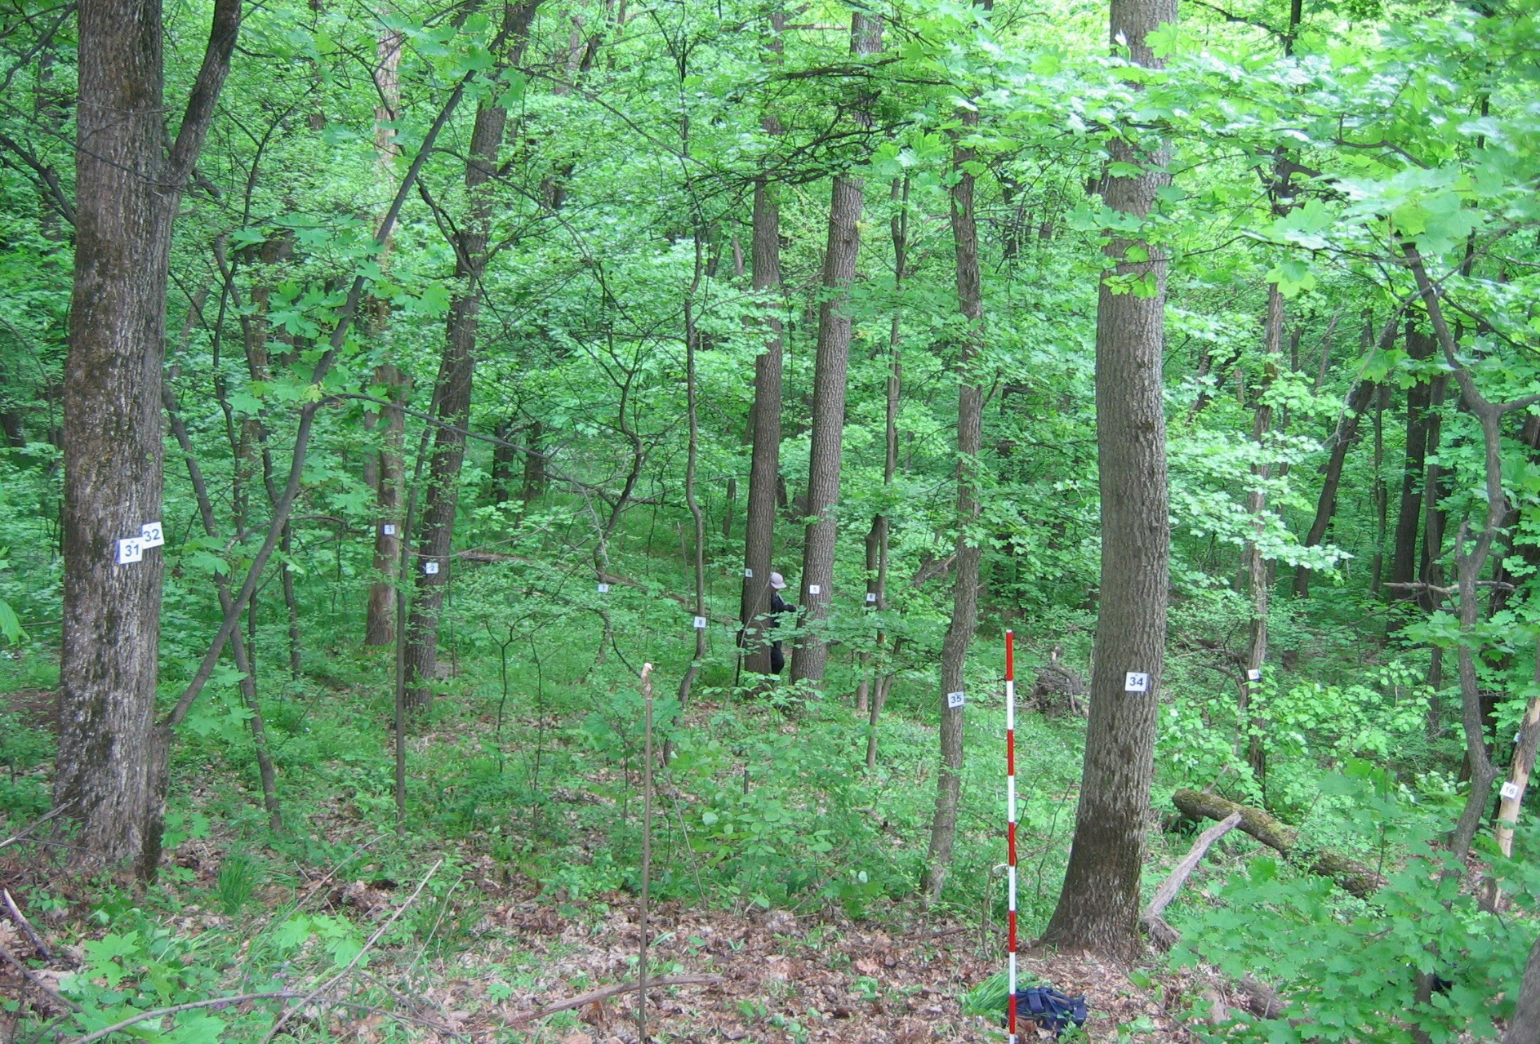
Thank you for your attention!
Thanks to Tetiana Pyvovar for her help in preparing this presentation
buksha@ukr.net
Picture: IFER, 2010

