Slide 1


What to regulate in multifunctional forest management: protection regime or harvesting regime?
Vitaliy Storozhuk National coordinator of the SFI project
Round table "Multifunctional and close-to-nature forestry: from concept to practice in Ukraine based on German experience"
18.12.2025

Slide 2
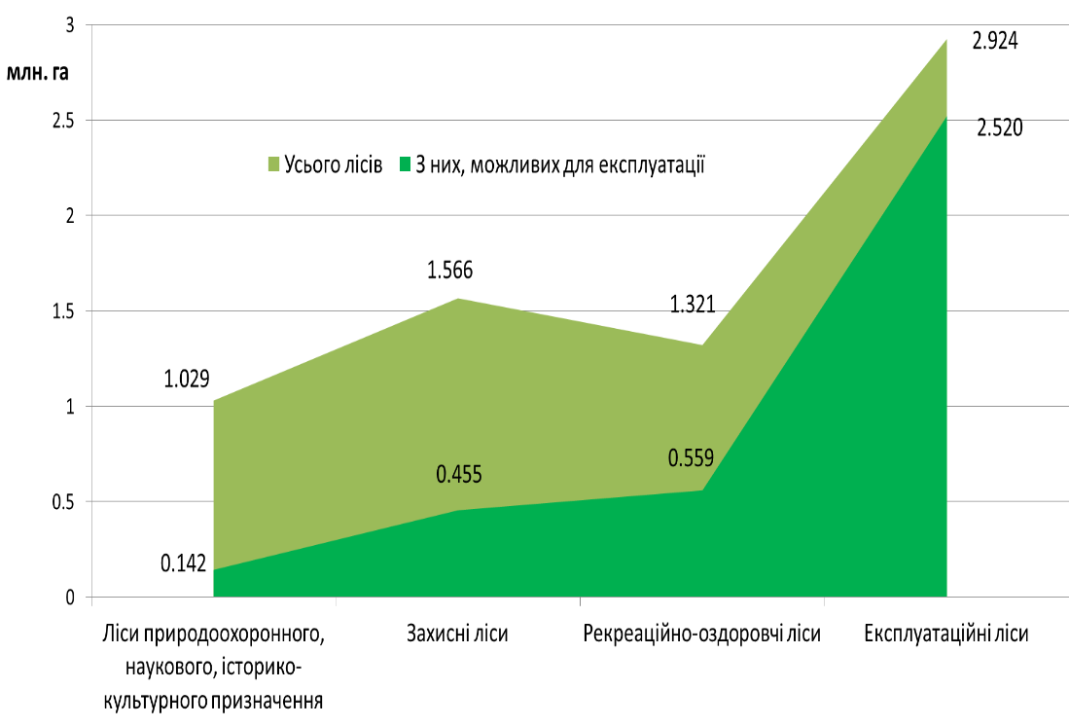
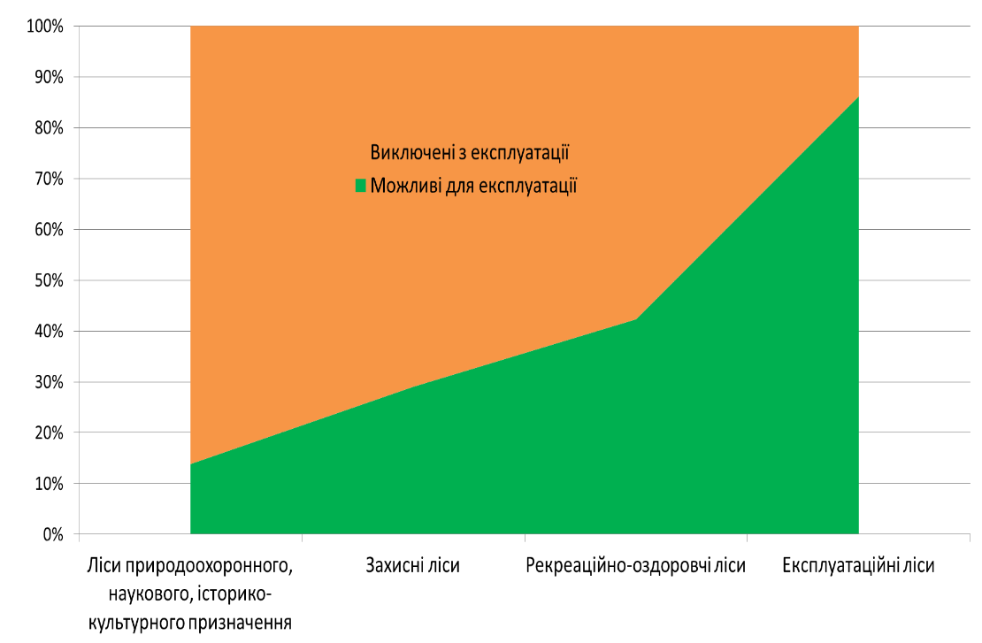
Distribution of forest categories of the State Forest Resources Agency by the scale of restricted use (2011)
Indicator | Forests of nature conservation, scientific, historical and cultural purposes | Protective forests | Recreational forests | Operational forests | Total
Total forests, ha | 1029483 (15 %) | 1565979 (23%) | 1320708 (19%) | 2924216 (43%) | 6840386 (100%)
Of these, available for operation | 142433 (14%) | 454685 (29%) | 558799 (42%) | 2519944 (86%) | 3675861 (54%)
% available for operation | 2% | 7% | 8% | 37% | 54%
Procedure for categorising forests and designating special protection areas (2007)

Slide 3
Types of logging in different forest categories (2025)
SUBCATEGORIES OF FORESTS | Types of logging
 | MUL |  |  | RFL | SR |  | RFL | RL | LL | ML
 | CC | GC | SC |  | SSL | SCL
Forests of nature protection, scientific, historical and cultural purposes
Nature reserves
Biosphere reserves (protected area)
Biosphere reserves (zone of special protection)
Biosphere reserves (buffer zone)
Biosphere reserves (anthropogenic land zone)
National nature parks (protected area)
National nature parks (reg. reg. zone)
National nature parks (static nature parks)
National natural parks (economic zone)
Regional landscape parks (protected area)
Regional landscape parks (reg. recreation area)
Regional landscape parks (protected area)
Regional landscape parks (economic zone)
Protected forest tracts
Natural monuments
Forests of historical and cultural significance
Forests for scientific purposes, incl. general reserves
Recreational and health forests
Forests within settlements
Forests of the 1st and 2nd zones of sanitary protection zones of water sources.

Slide 4
Types of logging allowed in different categories of forests (2025)
SUBCATEGORIES OF FORESTS | Types of logging
 | MUL |  |  | RFL | SR |  | RFL | RL | LL | ML
 | CC | GC | SC |  | SSL | SCL
Forests of conservation, scientific, historical and cultural significance
...
Recreational and health forests
Forests within settlements
Forests of the 1st and 2nd zones of sanitary protection zones of water sources.
Forests of the 1st and 2nd zones of sanitary protection districts.
Forests of the 3rd zone of sanitary protection districts of medical and health care areas.
Forest park part of green zone forests
Forestry part of green zone forests
Recreational and health forests, outside green areas
Protective forests
State protective forest belts
Field protection forest belts
Forests in canal right-of-way
Forests in railway rights-of-way
Forests in the right-of-way of motorways
Forests for erosion control
Forests along railway rights-of-way
Forests along motorway rights-of-way
Forests along river banks, around lakes, reservoirs, etc.
Riparian and other protective forests
Operational forests
Operational forests

Slide 5
Regulatory acts governing the logging regime
Forestry Code of Ukraine (2006 edition)
Forest management
Measures to increase productivity and improve the quality of forests | Special use of forest resources
 | Procedure for special use of forest resources (2007)
Timber harvesting
Rules for improving the quality composition of forests, conducting other felling and works related and not related to forestry (2007) | Rules for harvesting of the main use in the mountain forests of the Carpathians (2008)
Sanitary rules in the forests of Ukraine (2020) | Rules of felling of the main use (2009)
Organisation of forest management
Procedure for division of forests into categories and allocation of special protection areas (2007)
Procedure for forest management (2023)
...
RULES for improving the quality composition of forests, carrying out other felling and works related and not related to forestry (2007-2025) The specifics of felling for the formation and improvement of forests, other measures for the formation and improvement of forests, depending on their intended purpose, species composition of plantations, forest vegetation conditions, as well as other felling and works related and not related to forestry, are determined in the Instruction on felling for the formation and improvement of forests, other measures for the formation and improvement of forests, other felling and works related and not related to forestry, which is approved by the Ministry of Environment upon submission of the State Forest Resources Agency

Slide 6
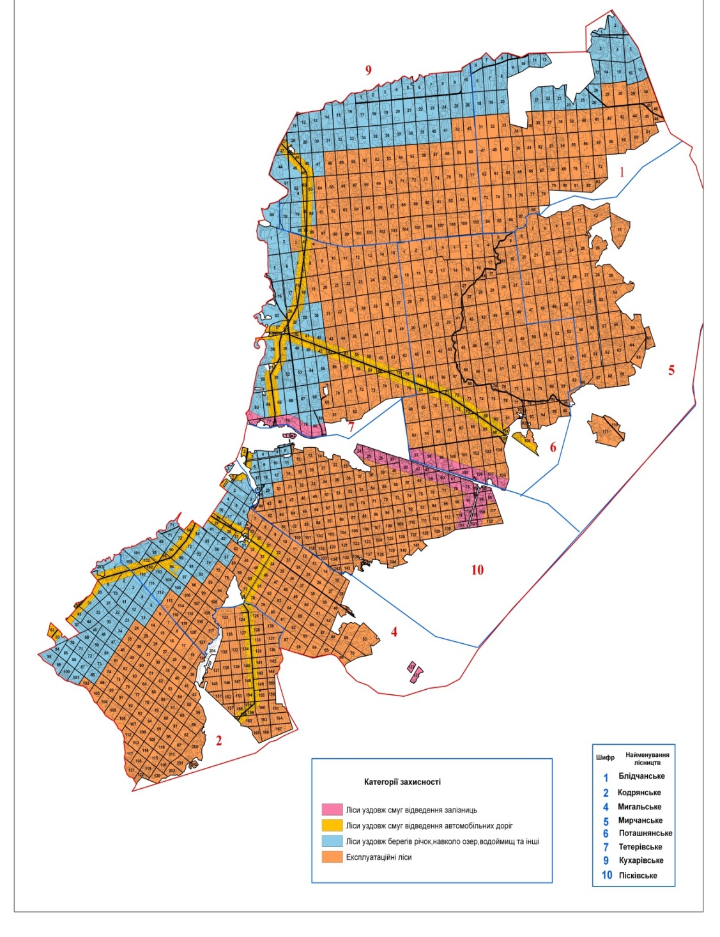
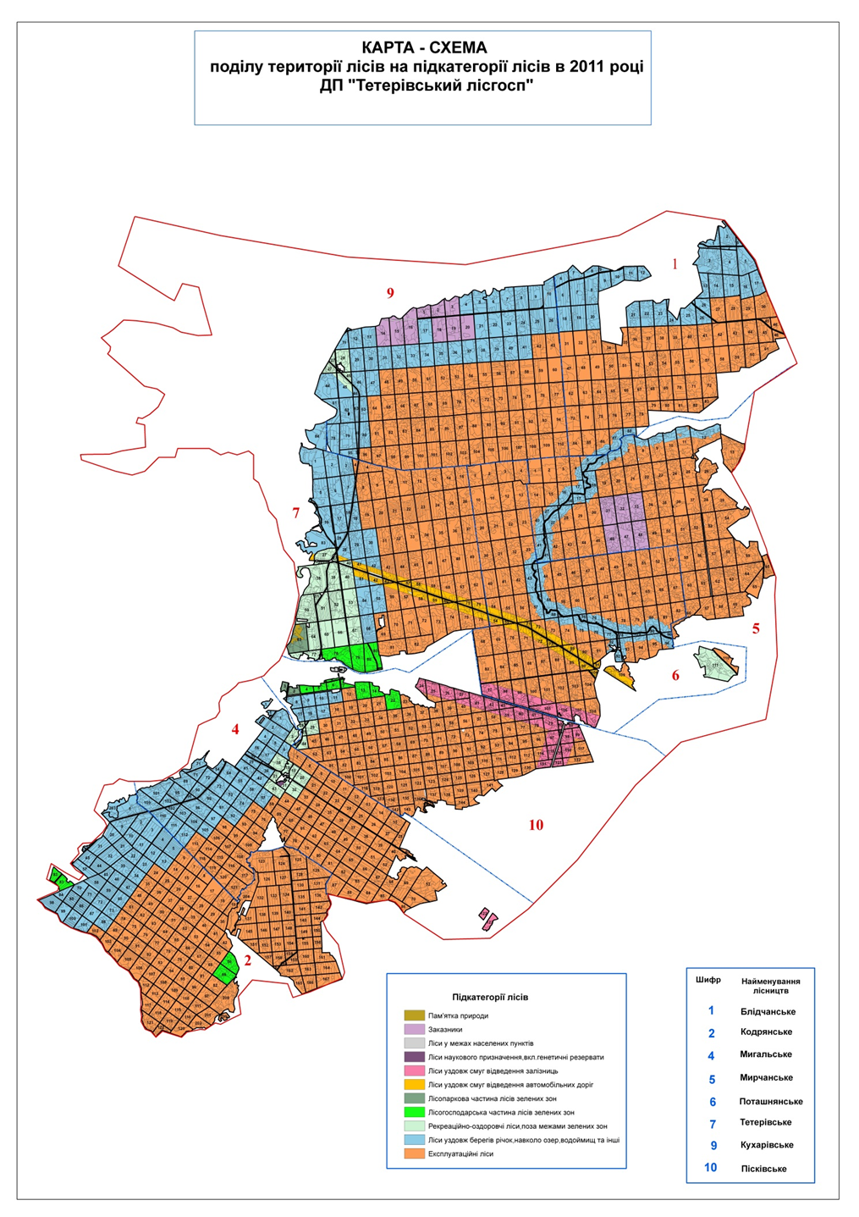
Maps of the division of the territory of the SE "Teterivsky forestry" into protection categories (2003) and forest subcategories (2011)
I
II
III

Slide 7
Some steps towards transition to multifunctional forest management
Introduce the concept of Continuous Cover Forestry (every cut is a thinning cut), which will reduce the area of clear-cutting and is a basic step for both close-to-nature forestry and multifunctional forestry
During the expected fundamental revision of the Forest Code, introduce procedures for allocating the full range of economic, environmental and social functions to each forest stand to ensure "multifunctional" forest management
Prepare relevant bylaws and instructions for management during the "multifunctional" division of forests (proposals to amend the Procedure for dividing forests into forest categories, Instructions for conducting felling for forest formation and rehabilitation, other measures for forest formation and rehabilitation, other felling and works related and not related to forest management)

