Slide 1

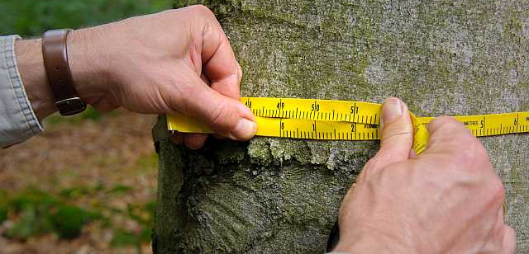
Reflections from 35 years of National Forest Inventory in Germany
Challenges and lessons learned
Thomas Riedel, Heino Polley
Thünen Institute of Forest Ecosystems, Eberswalde, Germany
A century of national forest inventories – informing past, present and future decisions
Sundvolden , 20.05.2019

Slide 2
German NFI – an early one between the late starters
Starting year of the first National Forest Inventory

Slide 3


(1) NFI does not solve a problem – but it supports decision finding
1984
Black forest is dying
27.07.1984:
First law to change the Federal Forest Act
Newly introduced §41a “Bundeswaldinventur”
(= Federal Forest Inventory)
But first discussions
started in 1974
concern for future wood supply
1981
Acid rain over Germany
The forest is dying

Slide 4



(2) NFI is more than a statistical design and the development is never finished
Information technlology
Rapid development
Inventory cycle is longer than software live cycle
Scientific sound methods
$$\sum_{k}{\left({n \atop k}\right)}$$
Sampling design
Statistical algorithms
Models and functions
€€
Financing
Permanent staff and additional NFI budget at the Thünen Institute
Periodic budget for data collection at federal state level
Institutionalisation
Overall NFI coordination at the Federal Ministry
Scientific NFI coordination at the Thuenen Institute.
NFI coordinators at federal state level
§§
Legalisation
Federal Forest Act § 41 a
Designed by PresentationGO.com

Slide 5
(3) NFI is a compromise between requirements and limitations
Always up to date!
Fast
Regular NFI every 10 years
Simplified subsample inventory in the time between
no cost escalation!
Cheap
high cost sensitivity in plot design
Increasing willingness for higher sample density
Complete
Multiple targets
Forest resources
Nature protection
Carbon sequestration
Outlook studies
robustness
Simpel
Comparability over time
Acceptance
Clear massages
Designed by PresentationGO.com

Slide 6


(4) A powerful data management is the backbone of the NFI
fit
for
future
Collecting
Plausibility checks
The dilemma
Inventory cycle
>
Software live cycle
high
-
performance
user
friendly
Security
high
flexibility
Aggregation
Presentation

Slide 7
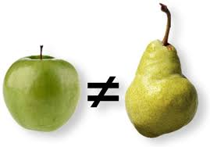
(5) The value of time series is an obstacle for innovation
Do not change
Definitions
Measurements
Formulas
Plot selection
But …
Growing information need
Need for more efficiency
Scientific innovation
For correct time series
Re-evaluation of old data with new methods

Slide 8
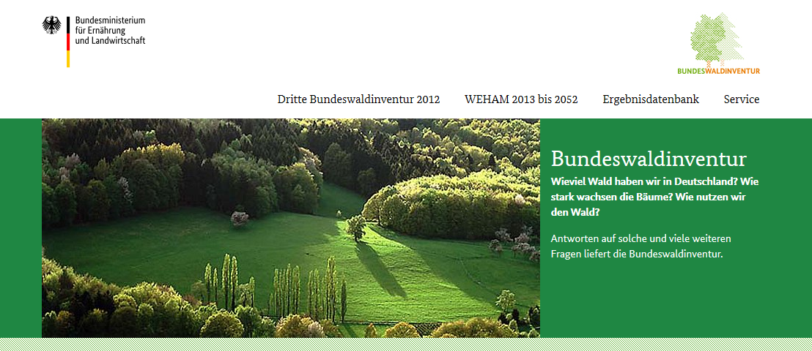
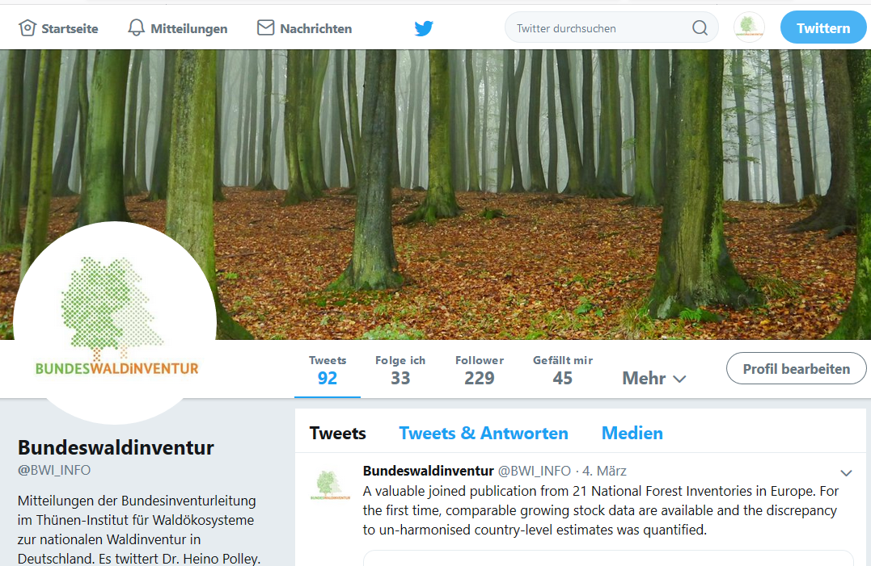
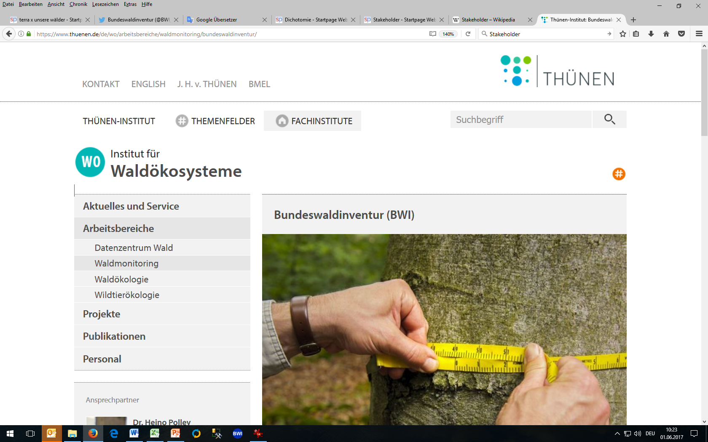
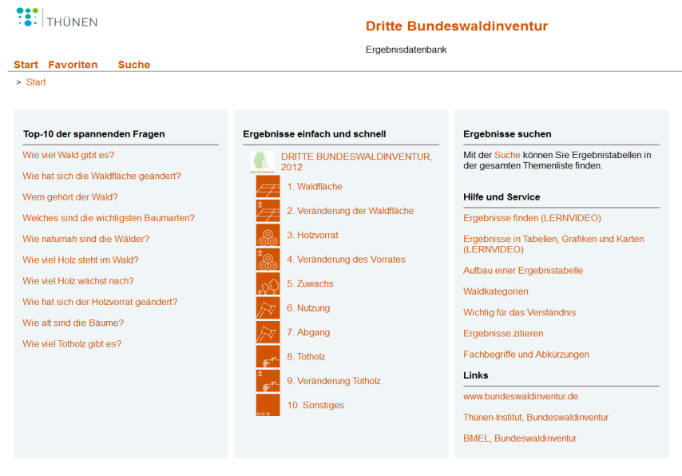
(6) Acceptance, trust and communication make the impact
bundeswaldinventur.de
twitter.com/BWI_INFO
thuenen.de/wo
bwi.info

Slide 9
(7) The NFI supports political processes but must be independent
Informa-tion
Kommu-nication
Action
National Forest Inventory
Forest Policy
Timber production
Biodiversity
Climate protection
Climate adaption
Strategic planning
Public relations
Financial incentives Legislation

Slide 10
(8) High ambitions need a critical mass of scientific manpower
National Inventory
Administration
6 persons
Thünen Inst.
+ Fed. Min. Food, Agricult.
Federal State Inventory
Administration
25 persons
1
2
…13
Survey
Teams
130 persons
1
2
…
…60

Slide 11


(9) Remote sensing data can be an addition but not a replacement for terrestrial inventory data

Slide 12

(10) We need national and international cooperation to strengthens competences

Slide 13
Development since 1987
Increasing awareness as a source of information for politics, business, science and the media
Increasing willingness to invest (grid density, survey frequency, more staff for research and coordination)
Technical progress in data management (powerful database, online data access, GIS)
Increasing networking in Europe (growing expectations regarding harmonization and data delivery at European level)
Increasing complexity

Slide 14
Future challenges
NEW
  Regional information: small area estimation
  using remote sensing data
  Time series (1987, 2002, 2008, 2012, 2017, 2022)
As always before
  Always up-to-date: faster evaluation
  Clear communication to all target groups
  Improve political impact
  More scientific projects
  More European harmonization
  Adequate funding, comprehensive knowledge, motivated staff

Slide 15
Роздуми 35 років Національної інвентаризації лісів у Німеччині
NFI не вирішує проблему - але підтримує пошук рішення
NFI більше, ніж статистичний дизайн
NFI є компромісом між вимогами та обмеженнями
Потужне управління даними є основою NFI
Значення часових рядів є перешкодою для інновацій
Прийняття, довіра і спілкування роблять вплив
NFI підтримує політичні процеси, але має бути незалежним
Високі амбіції потребують критичної маси наукової робочої сили
Дані дистанційного зондування можуть бути доповненням, але поки що не є заміною даних інвентаризації наземного лісу
Нам потрібно національне та міжнародне співробітництво для зміцнення компетенцій

Slide 16
Фактори успіху для національної інвентаризації лісів
Політика визнає потребу в інформації
Наука та зацікавлені сторони розробляють концепції
Легалізація, інституціоналізація, фінансування
Інвентаризація лісу надає вагому інформацію
Робота з громадськістю для поширення результатів
Варті довіри результати, об'єктивність, нейтральність
Розпізнавати нову потребу в інформації
Розвивати наукову кооперацію
Розширювати потужності/обсяги
Продовжувати розвиток методів

Slide 17
The German National Forest Inventory

Slide 18
Forest assessment, inventory and monitoring in Germany
Forest assessments before 1980
1878, 1883, 1893, 1900, 1913, 1927, 1937, 1948-1950, 1961 (West Germany)
1961 - 1970 Large area forest sampling inventory in East Germany
1970 / 1971 Large area forest sampling inventory in Bavaria
1970 - 1990 Forest planning database in East Germany
National Forest Inventory
1986 - 1988 1. National Forest Inventory
2001 - 2002 2. National Forest Inventory
2008 Sub sample (carbon Inventory)
2011 - 2012 3. National Forest Inventory
2017 Sub sample (carbon Inventory)
2021 - 2022 4. National Forest Inventory
Forest Monitoring
Crown Condition Survey
since 1984, every year
Forest Soil Survey
1987-1993 / 2006-2008
2023-2025
Intensive Forest Monitoring
since 1994, continuously

Slide 19
Lessons learned
NFI does not solve a problem – but it supports decision finding
NFI is more than a statistical design
NFI is a compromise between requirements and limitations
A powerful data management is the backbone of the NFI
The value of time series is an obstacle for innovation
Acceptance, trust and communication make the impact
NFI supports political processes but must be independent
High ambitions need a critical mass of scientific manpower
Remote sensing data can be an addition but so far not a replacement for terrestrial forest inventory data
We need national and international cooperation to strengthen competences

